Slide 1
- Case Study -
Volunteerism and a
Contact Management Database
You Get What You Pay For
Frank Dziubak
CSPP 51075
Enterprise Data Architecture
University of Chicago
Spring 2011
Notes:
Several months ago; Months actually before we had our first lecture in this class, I was conned into a small database project.
I'd like to tell you how the project went; what problems I ran into, particularly at the conceptual level, and to demonstrate how even the smallest, simplest project can spiral horribly, horribly out of control.
That you may never, ever follow me down this path.
First, some terminology.

Slide 2
Pro Bono
“For the Public Good”
To provide one’s professional services without payment, as a public service
Notes:
Pro Bono –
it’s a Latin phrase, meaning For the Public Good.
To provide one's professional services, without charge, as a public service.
Lawyers use this term a lot, when they need to feel good about themselves.
I want to make sure that you are all clear on the distinction between volunteer work, and Pro Bono.

Slide 3

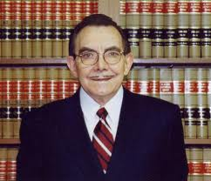
Volunteer
Lawyer
Paints Your House
Notes:
Volunteer work - is when a lawyer paints your house for free.

Slide 4

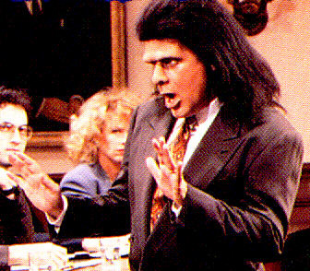
Volunteer
House Painter
Defends You in Court
Notes:
Volunteer work - is when a house painter depends you in court for free.

Slide 5

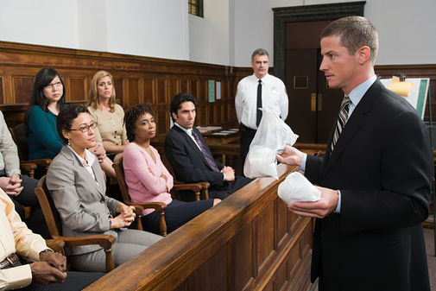
Pro Bono
Notes:
Pro Bono, on the other hand, is when a lawyer defends you in court,

Slide 6

Pro Bono
Notes:
. . . or when a house painter paints your house for free.
Do you see the distinction? Good.
But I also want you to know what lawyers are really thinking when they talk about Pro Bono.

Slide 7
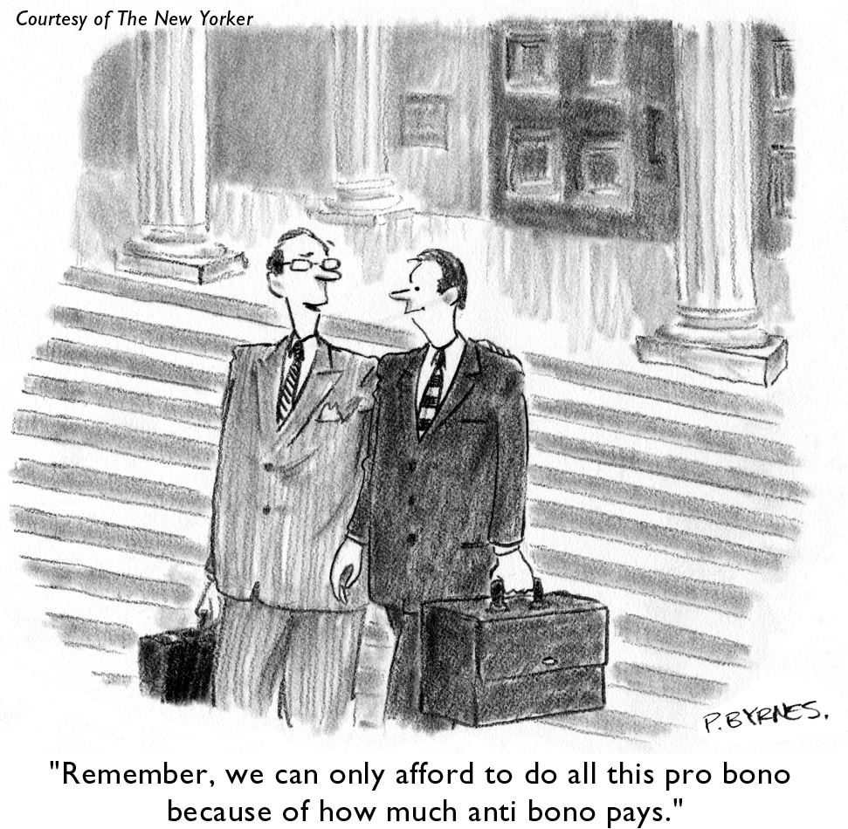

Slide 8
Notes:
Last September it was. An old friend approached me and said,
"Hey Frank, I'm doing work for this non-profit, and they’re really a mess. They really need a contact database. Will you build one for them.
And I waived my hands and said, ”Can't do it. I got ALGORITHMS this quarter."
And I lowered my shoulder like a running back, and I brushed right past her.
And then she said, "But you're such an expert with Access". And my ears twitched, and I smiled and turned back around. Because it was true. I was an Access rock star. My kung fu was good.
And I thought to myself, "Well I'm in Databases this quarter, too. Maybe Zarko will let me do this as my class project.
And when I open up my database consulting business, I can point to this project on my portfolio.
I can say that I did it . . . Pro Bono.

Slide 9
Archdiocese of Chicago
Office for Immigrant Affairs
Notes:
The non-profit, as it turned out, was an agency of the Archdiocese of Chicago.
The archdiocese is the organization that manages all the Catholic churches in the city.
And the Office of Immigrant Affairs. They help out
all the new kids in town.

Slide 10
Chicago a City of Immigrants
a few examples
Polish
Chinese
Indian
Mexican
(fascinating interactive map from The NY Times)
Map
Notes:
Chicago . . . is a city of immigrants. It always has been, since the late 1880s.
Waves and waves of different immigrant groups over the decades.
Thousands upon thousands of poor but hopeful travelers, in search of a better life.
http://www.nytimes.com/interactive/2009/03/10/us/20090310-immigration-explorer.html
Look at this, this is fascinating.
Polish
Chinese (and this only goes through the year 2000); think what it would like like now
Indian
Mexican
And every new group that has come here has tended to want to stay together in the same neighborhood.
And several of these groups have been predominantly catholic; and they all wanted their own church.
And they had all this cheap immigrant labor.
So, particularly in the early decades of the 20th century, they built them, beautiful churches, some of them just blocks apart from each other.

Slide 11
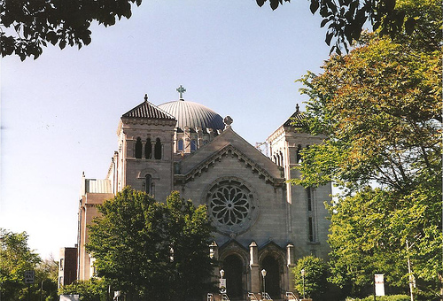
St Clement Church
Built by German immigrants - 1905
Notes:
Here's one: St Clements - built in 1905 by German Immigrants

Slide 12
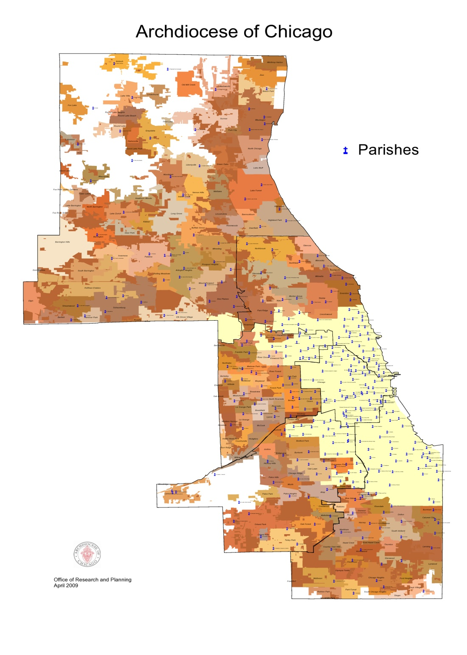
Parishes in the
Archdiocese
Current count:
382
(Little Blue Dots)
Notes:
And so today there are 382 parishes in the archdiocese.
And the thing is, all these groups, when they were choosing church names, they didn't talk to each other.
And so there are a lot of duplicates.

Slide 13
qDuplicateParishNames
parishName
count
St Joseph 7
St Mary 5
Immaculate Conception 5
Notes:
Look at this. There are:
Seven St. Josephs - Well, that kind of makes sense. Joseph was the father of Jesus.
and there are,
Five St. Marys - Well, that makes sense. She was his mother.
And, as you may know, Catholics have always been really big on babies. They had a lot of babies. I grew up in an Irish neighborhood, and my friends all came from families of 6, 8, 14 kids.
But, at the same time, Catholics have always been really uncomfortable talking
(in public at least) . . . talking about sex.
So it's really not surprising then that there are five: -- Immaculate Conceptions

Slide 14
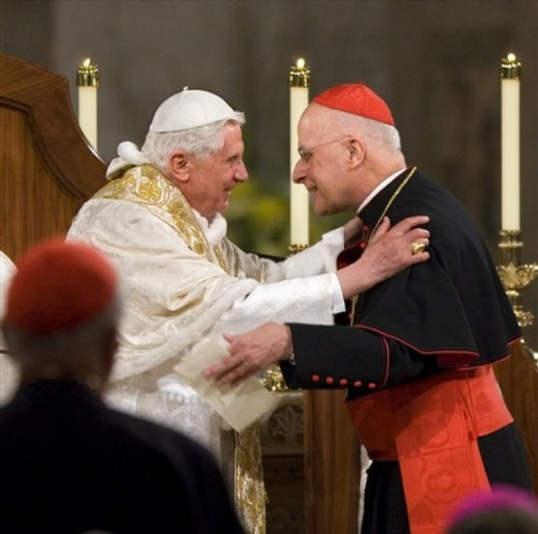
The Chain of Command
The Pope
Chicago’s Cardinal
Notes:
Here's the chain of command.
We got Benedict. He's in Rome.
And we got Francis George. He's our cardinal.

Slide 15
Office For Immigrant Affairs
Some 31 different groups, committees, subcommittees
volunteers, private donors, corporate sponsors, parish priests,
legal advisory boards
31 different address lists
31 different Excel spreadsheets
squirreled away on the hard drives of different staff members
Notes:
So the Office for Immigrant Affairs.
And so they have, some, 30 different committees and subcommittees, and volunteers, donors, sponsors, and legal advisory boards.
And every staff member in the agency has her own spreadsheet squirreled away. on her harddrive.

Slide 16
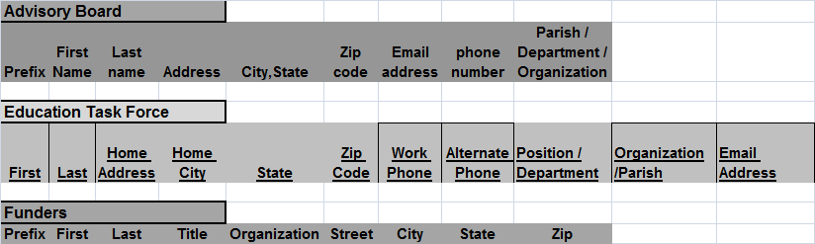
Er, wait, every spreadsheet is different . . .
Who’s going to standardize all these fields?
Spreadsheet 1
Spreadsheet 2
Spreadsheet 3
and so on . . .
and who’s going to weed out all these duplicate records?
Why . . . why are you laughing?
Where . . . Where are you going ?!?
No really . . .Don’t leave me here!
Notes:
and you we have our first problem.
every spreadsheet is different.
But this friend of mine who dragged me into this, she said she'd help.
She was going to be the Project Manager. Ha!
And she was all into, well, first we need to standardize all these fields.
And, I remember this vividly . . . I didn't say it out loud, but I thought it, and without any sense of irony.
I thought, ”Yeah, fine, fine. You go find out what fields they need;
I'm gonna go start creating tables.

Slide 17
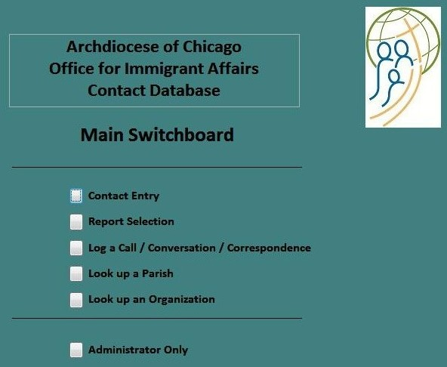
Notes:
And so we get to the database.
I was proud of it.
I had queries, and reports, and event triggers, and vba code.
I normalized the data (sort of).
I split out the database into backend tables and frontend user interfaces.
This was my masterpiece.

Slide 18
01-Dec-2010
Email
On Dec 1, 2010 11:41pm, TM <> wrote:
hi mark,
met with frank this evening . . .
Database looks good; will send it to you so you can take a look as he finishes exams.
. . . gives you time to see functionality; see if you would like things changed / improved.
Looking forward to seeing you and the team.
Notes:
And things were looking good.

Slide 19
02-Dec-2010
Email
On Dec 2, 2010 11:41pm, Mark <> wrote:
Hi TM and Frank,
WOW! What a product.
Great look and feel.
Functionality seems powerful.
Can tell a ton of work went into it.
Let’s discuss staff training.
A Slam Dunk !!!
P.S. Frank, hope algorithms exam goes well.
Also, there has been a field or two added to certain spreadsheets.
Say what?
Uh, oh . . .
Notes:
It was love at first sight.
But, then it began.

Slide 20
19-Jan-2011
Journal
Had the big meeting today to deliver database.
Twelve people (6 nuns) and an overhead projector.
Couldn't even demo it.
Their laptop was running XP and Access 2000.
Awful!
Moral:
Always be clear about operating system and applications version.
Notes:
The actual delivery meeting was a disaster.
Always specify your operating system and your applications version.

Slide 21
08-Feb-2011
Journal
Meeting to demo Version 2 went flawlessly.
Well, there were some additional requests . . .
Notes:
But we got that squared away.
And yet, there’s always something.

Slide 22
10-Feb-2011
Email
@gmail.com> 2/10/2011 12:08 AM >
mark and frank:
here is the updated data from the spreadsheets
from our last meeting.
I added a column for FAX number.
TM
They want a FAX number?
What were the odds?
That’ll mean a
Table Mod.
Notes:
A Fax number?
What the heck?
That means a Table Mod, and a New Field.

Slide 23
Tues
01-Mar- 2011
02:30 am
Journal
Shouldn’t have been screwing around with the database tonight . . .
but I needed some comfort after C++ class.
Notes:
It begins . . .

Slide 24
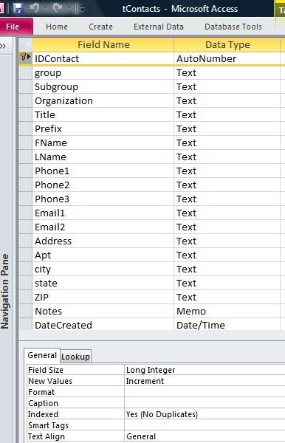
27-Nov-2010
Notes:
This is the original Contact table.
Take just a quick glance, and think about we’ve learned in this class.

Slide 25
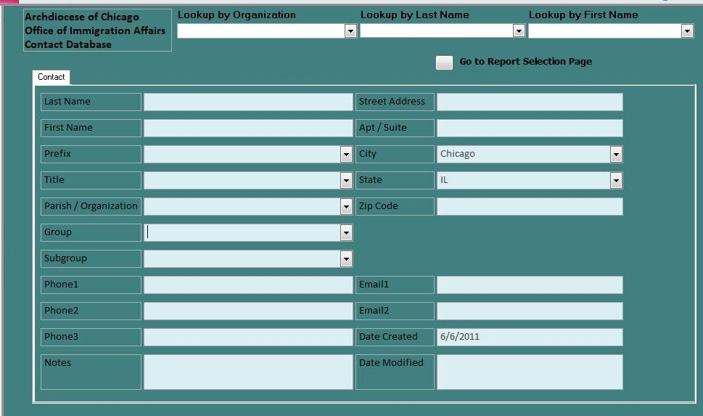
January . . .
“But, we need
Parish
AND Organization!”
“Well, then which address should go here?
I don’t have room for both.”
“By the way,
their mailing address might be their
Home address.
You better allow for three addresses.
And specify which one you’re showing.”
“Uh, you’re implying User Interface limitations should drive Table Design?
Sounds bass-ackwards.
You solve the problem.”
Notes:
The original interface.
Well, listen.
We really like to be able to both the parish somebody belongs to AND the organization they work for.

Slide 26
February . . .
“Hey, Hotshot . . .
You really need to show us
which phone is which:
Home / Office / Cell . . .
and what Priority we try them in.”
“Well, heck . . .
Do I store them in fields with their Type names:
Home / Office / Cell,
and then have other fields store their priority rank ?
Or do I store them in fields with their priority ranks, and then have other fields to specify
whether they’re Home, Office, or Cell ?”
Notes:
Do I list them in order: Home / Office / Cell, and have more fields to indicate Priority?
Or do I list them in order of Priority, and have more fields to indicate:
Home / Office / Cell?

Slide 27
March . . .
“You Bonehead!
Some of these people may be
on 5 or 6 different committees.
How are you gonna handle that?”
“Oh, mommy”
Notes:
Actually, this one wasn’t all that hard for me.

Slide 28
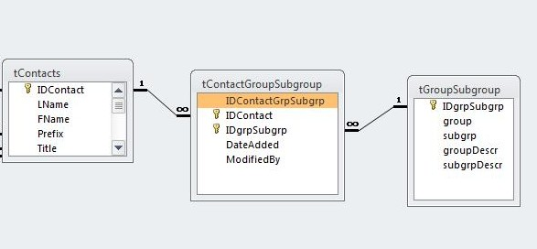
Relationship of Contacts to Groups /Subgroups
Many-to-Many
with Intermediary Table
Notes:
A many-to-many relationship between Contacts and Groups
using an Intermediary table.

Slide 29
March . . .
“By the way,
we use a Master Parish List once a year
to update the Pastors who have been reassigned to different parishes.
can we run those updates automatically?”
“Well, that depends on how I design the table relationships.
Is a person associated with his role and organization,
or is a role associated with a person.
Which part is the primary key?
“If a pastor moves to a parish, do his committees move with him, or are they a function of role at the original parish?”
“Help me, Mr. Wizard! I don’t want to be a Database guy anymore!”
“Take me back to C++ !”
Notes:
How, do you handle the relationship between
a person, an organization, and his role within that organization.
I have no fricking idea.

Slide 30
09-Mar-2011
Journal
Just looked up Mark’s LinkedIn profile.
4 years at Cap Gemini
Crap! He’s Big – 6
I’ve been hustled !!!
Notes:
By the way, the guy I was dealing with, Mark, is the calmest, nicest guy you'll ever meet. But he has eyes like a hawk for details. And when he catches something, and questions it, there's just the slightest hint of an edge, of sharpness to his voice.
And some of the things he brought up made me wonder,
How does this hick from the non-profit world know how to ride me for:
version control
bullet-proofing
bells and whistles
ad-hoc reporting
Where's this guy from? Something doesn’t smell right.
So I checked his LinkedIn profile.
The thing you need to know about these non-profit people is that a lot of them been players in the real world, and at some point they've said, "What am I doing with my life? I want to get off of this train".

Slide 31
Journal
03-Feb-2011:
Wasted 3 hours with the database, midnight to 3am.
10-Feb-2011
Another 15 hours, but database is looking amazing.
15-Feb-2011
it's finished.
21-Feb-2011:
Ok, I think Version 2 is perfect.
Focus on school work.
26-Feb-2011:
Maybe perfection . . .
But needed to be spending all this time on C++ homework.
03-Mar-2011:
I think Version 3 is in great shape. I think I'm finished.
11-Mar-2011
Ok, this time I really think I fixed it.
Notes:
This slide is going to be a little disturbing. I want you to be prepared for it.
I'd like to spend one minute on the topic of Obsession.

Slide 32
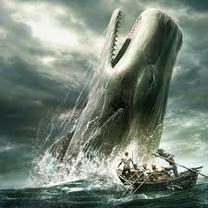
Moby Dick
Herman Melville
1851
Notes:
Have you ever read Moby Dick? Written by Herman Melville in 1851. It's about the obsession of a sea captain for the great white whale that took his leg.
But, lest you think that words written in 1851 can have no resonance for us today. I give you a more contemporary work that uses his text almost word for word.

Slide 33
Obession

Slide 34
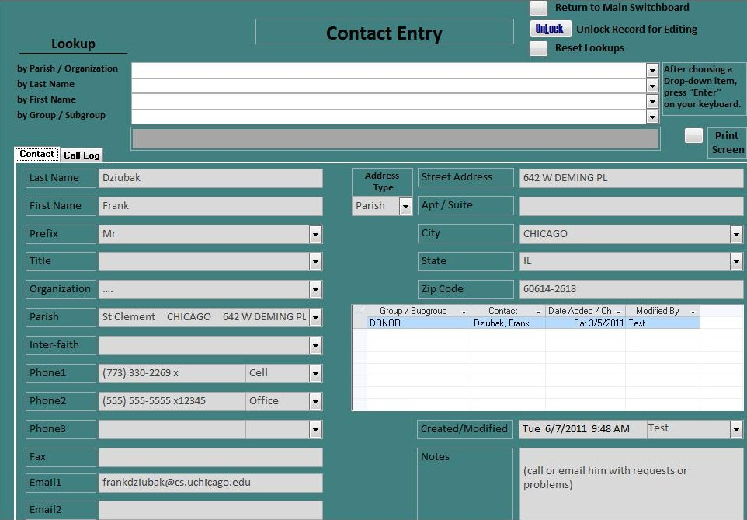
Version 004
Notes:
Alright, here’s a cleaned up version.
- We addressed Home / Office / Cell
We split out Parish and Org
We’re at least specifying which address is appearing now.
- We have a subform so people can be on as many committees as they want.
On Thursday March 24th, the database went into production.
And I haven't gotten any urgent phone calls.
If it ain't broke, don't fix it.
But there'll be change requests.
There are already some in the queue.
And how easy will they be?
Will I have to change table structures again?
Add new fields?

Slide 35
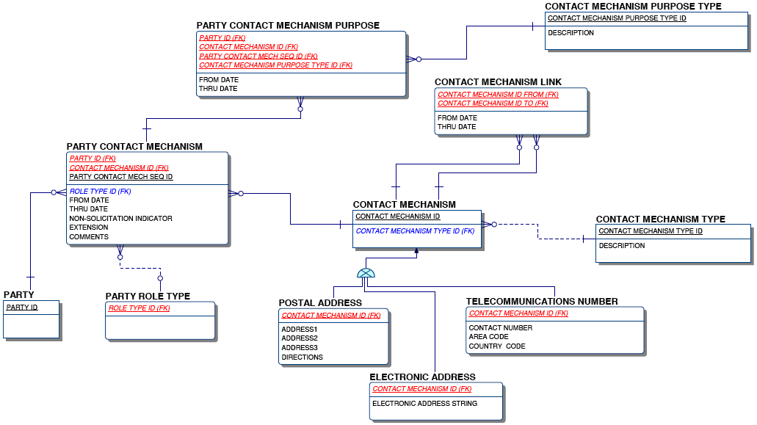
Contact Mechanism
Courtesy of
Mark Shacklette
Notes:
Take a look at our Contact Mechanism UDM.
And now take a look at our table again.

Slide 36
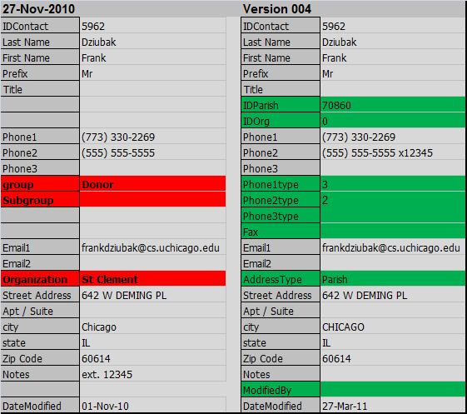
Ok, sure, this one has problems . . .
But, this is the best I could come up with???
Does this conform to our Contact Mechanism UDM?
Is this in Boyce-Code Normal Form?
Well, Is it?
Is it, Mr. Hadidianbaugher?
Is that a pledge pin on your uniform?
Notes:
The original on the left had obvious problems.
The current version is improved.
And yet . . .
Does this conform to our Contact Mechanism UDM?
Is this table in Boyce-Codd Normal Form?
Is it?
Is it, Mr. Hadidianbaugher?
Is that a pledge pin on your uniform?

Slide 37
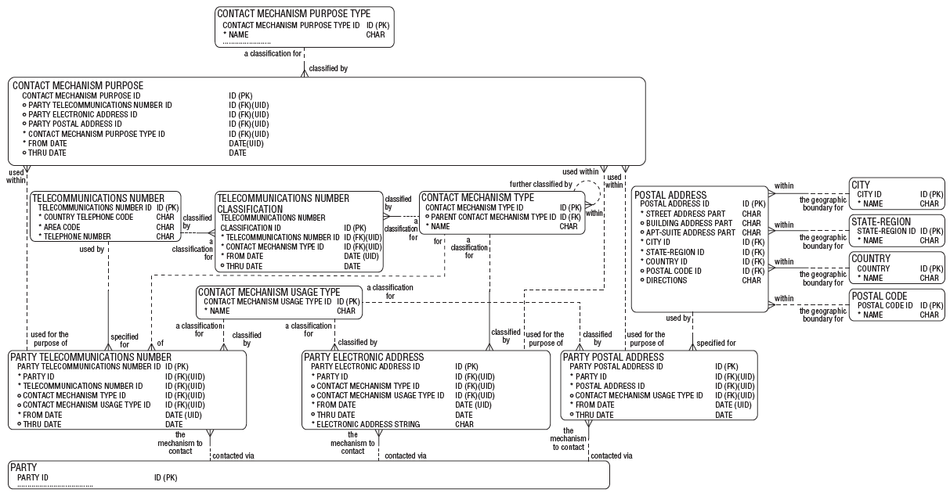
UDM Contact Mechanism
Courtesy of
Mark Shacklette
Notes:
Ok, so here's what I want to leave you with.
There's no such thing as a little volunteer project.
Pace around, and point at the board.
This is not just Theory, people.
This is the Real World!
This stuff happens!
Don't let it happen to you!

