Slide 1
C Tutorial Session #2
Type conversions
More on looping
Common errors
Control statements
Pointers and Arrays
C Pre-processor
Makefile
Debugging

Slide 2
Type Conversions
main()
{
int i;
unsigned int stop_val;
stop_val = 0;
i = -10;
while (i <= stop_val)
{
printf ("%d\n", i);
i = i + 1;
}
}

Slide 3
Common mistake
Example:
int n = 0;
while (n < 3)
printf(“ n is %d\n”, n);
n++;

Slide 4
Troubles with Truth
status = scanf(“%ld”, &num);
while (status = 1) {
printf(“please enter a number\n”);
status = scanf(“%ld”, &num);
}

Slide 5
The for loop
Syntax:
for (exp1; exp2; exp3)
Example:
for (count = 1; count < 10; count++)
{
printf(“count is %d\n”, count);
}

Slide 6
Count by charaters
char count;
for (count = ‘a’; count <= ‘z’; count++) {
printf(“count is %c\n”, count);
}

Slide 7
Nested loop
Example:
for (row = 0; row < 10; row++) {
for (ch = ‘a’; ch < ‘f’; ch++) {
printf(“%c “, ch);
}
}

Slide 8
C Control Statements
if statement
Syntax:
if (expression) {
statements
}
else {
statements
}

Slide 9
Sample code
if (x > 0) {
printf(“ x is greater than 0.\n”);
} else {
printf(“ x is less than or equals to 0.\n”);
}

Slide 10
Another example
int main() {
char ch;
ch = getchar();
while (ch != ‘\n’) {
putchar(ch);
ch = getchar();
}
return 0;
}

Slide 11
Using continue and break
ch = getchar();
while (ch != ‘\n’)
{
if (ch == ‘q’)
break;
if (ch == ‘$’)
{
printf(“dollar!\n”);
continue;
}
putchar(ch);
ch = getchar();
}
printf(“finished.\n”);

Slide 12
Continue and break
continue skips the rest of current iteration and starts the next iteration.
break causes the program to break free of the loop that encloses it and to proceed to the next stage of the program.

Slide 13
Multiple choice: switch and break
switch (ch)
{
case ‘\n’:
printf(“newline\n”);
break;
case ‘q’:
exit(0);
case ‘$’:
printf(“dollor!.\n”);
break;
default:
putchar(ch);
break;
}

Slide 14
Arrays
An array is composed of a series of elements of one data type.
An array declaration tells the compiler how many elements the array contains and what the type is for these elements.
Example: float candy[365]; char code[12];

Slide 15
Assigning Array Values
Initialization.
int arr[6] = {0, 1, 2, 3, 4, 5};
Assigning values.
for (counter = 0; counter < 6; counter++) {
arr[counter] = counter;
}

Slide 16
Multidimensional Arrays
An two dimension array is an array of one dimension arrays.
Example: float rain[5][12];
rain is an array of five elements. Each element is an array of twelve float point numbers.

Slide 17
Pointers and Arrays
Pointers provide a symbolic way to use address.
Array notation is simply a disguised use of pointers.
rain = &rain[0] // true

Slide 18
Functions, Arrays and Pointers
Suppose you want to write a function that operates on an array. What would the function call look like?
total = sum(marble);
What would the function declaration be?
int sum(int *ar);
NOTE: array name is the address of the first elements.

Slide 19
Pointer Operations
Example:
int urn[5] = {1, 2, 3, 4, 5};
int *ptr1, *ptr2, *ptr3;
ptr1 = urn;
ptr2 = &urn[2];
Question: if ptr1[x] == ptr2[1] is true, what is x?

Slide 20
C Preprocessor
#include <string.h> (or “string.h”) There is a difference between the < > -- look for the file in the include path and “ “ look first in local directory, then in the include path
#define [name] #define [name] value When [name] is used it is replaced with its value Eg. #define DEBUG #define DEBUG 1
#ifdef [name] #ifndef [name]
#endif

Slide 21
Examples
#ifdef DEBUG
printf ("entering main ()\n");
#endif
…
#define TRUE 1
#define FALSE 0
#define BYTE unsigned char
BYTE success;
success = function ();
if (success == FALSE);
{
#ifdef DEBUG
printf ("error\n”); #endif exit (0);
}

Slide 22
Makefile
The make command allows you to manage large programs or groups of programs.
The make program keeps track of which portions of the entire program have been changed, compiles only those parts of the program which have changed since the last compile.

Slide 23
Compilation Steps
Compiler stage: All C language code in the .c file is converted into a lower-level language called Assembly language.
Assembler stage: The assembly language code is converted into object code.
Linker stage: The final stage in compiling a program involves linking the object code to code libraries and produces an executable file.

Slide 24
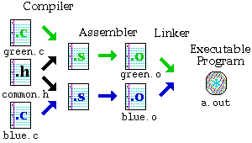
Compile Multiple files
Programmers usually divide source code into separate easily-manageable .c files when programs become large.

Slide 25
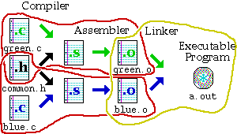
Separate Compilation Steps
Compile green.o: cc -c green.c
Compile blue.o: cc -c blue.c
Link the parts together: cc green.o blue.o
Notes:
In order to generate green.o, 2 files are required.

Slide 26
Using multiple source files
no two files have functions with the same name in it.
no two files define the same global variables.
To use functions from another file, make a .h file with the function prototypes, and use #include to include those .h files within your .c files.
At least one of the files must have a main() function.

Slide 27
Dependencies
Make creates programs according to the file dependencies.

Slide 28
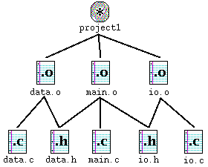
Dependency graphs

Slide 29
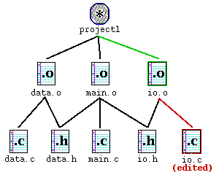
How dependency works
Notes:
Suppose that you have gone through the process of compiling the program, and while you are testing the program, you realize that one function in io.c has a bug in it. You edit io.c to fix the bug.
The figure above shows io.c outlined in red. By going up the graph, you notice that io.o needs to be updated because io.c has changed. Similarly, because io.o has changed, project1 needs to be updated as well.

Slide 30
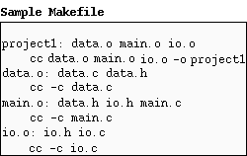
How does make do it?
Notes:
The make program gets its dependency "graph" from a text file called makefile or Makefile which resides in the same directory as the source files. Make checks the modification times of the files, and whenever a file becomes "newer" than something that depends on it, (in other words, modified) it runs the compiler accordingly.
For example, the previous page explained io.c was changed. If you edit io.c, it becomes "newer" than io.o, meaning that make must run cc -c io.c to create a new io.o, then run cc data.o main.o io.o -o project1 for project1.

Slide 31
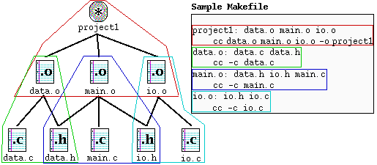
Translating the dependency graph
target : source file(s)
command (must be preceded by a tab)
Notes:
Each dependency shown in the graph is circled with a corresponding color in the Makefile, and each uses the following format:
target : source file(s)
command (must be preceded by a tab)
A target given in the Makefile is a file which will be created or updated when any of its source files are modified. The command(s) given in the subsequent line(s) (which must be preceded by a tab character) are executed in order to create the target file.

Slide 32
Using the Makefile with make
Once you have created your Makefile and your corresponding source files, you are ready to use it by typing make.

Slide 33
Basic Debugging
Prepare code for debugger add –g option to compiler command gcc –g –o <file> <file.c>
Debug the program gdb <file>
Breakpoints and execution b <line#> OR <function> s – step c – continue n – next
Look at variables print <expr>

