Slide 1
Design pattern: command
Encapsulate a request as an object, thereby letting you parameterize clients with different requests, queue or log requests, and support undoable operations.
Notes:
Reference:
Gamma et al.
https://en.wikipedia.org/wiki/Command_pattern
http://www.tutorialspoint.com/design_pattern/command_pattern.htm

Slide 2
Motivation
Sometimes it’s necessary to issue requests to objects without knowing anything about the operation being requested or the receiver of the request.
GUI Buttons and menu items
Macro Recording
Thread pools
Transactional behaviour
Notes:
GUI:
The actions to the GUI buttons is a command, and the button object may have no knowledge of the task.
Macro Recording:
If all user actions are represented by command objects, a program can record a sequence of actions simply by keeping a list of the command objects as they are executed.
Thread pools:
It maintains a pool of threads that execute commands from the queue. The items in the queue are command objects.
Transactional behavior:
a database engine or software installer may keep a list of operations that have been or will be performed. Should one of them fail, all others can be reversed or discarded.

Slide 3
Strategy
The Command Pattern consists of four parts
Command
An interface, in which concrete command classes implements
Invoker
Executes a command without knowing what is encapsulated
Receiver
Known by concrete commands
Methods invoked by concrete commands to do the work
Client
Driver class
Passes command object to invoker to execute a command

Slide 4
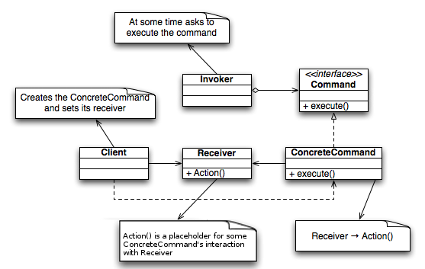
UML

Slide 5
Benefits
Decouples the object that invokes the operation from the one that knows how to perform it.
Can be manipulated and extended like other object which provides flexibility
Assemble commands into a composite command (e.g. a macro command)
Easy to add new Commands, because you don’t have to change existing classes

Slide 6
Example
Java

