Slide 1
Design pattern: OBJECT Adapter
To bridge two incompatible classes/interfaces using composition
“Wrappers”

Slide 2
Gang of Four Patterns
Creational | Structural | Behavioral
Factory Method Abstract Factory Builder Prototype Singleton | Adapter Bridge Composite Decorator Flyweight Facade Proxy | Interpreter Template Method Chain of Responsibility Command Iterator Mediator Memento Observer State Strategy Visitor
Notes:
Structural: patterns designed to do s/t and it’s their structure & relationship between classes that provide that responsibility

Slide 3
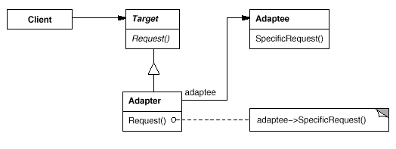
Structure

Slide 4
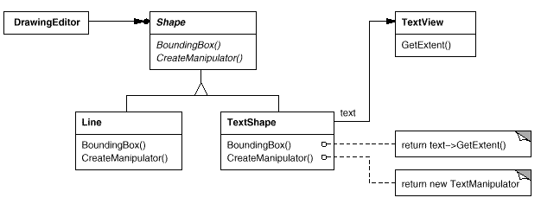
Structure (Book example)
Client
Target
Adaptee
Adapter
instance

Slide 5
About
Allow incompatible classes to work together by substituting the implementation of one interface for another
Can reuse already designed classes that have otherwise incompatible interfaces with your client program
Adapter provides functionality that the adapted class doesn’t provide
Specific to object adapters
Adapter can work with Adaptee class and it’s subclasses

Slide 6
Benefits & Considerations
Allows use of incompatible classes/avoid rewriting classes to fit your application
One adapter -> many adaptees
The adaptee & its subclasses
Some languages, like Java, do not allow for multiple inheritance from classes (for class adapters)
The amount of work that an Adapter does depends on how similar your program interface is to the Adaptee’s interface
The Adaptee’s interface is hidden from the client

Slide 7
Java Code
TempApp
Therm
TempCalc
display()
getX()
calc
SmartTherm
display()
calc.getX()

