Slide 1
State
Chuanxi Xiong
Peng Gao

Slide 2
State
Allow an object to alter its behavior when its internal state changes.
The object will appear to change its class.

Slide 3
Motivation
An object's behavior depends on its state, and it must change its behavior at run-time depending on that state.
Operations have large, multipart conditional statements that depend on the object's state.

Slide 4
Benefits
Localizes state-specific behavior and partitions behavior for different states.
Save large conditional statements.
Explicit transition between states.
State objects can be shared.

Slide 5
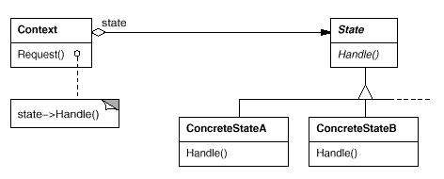
State UML

Slide 6
Consequences
Who defines the state transitions? Context or State subclasses. Or a table-based alternative.
Creating and destroying State objects.
State objects are often Singletons.

Slide 7
Example
ATM Machine

Slide 8
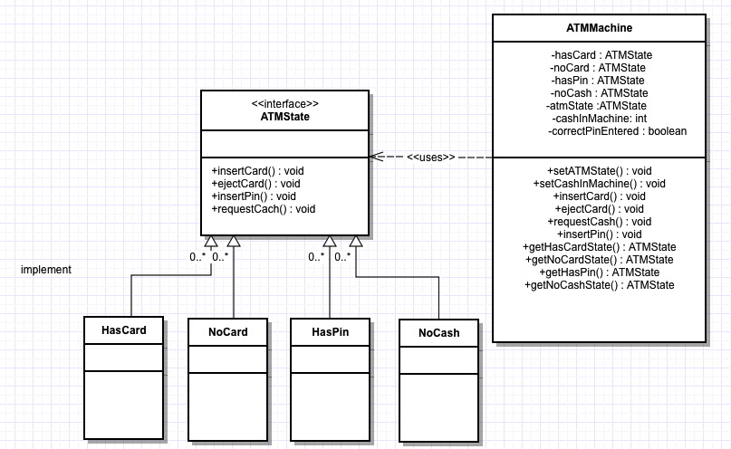
Example

Slide 9
