Slide 1
Abstract Factory Pattern
Jonathan Ma
From Gamma: Provide an interface for creating families of related or dependent objects without specifying their concrete classes.

Slide 2
What is the Abstract Factory Pattern used for?
Suppose you have a program that produces GUI elements, such as buttons, title bars and you want it to vary depending on the appearance or the OS.
Using this pattern allows you to create families of objects each depending on a specific category (Windows, Linux, Mac) without knowing the concrete classes (WinButton, WinScrollbar)

Slide 3
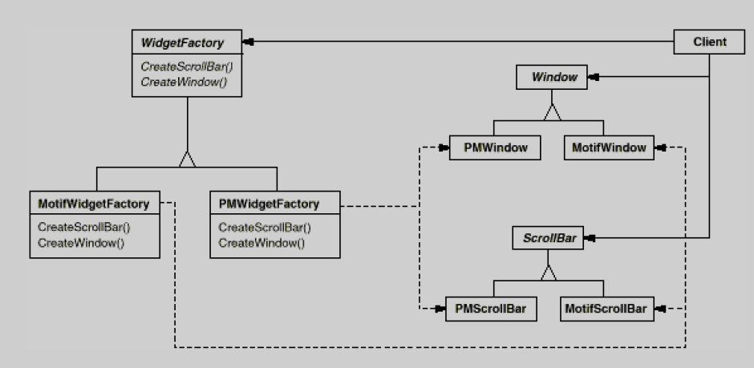

Slide 4
Pros and Cons for the Pattern
Advantages
Disadvantages
Promotes consistency across the program
Promotes easy switching of object categories.
  Just substitute the concrete factory in use.
You never have to work with concrete objects, only concrete factories.
  Extremely useful if using the program as a library.
Large number of classes needed:
  Will need to generate a+b+ab +1 total classes, where a is number of factories and b is number of abstract objects.
Can be difficult extend functionality for individual objects
  Need to change the abstract interface and implement the interface in the concrete objects
Can never access methods outside of the abstract object’s interface – this is because you only know the static type, not the dynamic type.

Slide 5
Maximizing Benefits of Pattern
Build a collaborator class or a make function that generates the object or factory needed based on an input string.
  Advantage: You never even have to create a concrete factory object, or have the user know it even exists!
Make concrete factories singletons.
  Only one factory is needed for the whole program – allows you to do bookkeeping operations from within the concrete factory.

