Slide 1
Bridge Pattern
Dmytro Onishchenko

Slide 2
Principle
“Decouple an abstraction from its implementation so the two can vary independently”
Bind abstraction and implementation by composition (run-time), not inheritance (compile-time)

Slide 3
Context
Abstraction has multiple forms and multiple different implementations
We need a flexible and robust way to bind the two and to let abstraction and implementation extend and compose independently

Slide 4
Action
Define separate hierarchies for abstraction and for implementation
Provide a “bridge” - an abstraction’s method that takes an instance of implementation and executes its specific functions for an abstraction;

Slide 5
Problems Solved
A certain implementation can be chosen by a certain abstraction at the run-time
No need to implement each combination of abstraction and implementation explicitly
Thus, any extension is simply an addition of a single new abstraction/implementation subclass

Slide 6


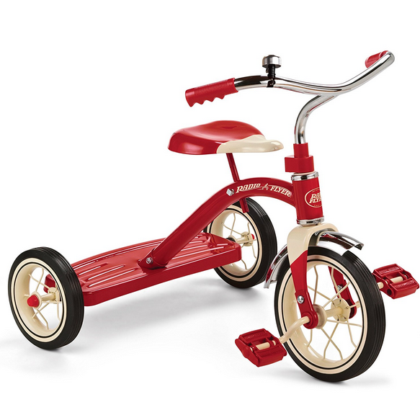
Example - Bikes

Slide 7
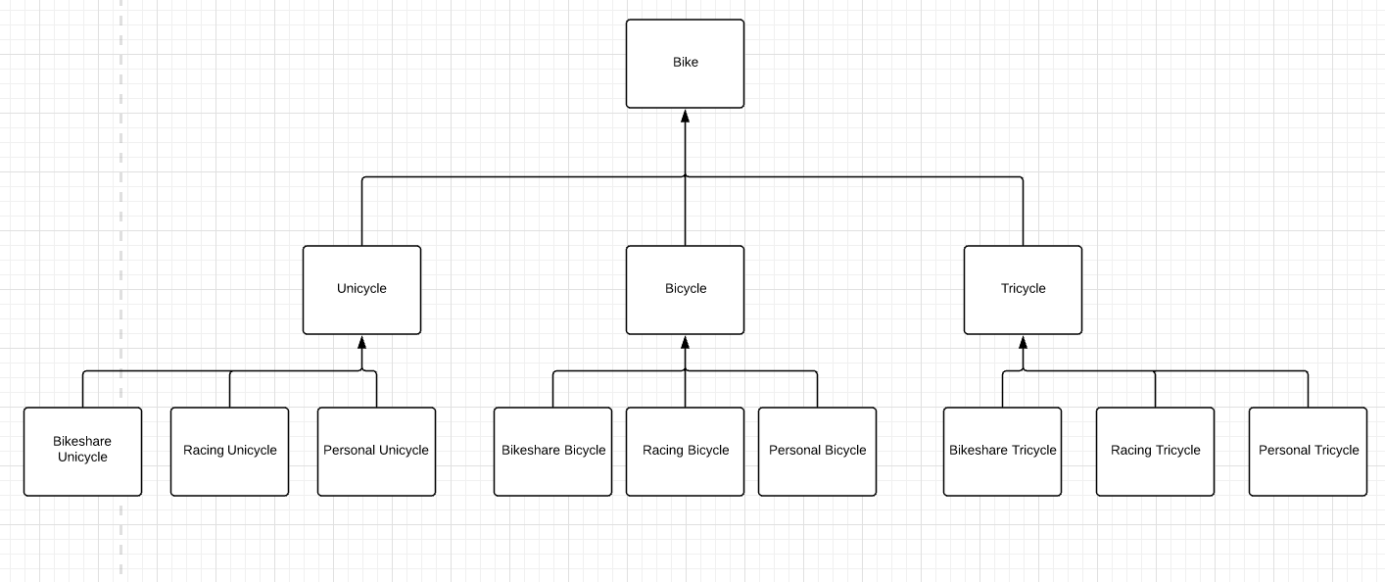
Inheritance-based approach

Slide 8
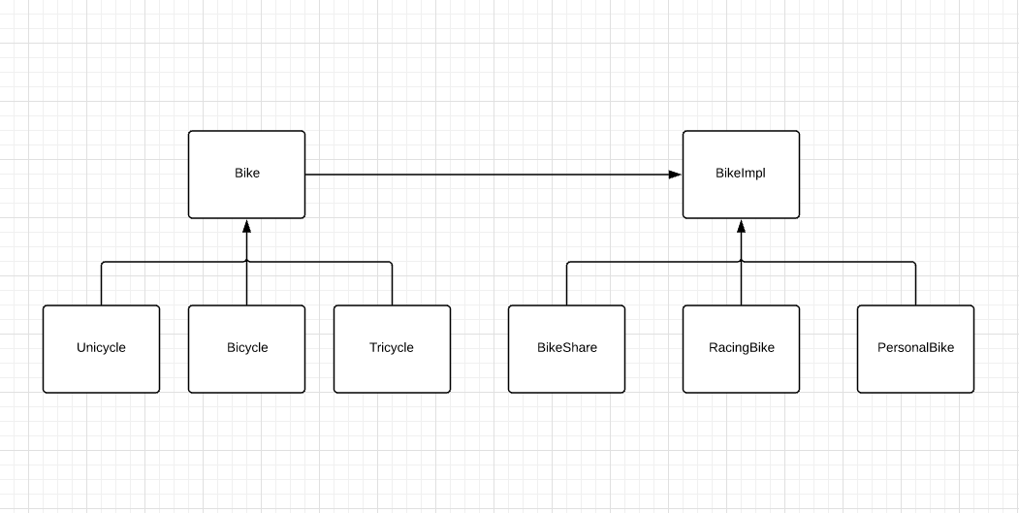
Bridge-based approach

Slide 9
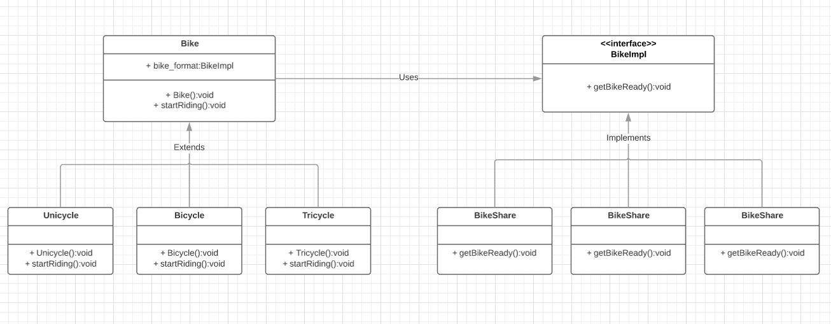
UML

Slide 10
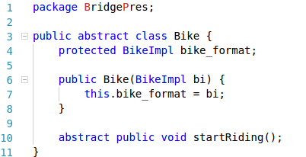
Code Example - abstraction

Slide 11
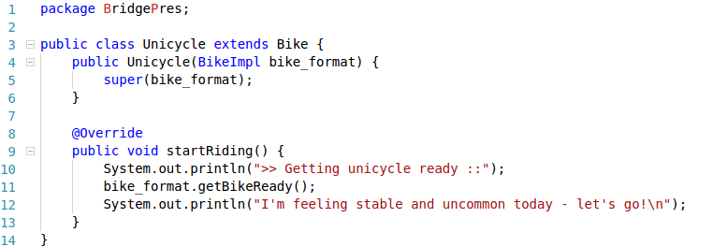
Code Example - abstraction subclasses

Slide 12
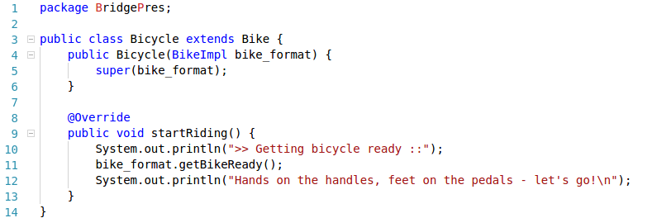
Code Example - abstraction subclasses

Slide 13
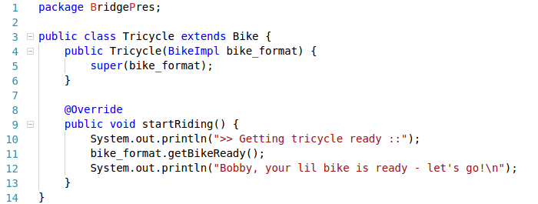
Code Example - abstraction subclasses

Slide 14

Code Example - Implementation Interface

Slide 15
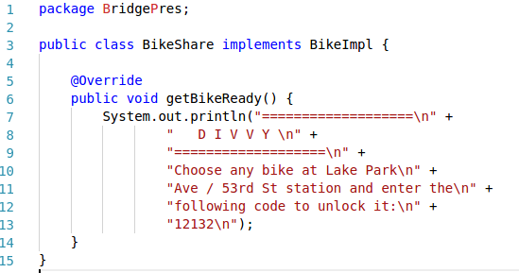
Code Example - Implementation Subclasses

Slide 16
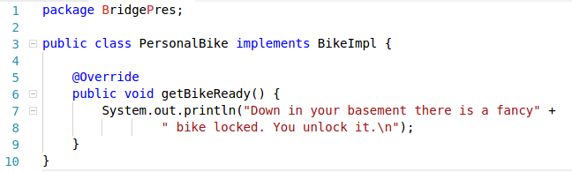
Code Example - Implementation Subclasses

Slide 17
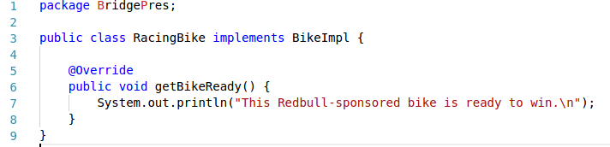
Code Example - Implementation Subclasses

Slide 18
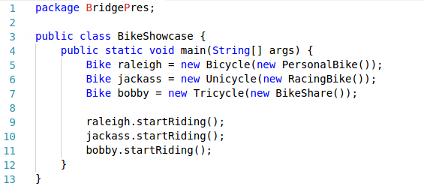
Code Example - Test Application

Slide 19
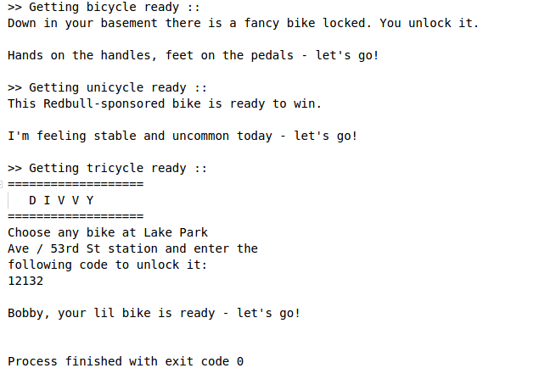
Code Example - Application Output

