Slide 1
Builder Pattern
Presented by
Yue Dou & Zhenghong Zhang

Slide 2
What is the Problem?
Suppose you want to create a very complex object with many parameters...
Student (FirstName, LastName, Age, Height, Nationality, Major....)
What if you want to create a Student object only with given FirstName, LastName and Nationality?
What if you want to quickly create Student objects of different types, like MastersStudent or PhDStudent?

Slide 3
Intent of Builder Pattern
To separate the construction of a complex object from its representation so that the same construction process can create different representations
The construction process allows different representations for the object that is constructed.
The object construction process becomes independent of the components that make up the object.

Slide 4
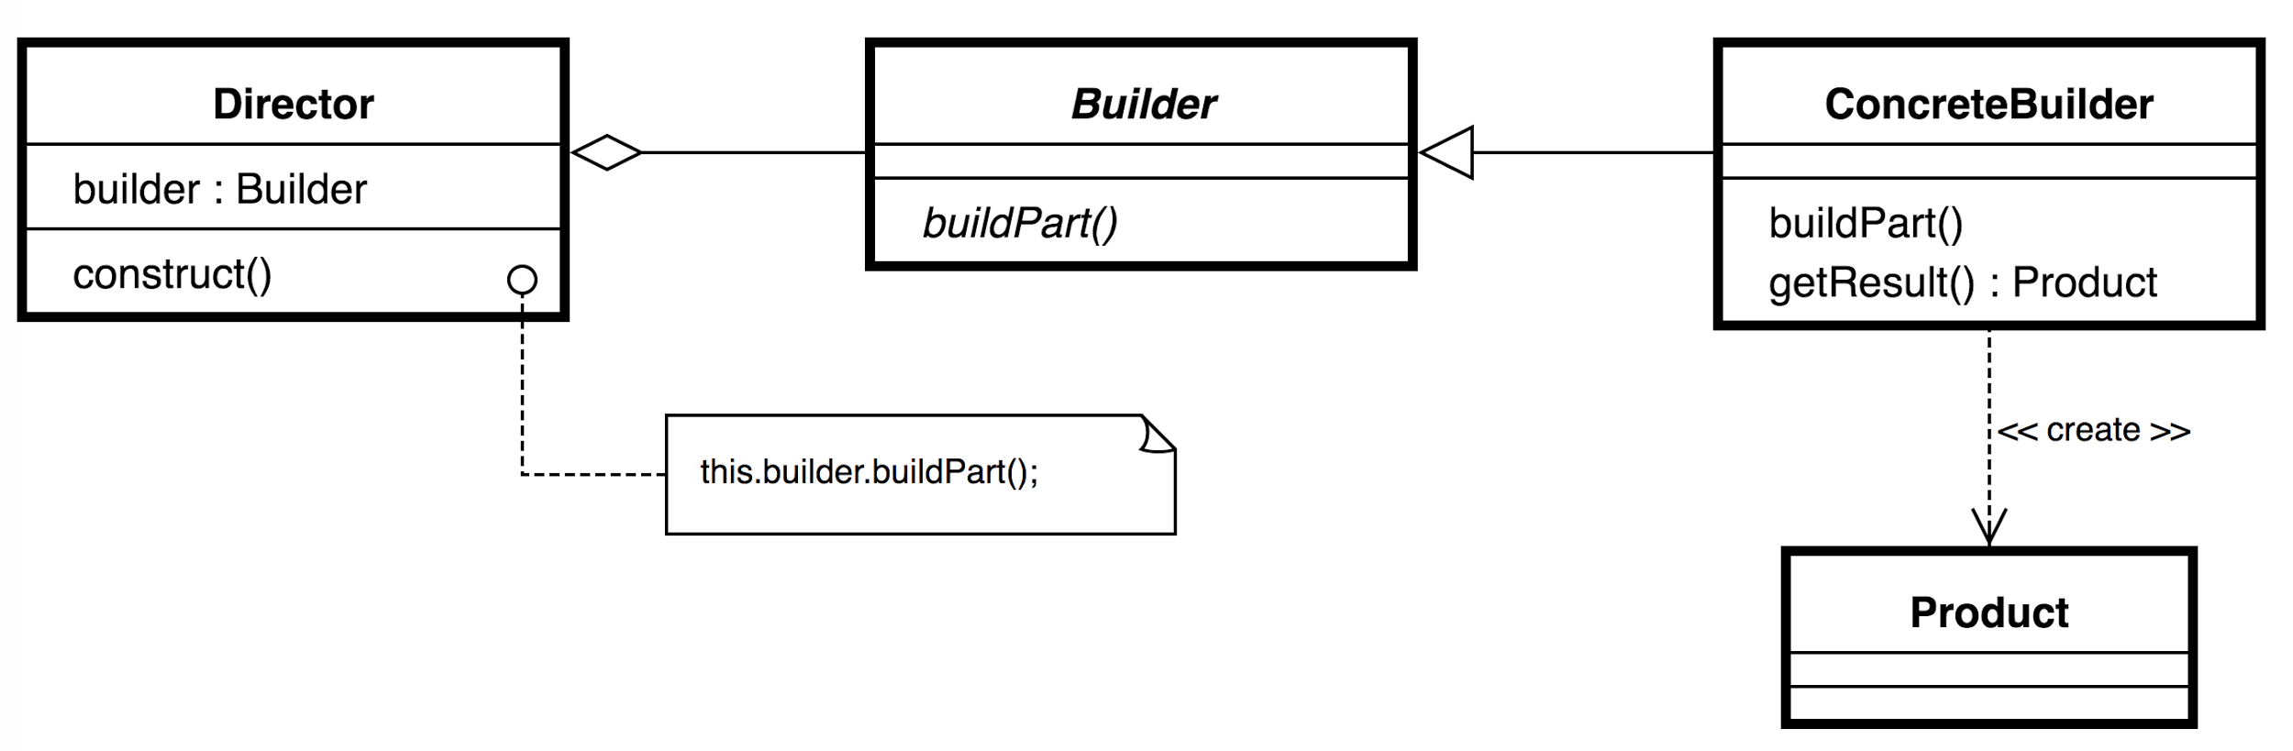
How Does it Work?
It uses simple objects and a step by step approach.

Slide 5
Advantages of Builder Pattern
You can vary an object’s representation without changing the way the object is constructed.
It allows you to have control over your construction process in an incremental approach.
It encapsulates the construction process of a complex object and thereby increases the modularity of an application

Slide 6
When to Use Builder Pattern?
The object to be constructed is very complex.
The process of constructing an object must support different representations of the constructed objects.
The construction construction process of a complex object should be encapsulated.

Slide 7
Implementation of Builder Pattern

Slide 8
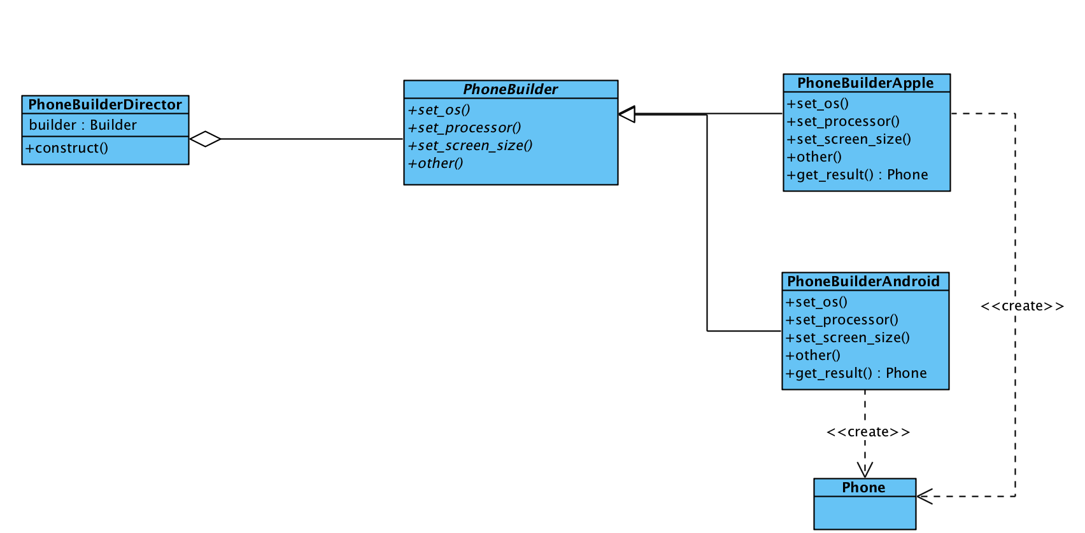
UML of Actual Implementation

Slide 9
Implementation Example in Python

Slide 10
References
http://en.proft.me/2016/09/25/builder-design-pattern-java-and-python/
https://en.wikipedia.org/wiki/Builder_pattern
https://sourcemaking.com/design_patterns/builder

