Slide 1
Class Adapter
James Lai

Slide 2
The Adapter Pattern
Both the Class Adapter and the Object Adapter are versions of a pattern known as the Adapter Pattern
Problems:
We have a class that fulfils our needs, but the interface isn’t what the client expects
We have two (or multiple) classes that we want to interact, but their interfaces don’t work together

Slide 3
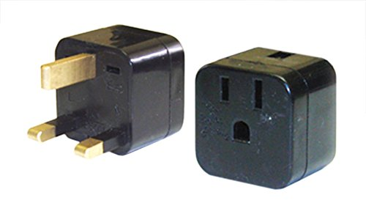
The Adapter is an intermediary abstraction that maps the interface of a class (Adaptee) to another interface (Target)
This allows the old class to appear as if it has the expected interface
It also allows two incompatible interfaces to be bridged and for those two classes to work together
The Client makes a request to the adapter through the Target.
The Adapter translates the request to the Adaptee (using the adaptee’s interface)
Client: US device
Expected: US power socket

Slide 4
The Class Adapter
The Class and Object Adapter are both approaches to the overarching Adapter Pattern
The defining feature of the Class Adapter is its usage of multiple inheritance to adapt one interface to another
The Adapter would inherit from both the Target and the Adaptee

Slide 5
Let’s say we have a game where you click on enemies to do damage to them
class Enemy(object):
def __init__(self, hp):
self.hp = hp
def clicked(self):
self.hp = self.hp - 1
def click_character(character):
character.clicked()
Now we want to add allies where clicking on them heals them, but we have a class from a previous game
class Ally(object):
def __init__(self, hp):
self.hp = hp
…
def heal(self):
self.hp = self.hp + 1

Slide 6
from abc import ABC
from ally import Ally
class NonPlayerChar(ABC):
#abstract base class for all clickable characters
def clicked(self):
pass
class Enemy(NonPlayerChar):
def __init__(self, hp):
self.hp = hp
def clicked(self):
self.hp = self.hp - 1
class AllyClassAdapter(Ally, NonPlayerChar):
def __init__(self, hp):
Ally.__init__(self, hp)
def clicked(self):
return self.heal()
Adaptee
class Ally(object):
def __init__(self, hp):
self.hp = hp
…
def heal(self):
self.hp = self.hp + 1

Slide 7
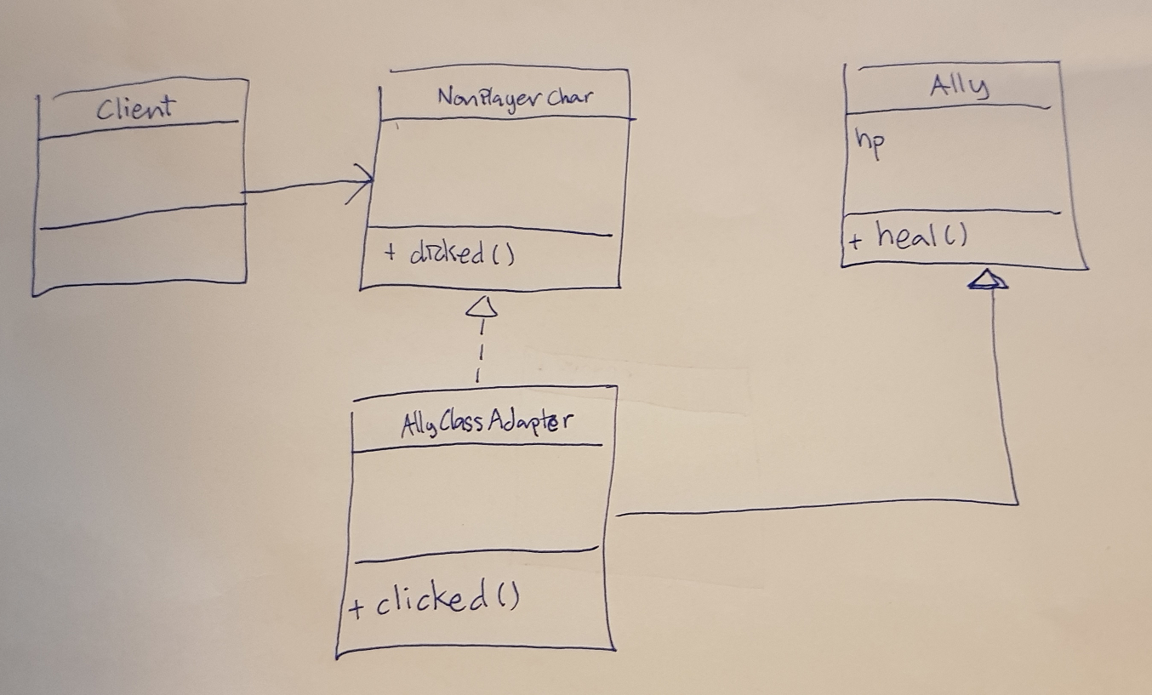

Slide 8
Thank you

