Slide 1
COMPOSITE DESIGN PATTERN
Kiran Baktha

Slide 2



PURPOSE!
Processing of a primitive object is handled one way, and processing of a composite object is handled differently.
Composite design pattern lets clients treat individual objects and compositions of objects uniformly.

Slide 3
VIDEO…..

Slide 4
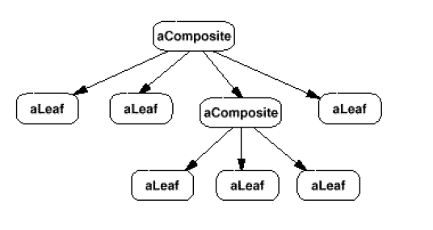
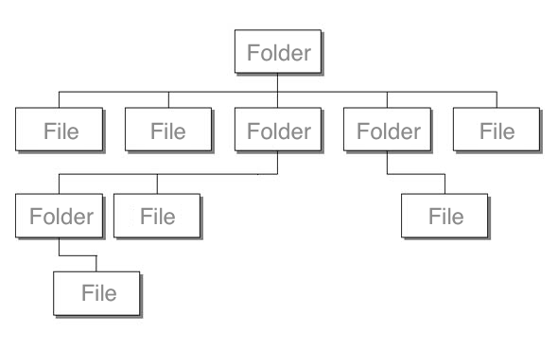
STRUCTURAL PATTERN
Composite Pattern is a Structural Pattern
Structural patterns are concerned with how classes and objects are composed to form larger structures.
Structural object-patterns define ways to compose objects to obtain new functionality.

Slide 5
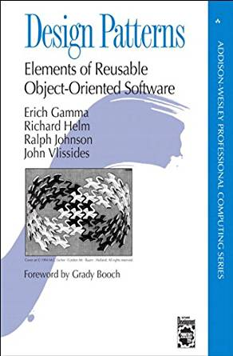
APPLICABILITY
You want clients to be able to ignore the difference between compositions of objects and individual objects. Clients will treat all objects in the composite structure uniformly.
You want to represent part-whole hierarchies of objects. (any object in a collection is a part of the whole composition and composition as a whole is a collection of parts.)

Slide 6
APPLICABILITY
USE:
DELETION
COPY
TRANSFER
DON’T USE
CREATE

Slide 7
ADVANTAGES
Clients can treat composite structures and individual objects uniformly. Clients normally don't know (and shouldn’t care) whether they're dealing with a leaf or a composite component.
Makes it easier to add new kinds of components. Newly defined Composite or Leaf subclasses work automatically with existing structures and client code. Clients don't have to be changed for new Component classes.

Slide 8
DISADVANTAGES
Makes it too general. It is difficult to restrict the objects which should be treated as composite.
To enforce such a constraint, usually run type checks have to be used since the type system of the programming language cannot be used.

Slide 9



PARTICIPANTS
Component
Declares the interface for all objects in the composition.
Implements default behavior for the interface common to all classes.
Leaf
Represents the Primitive Object (No Children)
Composite
Represents the Composite Object. Stores Child components and implements child related operations in the component interface.
Client – Manipulates objects through the component interface.

Slide 10
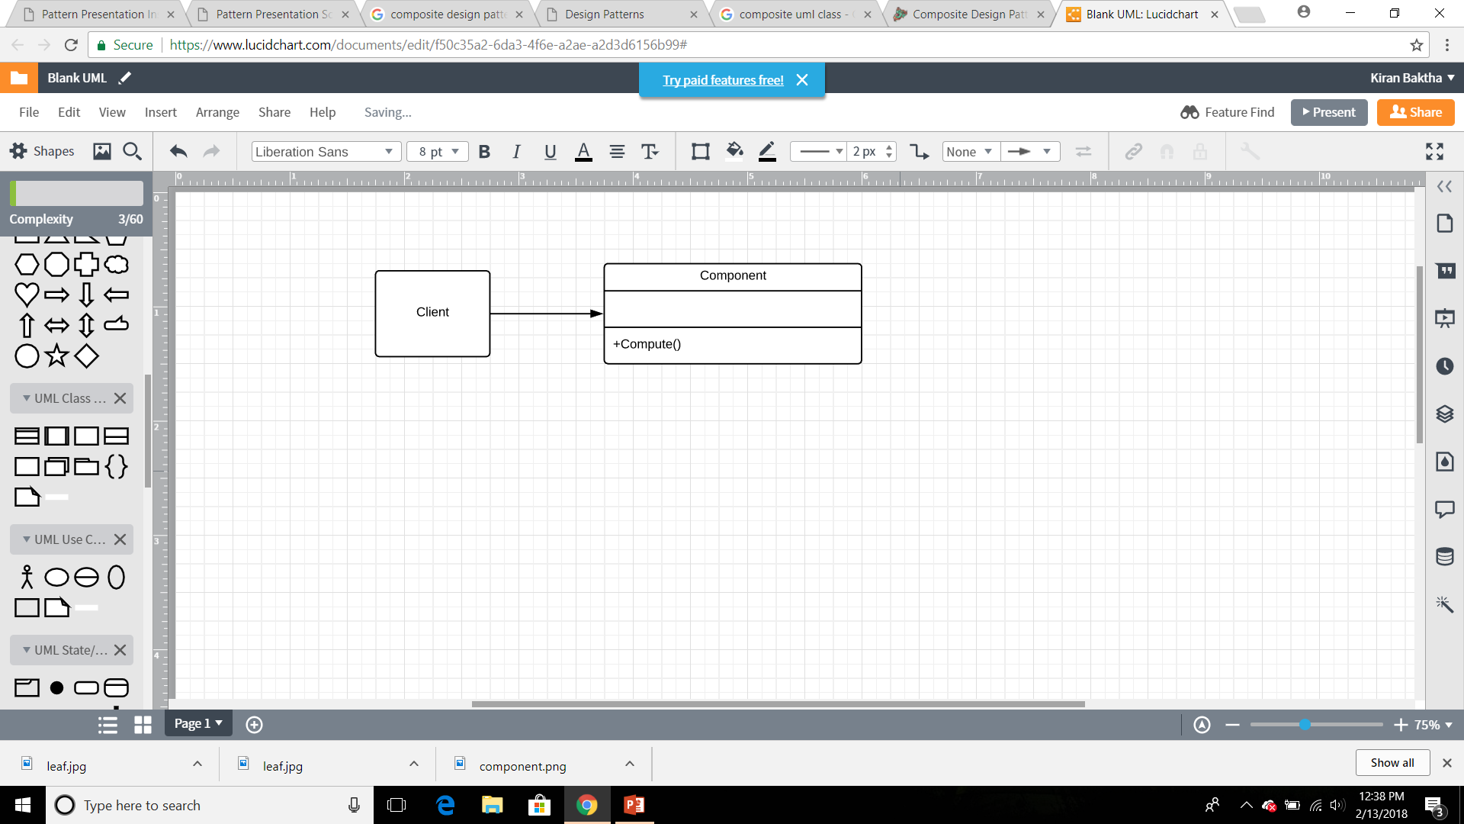
UML

Slide 11
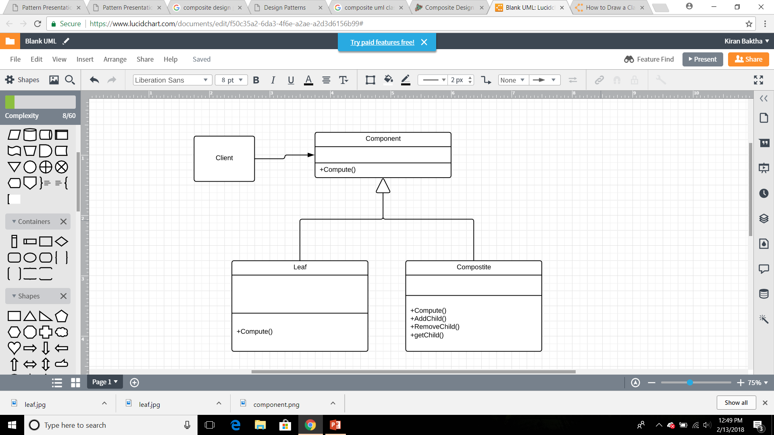
UML

Slide 12
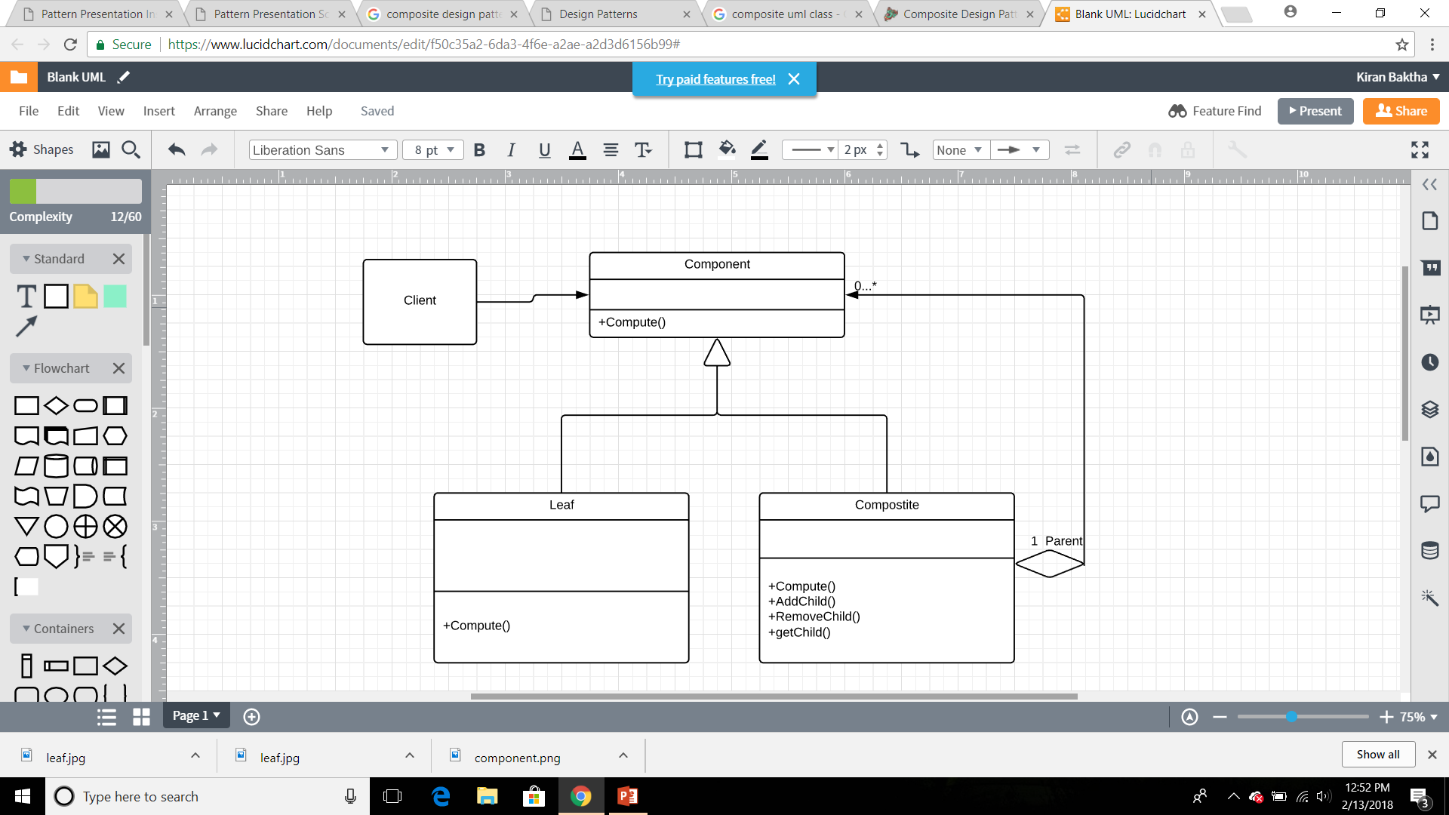
UML

Slide 13
ARITHMETIC EXPRESSION EXAMPLE
+,*,/,-
2+3
Operand can be a number or another arithmetic expression
(2+3) + (5*6) + 7
To be treated the same way

Slide 14
INTERACTIVE CODING
Let’s built it step by step from scratch. Over to IDE.

