Slide 1
Mediator Pattern

Slide 2
“Luigi, can’t talk long. Bowser doesn’t know my videophone still works for calling out. I don’t know where he’s keeping me. Sewage. He’s coming back. Later!”
-Princess Peach

Slide 3
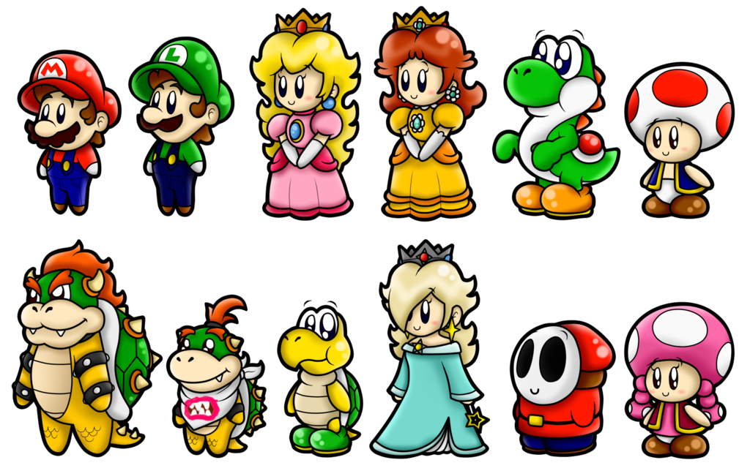
Here’s the Deal…
Mario, Luigi, Yoshi, and the Mushroom need a system to communicate on their quest to save the Princess

Slide 4
Here’s one way to connect our heroes…

Slide 5

What if we added a new character to the quest?

Slide 6
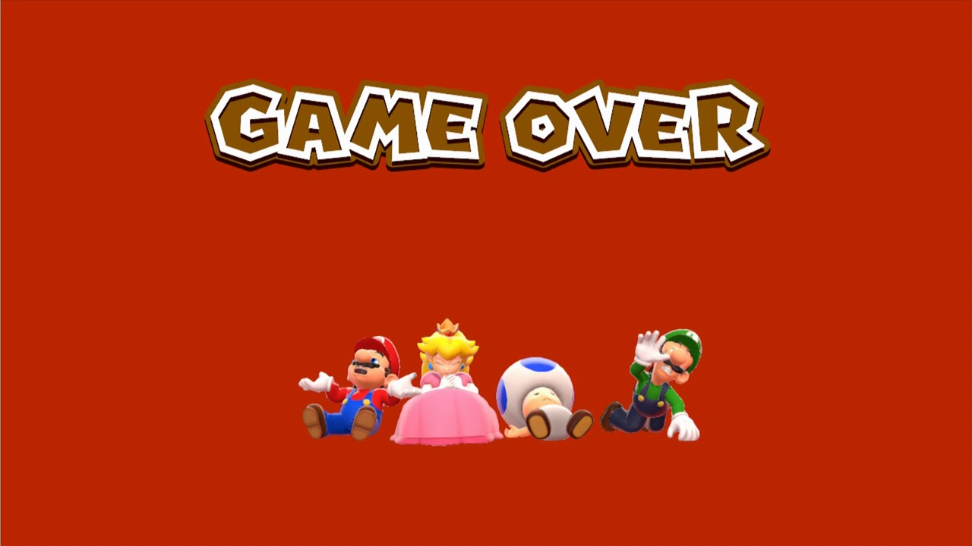
This architecture is not all that scalable
(The number of connections grows at O(n^2)…)

Slide 7

What If Instead…
The Mediator!
We introduce a new role in the system – the mediator – responsible for relaying messages to our heroes

Slide 8
What If Instead…
The Mediator!
Now our heroes do not have to know about each other. They only interact with the mediator.

Slide 9
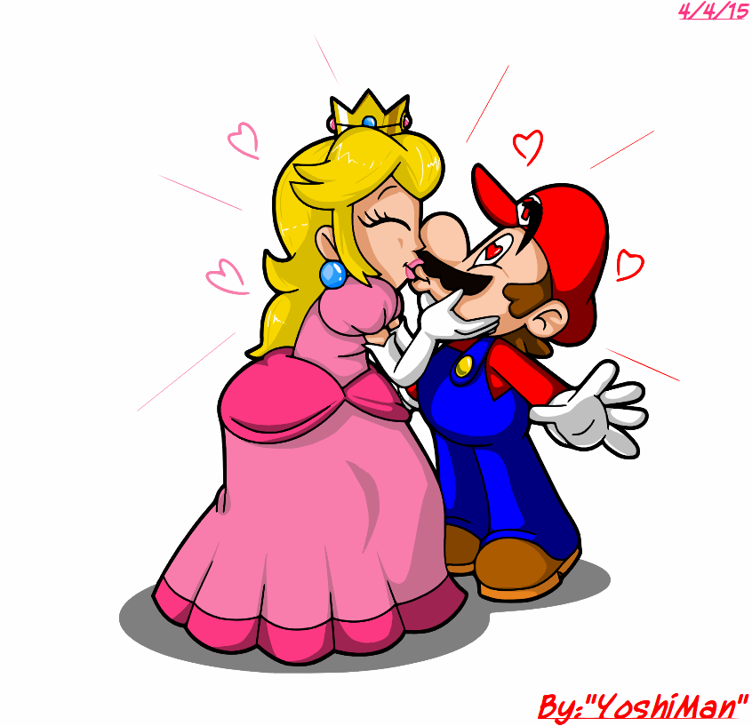
Now our architecture is way more scalable
The number of connections grows at O(n)

Slide 10

Ready for some UML?

Slide 11
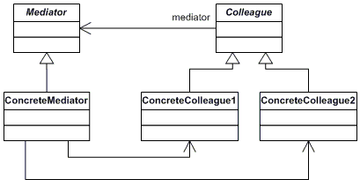
Architecture

Slide 12
Mediator & Colleague
A Colleague Does Not Know About Other Colleagues!
(That’s all in Mediator!)
Mediator
Colleague
- ArrayList<Colleague>
- Mediator
+ void shareMessage
+ (String message,
+ Colleague speaker)
Colleague “says” something to mediator
+ void joinChat
Mediator mediator)
+ void says(String message)
+ void receiveMessage
(String message)
Mediator then shares message with all other colleagues
(via the participant’s own Mediator object, which is an attribute)

Slide 13
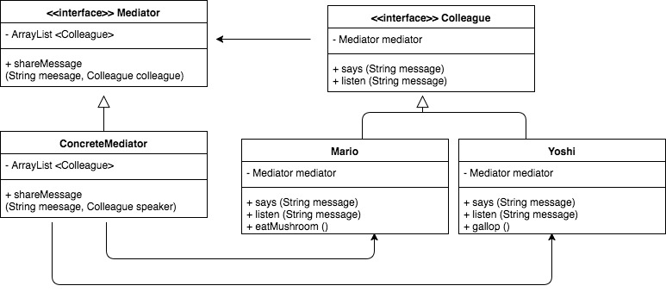
public class ConcreteColleague implements Colleague {
String name;
Mediator mediator;
public void says(String message){
mediator.shareMessage (name + " says: " + message, this);
}
}

Slide 14
public class ConcreteMediator implements Mediator {
ArrayList<Colleague> heroes;
public void shareMessage(String message, Colleague speaker){
for (Colleague hero : heroes){
if (hero != speaker) hero.listen (message);
}
}
}

Slide 15
public class ConcreteColleague implements Colleague {
String name;
Mediator mediator;
public void listen (String message){
System.out.println (message);
}
}
Psst… Isn’t Mario a Singleton?

Slide 16
where else can we find the Mediator?
(As if saving the Princess wasn’t compelling enough… I get it, we can’t all be into 90’s video games!)
GUI Window (Mediator) interacting with elements on the page (Colleagues)
Radio Dispatch System
Orchestra
Air traffic control System
Complex, High-stakes, Negotiation
Dispute Resolutions
They’re in more places than meets the eye!

Slide 17
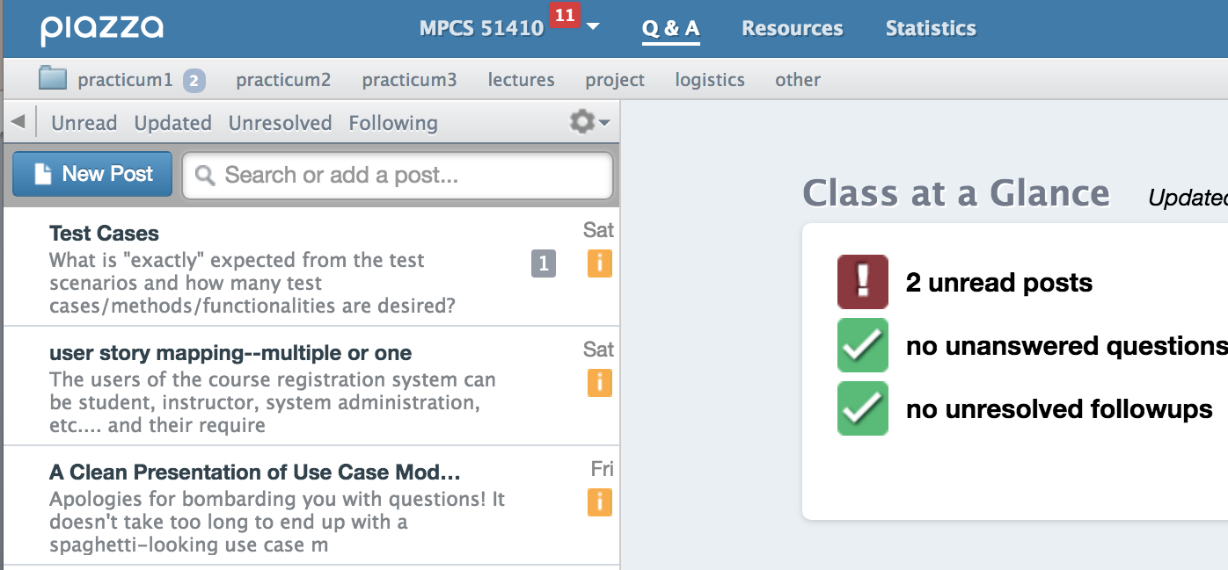
Some real world examples
Our Beloved Piazza

Slide 18
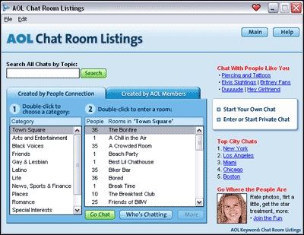
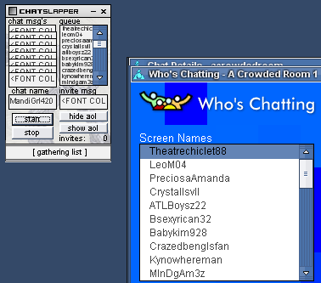
Some real world examples
(Again, still not stuck in the 90’s :p)
Who remembers these?

Slide 19

A Word of Warning
Positives:
Simplifies interaction between classes
Allows for easier scalability
From many-to-many interactions to one-to-many
Allows easier reuse of Colleagues
Easier to understand
Negatives:
“Trade complexity of interaction for complexity of mediator”
May end up with too complex of a mediator
Risk is more concentrated in mediator
Possibly leading to a more fragile system?

Slide 20
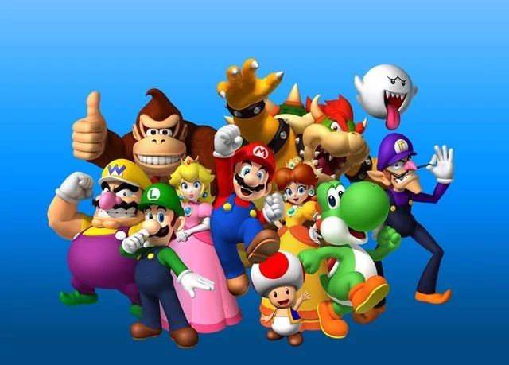
That’s it Folks!

