Slide 1
Files CMSC 15400: Introduction to Computer Systems Chapter 10
Instructor:
Haryadi Gunawi
Notes:
FD + shortcount must take 35 minutes.
Don’t take questions until checkpoint slides. We slice the layers one by one.
Buffering needs 15 minutes at least.

Slide 2
Files and File Descriptors

Slide 3
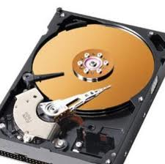
Unix Files and I/Os
OS provides abstraction
Processes abstracts the processors
You: simply run processes
OS: set up all the details (last three lectures)
Files abstracts the storage (disk/ssd/cloud storage/etc.)
You: simply open/read/write/close files
OS: map files to bits on storage
Open(…/Dropbox/file)
Dropbox
Open(localfile)

Slide 4
Basic Unix I/O operations (system calls):
Opening and closing files
open()and close()
Reading and writing a file
read() and write()
Changing the current file position (seek)
indicates next offset into file to read or write
lseek(offset, …)
Ex: skip DVD chapters / fast forward
(read the manuals for more – will go fast in lecture)
man 3 open ; man 3 close, man 3 read, … in CSIL / Linux
man 2 open … in Mac

Slide 5
Opening files
Open in read/write modes, examples:
Firefox open .html pages in read only mode
Microsoft word open .docx pages in write mode
Returns a small identifying positive integer file descriptor
Fd < 0 means error
What does integer fd represent? (later)
For now: one fd per open call
int fd; /* file descriptor */
fd = open(“/etc/hosts", O_RDONLY);
if (fd < 0) {
printf(”oops");
exit(1);
}
Notes:
O_RDONLY
O_WRONLY
O_RDWR

Slide 6
Closing files
int fd = open(…);
…
int retval = close(fd)
if (retval < 0) … /* check */
Use “fd” to close the file
Good practice: Always check return codes (“retval”)
Notes:
“Moral” doesn’t follow??

Slide 7
FYI
2^10 1K 1024
2^20 1M 1024*1024
2^30 1G
K = 1024
k = 1000
B = byte
b = bit

Slide 8
Reading files
read() → OS copies bytes from the last file position to your buffer
Read a 500-KB file?
Call read (…, 1024) 500 times
char buf[1024]; → 1 KB
int nbytes;
read(fd, buf, 1024);
B₀
B₁
Byte₂• • •
B₁₀₂₃
B₁₀₂₄
B₁₀₂₅
• • •
B₂₀₄₈
Every read() moves forward
the current file offset (position)
(OS keeps this information)
Notes:
What is the largest number of bytes we can read? 2GB because signed

Slide 9
Writing files
Writing a file copies bytes from memory to the current file position, and then updates current file position
Downloading 1MB file with 1KB buffer
Call write() 1024 times
char buf[1024] = “random data”;
int nbytes;
write(fd, buf, 1024);
Notes:
Skip this … quickly… no time

Slide 10
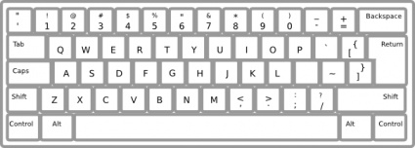
FD Table
The OS maintains a file descriptor table for every process
(part of the process’ PCB – invisible to you)
The first 3 file descriptors
Each process begins life with 3 open file descriptors:
0: standard input (default: keyboard)
1: standard output (default: screen)
2: standard error (default: screen)
Open a new file
Starts from fd = 3
fd | File information
0 | stdin
1 | stdout
2 | stderr
3 | (unused)
…

Slide 11
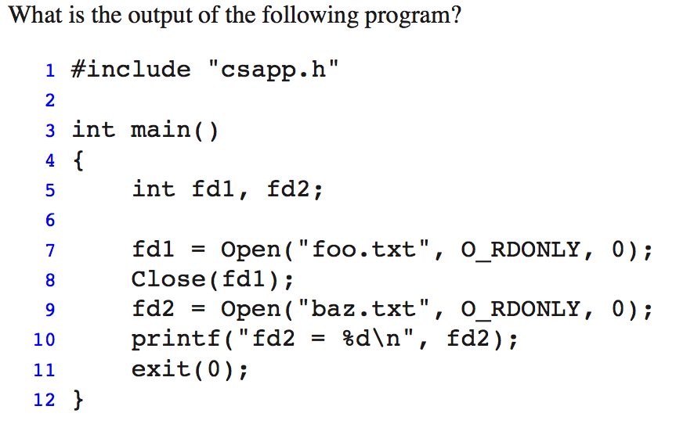
Practice problem
fd | File information
0 | stdin
1 | stdout
2 | stderr
3 | (unused)
…
Notes:
3

Slide 12
File descriptors (Sharing and redirection)
Metadata, sharing, and redirection

Slide 13
File descriptor
User: “fd” is just a number
Ex: FD table of a microsoft word process
OS: “fd” represents a pointer to file descriptor structure
Describe file access information
Current position, read/write mode, etc.
// Inside OS:
struct fd {
WRITE mode
curpos=0
file = hw6.doc
}
fd | (Descriptor Tbl)
0 | stdin
1 | stdout
2 | stderr
3
4
READ mode
curpos=1000000 (bytes)
file = macbethNovel.doc

Slide 14
(Another View)
FDs = represent open files
File metadata
(“stat()” syscall)
See book
Descriptor table
(file descriptor numbers)
Open file table
(File descriptor structures)
stdin
fd 0
stdout
fd 1
pos=0
stderr
fd 2
fd 3
refcnt=1
File metadata
(“stat()” syscall)
See book
fd 4
...
pos=100
refcnt=1
...
Notes:
Closing a file decrements the reference count. Kernel deletes entry if ref count = 0.
File position …

Slide 15
How the Unix kernel represents open files
User:
“fd” is a number (a “handler”)
OS:
“fd” is actually a file descriptor structure
fd describes file access information
Current position, open in read/write mode, etc.
However, “fd” is not file metadata
Fd does not describe the file
File METADATA
(from “stat()” syscall)
This is NOT a file descriptor
(see the BOOK regarding file metadata and the stat() system call)
Notes:
Closing a file decrements the reference count. Kernel deletes entry if ref count = 0.

Slide 16
File sharing
Two distinct FDs sharing the same disk file
E.g., Calling open twice with the same filename argument
fd3=open(“file.txt”),
fd4=open(“file.txt”),
read(fd4, buf, 1000)
Descriptor table
FD
File metadata
of
file.txt
stdin
fd 0
stdout
fd 1
pos=0
stderr
fd 2
fd 3
refcnt=1
fd 4
...
FD
pos=1000
refcnt=1
...
Notes:
Why would you want to do that? Read different parts of the file …

Slide 17
I/O redirection (Project 4)
Question: How does a shell implement I/O redirection?
ls > foo.txt
“>” is a shell feature
How do you build implement this feature?
Answer: By calling the dup2(fdsrc, fddst) syscall
Copies (per-process) descriptor table entry fdsrc to entry fddst
Descriptor table
before dup2(3,1)
Descriptor table
after dup2(3,1)
fd 0
fd 0
fd 1
monitor
fd 1
foo
fd 2
fd 2
fd 3
foo
fd 3
foo
fd 4
fd 4
Notes:
= right angle bracket (greater than)
Fd1 points to a monitor

Slide 18
Ex:
Shell code:
rv = fork();
if (rv == 0) {
// the child
fd = open(“out.txt”)
dup2(fd, stdout) // dup2(3,1)
execve(prog);
}
prog > out.txt
fork() → OS clones the parent’s fd table to the child
open() → only modify the child’s FD table!!
dup2() → manipulate fds
Child’s fdTable[1] → ??
Shell’s fdTable[1] → ??
Child’s fdTable[3] → ??
Shell’s fdTable[3] → ??
“prog” code:
Main() {
printf(“hello world”);
// write(1, “hello world”, ..);
}
fd | (child/prog)
0 | stdin
1 | stdout
2 | stderr
3
4 | ..
fd | (parent/shell)
0 | stdin
1 | stdout
2 | stderr
3
Out.txt
out.txt
Notes:
If there is only one process, one shell running, how many fd table there is in OS?
After fork, how many fd tables.
The four answers: out.txt, stdout, out.txt, none ..

Slide 19
Ex2:
call dup2(4,3)
Both fd entries point to the same file descriptor!!
dup2(4,3); // read@
read(4,buf,1); // pos=??
read(3,buf,1); // pos=??
lseek(3,20);
read(4,buf,1); // pos=??
FD A
File metadata
stdin
fd 0
stdout
fd 1
pos=5
stderr
fd 2
fd 3
refcnt=1→0
fd 4
...
FD B
File metadata
pos=10
0
1
…
10
11
…
Refcnt=1→2
...
Notes:
Pos = 10
Pos = 11
Pos = 20

Slide 20
Fun with file descriptors (1)
int fda, fdb, fdc;
char c1, c2, c3;
fda = Open(fname, O_RDONLY, 0);
fdb = Open(fname, O_RDONLY, 0);
fdc = Open(fname, O_RDONLY, 0);
dup2(fdb, fdc);
read(fda, &c1, 1);
read(fdb, &c2, 1);
read(fdc, &c3, 1);
// c1, c2, c3 = ???
pos=??
pos=??
pos=??
…
fda
fdb
fdc
ffiles1.c
What would this program print for file containing “abcde”?
01234
Notes:
Draw 3 file descriptor structures.
c1 = a, c2 = a, c3 = b

Slide 21
How processes share files: Fork()
A child process inherits its parent’s open files
Note: situation unchanged by exec functions (use fcntl to change)
Before fork() call:
Descriptor table
[one table per process]
Open file table / FD structures
[shared by all processes]
File A (terminal)
stdin
fd 0
stdout
fd 1
File pos
stderr
fd 2
fd 3
refcnt=1
fd 4
...
File B (disk)
File pos
refcnt=1
...

Slide 22
How processes share files: Fork()
A child process inherits its parent’s open files
After fork():
Child’s table same as parent’s, and +1 to each refcnt
Descriptor table
[one table per process]
Open file table
[shared by all processes]
Parent
FD structure for A (terminal)
fd 0
fd 1
File pos
fd 2
fd 3
refcnt=2
fd 4
...
Child
FD structure for B (disk file)
fd 0
fd 1
File pos
fd 2
refcnt=2
fd 3
fd 4
...
Notes:
Only copy the descriptor table !!!!

Slide 23
Fun with file descriptors (2)
ffiles2.c
int fd; char c1, c2;
fd = open(fname, O_RDONLY, 0);
read(fd, &c1, 1);
rv = fork();
if (rv > 0) // Parent
sleep(1);
read(fd, &c2, 1);
print (c1, c2); // ???
else // Child
sleep(0);
read(fd, &c2, 1);
print (c1, c2); // ???
(next slide for animation)
What would this program print for file containing “abcde”?
(or, if child calls sleep(2)?)
Notes:
If parent sleep for 1 second:
Child: c1 = a, c2 = b
Parent: c1 = a, c2 = c
If child sleep for 1 second:
Child: c1 = a, c2 = c
Parent: c1 = a, c2 = b

Slide 24
Fun with file descriptors (2)
ffiles2.c
int fd; char c1, c2;
fd = open(fname, O_RDONLY, 0);
read(fd, &c1, 1);
rv = fork();
if (rv > 0) // Parent
sleep(1);
read(fd, &c2, 1);
print (c1, c2); // ???
else // Child
sleep(0);
read(fd, &c2, 1);
print (c1, c2); // ???
What would this program print for file containing “abcde”?
(or, if child calls sleep(2)?)
Notes:
If parent sleep for 1 second:
Child: c1 = a, c2 = b
Parent: c1 = a, c2 = c
If child sleep for 1 second:
Child: c1 = a, c2 = c
Parent: c1 = a, c2 = b

Slide 25
Fun with file descriptors (3)
int fd1, fd2, fd3;
char *fname = argv[1];
fd1 = Open(fname, O_CREAT|O_TRUNC|O_RDWR, S_IRUSR|S_IWUSR);
Write(fd1, "pqrs", 4);
fd3 = Open(fname, O_APPEND|O_WRONLY, 0);
Write(fd3, "jklmn", 5);
fd2 = dup(fd1); /* dup fd1 to fd2 – see manual */
Write(fd2, "wxyz", 4);
Write(fd3, "ef", 2);
Always write to the end of file
(ignore the offset)
ffiles3.c
What would be the contents of the resulting file?
Try yourself! A MUST! Answer: pqrswxyznef
(Remember: After dup2(src, dst), both fd entries point to the same (src) file descriptor!! )

Slide 26
O_APPEND
Position is always updated to the end of the file
Lseek on O_APPEND fd will be ignored
int fda, fdb;
char buf[100];
fda = open("outfile", O_CREAT|O_TRUNC|O_RDWR, S_IRUSR|S_IWUSR);
fdb = open("outfile", O_APPEND|O_WRONLY, 0);
write(fda, "aa", 2); // file is "aa"
write(fdb, "bb", 2); // file is "aabb"
write(fda, "cc", 2); // file is "aacc"
write(fdb, "dd", 2); // file is "aaccdd"
lseek (fdb, 0, SEEK_SET); // ignored by the OS, fdb always append
write(fdb, "ff", 2); // file is "aaccddff"

Slide 27
Shortcounts
In book: robust I/O package

Slide 28
Reading files
char buf[1000];
int fd;
int nbytes;
nbytes = read(fd, buf, 1000);
if (nbytes < 0) {
perror("read");
exit(1);
}
read() returns number of bytes read from file fd into buf
nbytes < 0 indicates that an error occurred
nbytes == 1000 → great!
nbytes == 500??
Short counts (nbytes < readSize)
Not errors!! E.g. file is only 500 bytes long
Notes:
What is the largest number of bytes we can read? 2GB because signed

Slide 29
Dealing with short counts
Put simply
You want to read N bytes
OS returns less than N bytes
Short counts can occur in these situations:
Encountering (end-of-file) EOF on reads
Reading text lines from a terminal
Reading and writing network sockets or Unix pipes
Short counts never occur in these situations:
Reading from disk files (except for EOF)
Writing to disk files
One way to deal with short counts in your code:
Use the RIO (Robust I/O) package from your textbook’s csapp.c file (Appendix B)
FYI only

Slide 30
Buffering
In book: robust I/O package

Slide 31
read() vs. rio_read()
Simple example:
A big file contains a list of 16-digit (16-char/byte) numbers
Boss: “compute the total!!!”
My read()
One read system call for every 16-byte read!
If file is big? 16 MB → 1+ million system calls. Good/bad?
rio_read()
Buffering!
Read 8 KB (8192 bytes) per read system call, but return to caller 16 bytes at a time
int total = 0;
rio_t *rp = malloc(rio_t);
…
while (rio_read(rp,buf,16)) {
total += atoi(buf);
}
int total = 0;
while (read(fd,buf,16)) {
total += atoi(buf);
}

Slide 32
int total = 0;
rio_t *rp = malloc(rio_t); // int fd;
rp->fd = open(…);
// rp->buffer[8192] → 8 KB
// “rp” is wrapper for fd
// “rio_read” is an efficient wrapper for “read”
// see the book, for more
while (rio_read(rp,buf,16)) {
total += atoi(buf);
}

Slide 33
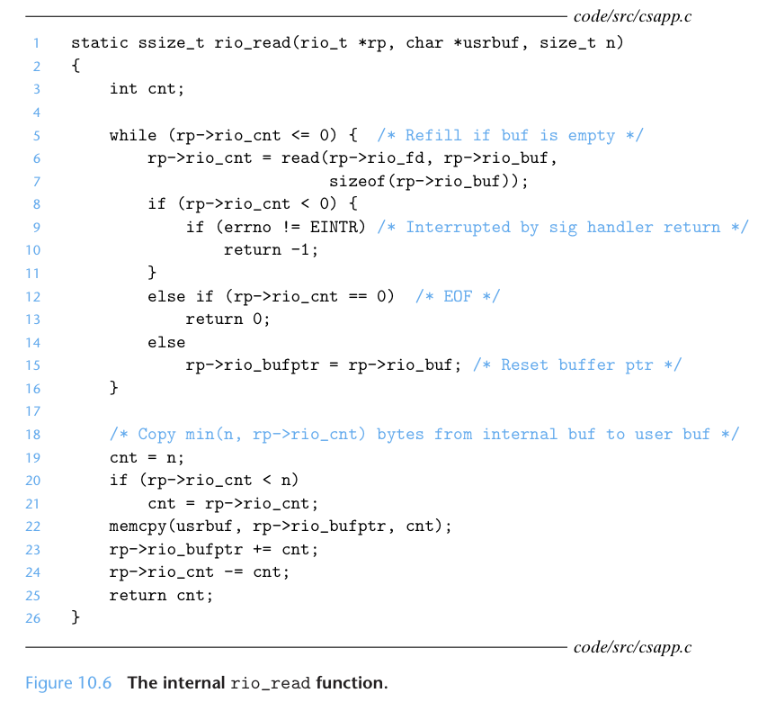
rio_read, a wrapper of read()
Ex: 16 bytes
read() syscall takes
Ex: 8 KB (8096 bytes)
Dealing
With
short counts
Copy 16 bytes
to caller’s usrbuf
Buffer
already read
unread
csapp.c
Notes:
Please read the book to understand what each line by line is doing here.

Slide 34
Another illustration
rio_read(rp, yourBuf, 1KB) from a 7 KB file
rp→buffer is 8 KB
1st 1KB
…
2nd 1KB
3rd 1KB
4
5
6
7
Savings: # rio_read() calls / # read() calls = ??
Savings if rio_read(1byte)??
read(8KB) syscall (retval = 7KB)
Memcpy to yourBuf
Notes:
Shortcount !! At 7 KB …. Does not return 8 KB
7x (but imagine, rio_read(1byte) → 7000x saving!)

Slide 35
Yet Another illustration
rio_read(rp, yourBuf, 1KB) on 7 KB file
rp→buffer is 3 KB
1
..
2
3
4
..
5
6
7
Savings: # rio_read() calls / # read() calls = ??
read(3 KB) syscall → get the first 3 KB
Buffer is all read!
read(3 KB) syscall → get the next 3 KB
Notes:
Savings: 7/3 = 2.3x

Slide 36
Buffered I/O: Implementation
For reading from file
File has associated buffer to hold bytes that have been read from file but not yet read by user code
Layered on Unix file:
rio_cnt
Buffer
already read
unread
rio_buf
rio_bufptr
short_count
Buffered Portion
not in buffer
already read
unread
unseen
Current File Position

Slide 37
Buffering in Standard I/O
Standard I/O functions use buffered I/O
Buffer flushed to output fd on “\n” or fflush() call
printf("h");
printf("e");
printf("l");
Other alternatives to open()/read()/write():
fopen(), fread(), fwrite()
See “man fopen”, etc
printf("l");
printf("o");
buf
printf("\n");
h
e
l
l
o
\n
.
.
fflush(stdout);
write(1, buf, 6);

Slide 38
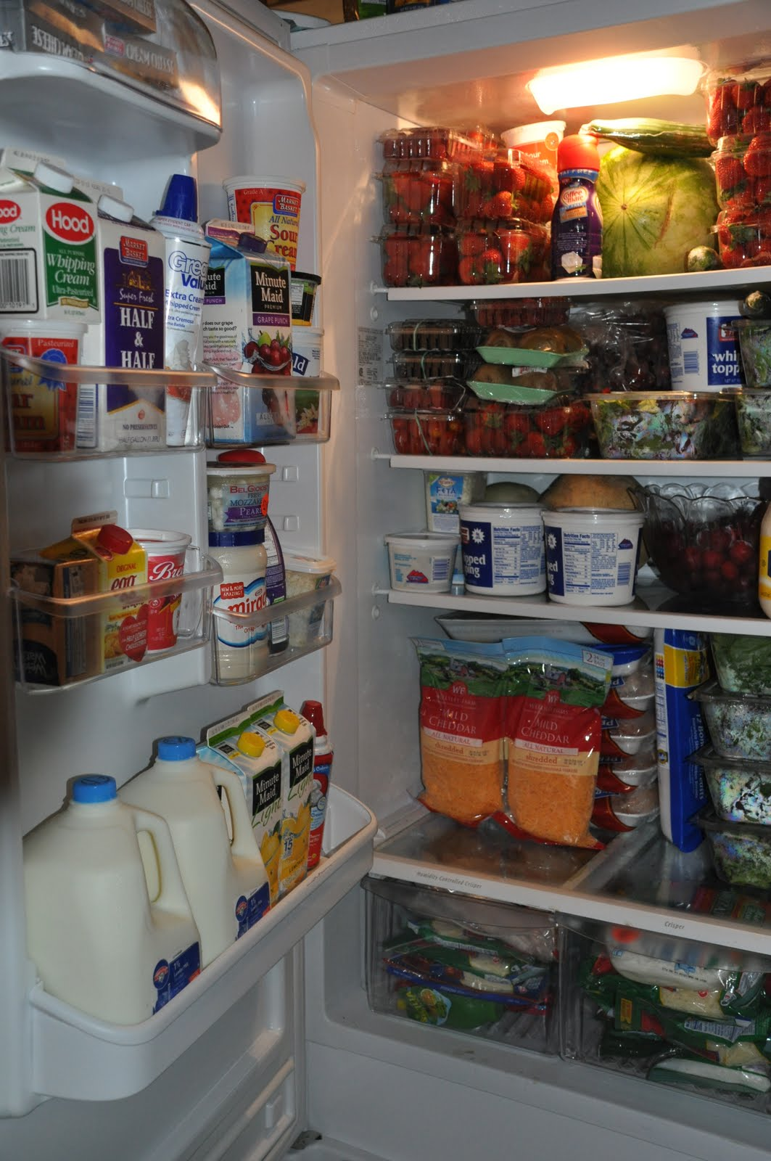
Buffering Summary
Prevalent topic!
High-performance computing, storage systems, networking, …
Reduce overhead cost
At what other cost?
(Nothing is perfect; all about tradeoffs)
Principle: trade X for Y
Trade space for performance
Space = memory is big (big buffer is fine)
Syscall = expensive
Real-life analogy?
If grocery near, buy small fridge (buffer)
If grocery far (expensive syscall), buy very large fridge (buffer)
Notes:
At what other cost?
Performance vs. code complexity …
Some extra buffer in memory.

Slide 39
Extra Slides

Slide 40
Unix files
A Unix file is a sequence of m bytes:
B₀ , B₁ , .... , B_{k} , .... , B_{m-1}
All I/O devices are represented as files:
/dev/sda2 (/usr disk partition)
/dev/tty2 (terminal)
On Linux: even the kernel is represented as a file:
/dev/kmem (kernel memory image)
/proc (kernel data structures)

Slide 41
Unix file types
Regular file
File containing user/app data (binary, text, whatever)
OS does not know anything about the format
other than “sequence of bytes”, akin to main memory
Directory file
A file that contains the names and locations of other files
Character-special and block-special files
Terminals (character special) and disks (block special)
FIFO (named pipe)
A file type used for inter-process communication
Socket
A file type used for network communication between processes

Slide 42
Buffered I/O: Motivation
Applications often read/write one character at a time
getc, putc, ungetc
gets, fgets
Read line of text on character at a time, stopping at newline
Implementing as Unix I/O calls expensive
read and write require Unix kernel calls
> 10,000 clock cycles
Solution: Buffered read (user/library implements this)
Use Unix read to grab block of bytes
User input functions take one byte at a time from buffer
Refill buffer when empty
Buffer
already read
unread
short_count

