Slide 1
Concurrent programming with
Processes and Threads
CMSC 15400: Introduction to Computer Systems
Sections 12.1-12.3
Instructor:
Haryadi Gunawi
Remind students to read Section 11.4 (socket interface) before Lecture “sy1”
Notes:
TIME: good, 2 minutes free

Slide 2
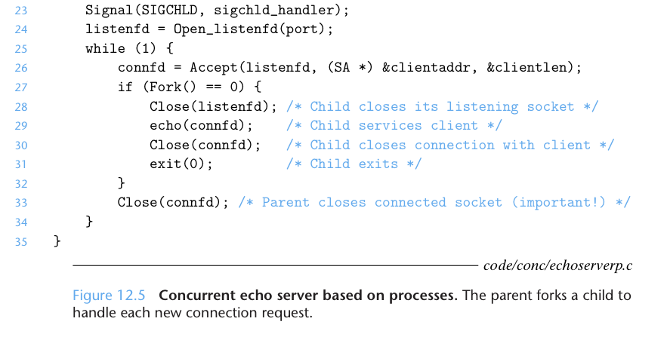
Webserver
Client 1
“hello”
echo() server
  Sending “hello” back
How to design?
  This lecture covers the details of the code below
Client 2
Webserver
Client …
“hello”
Creating “listenfd” for accepting a new connection (read the book)
Notes:
Explain what an echo is …

Slide 3
Two server implementations
With fork
// 1st approach:
// Without fork (simple!)
while(1) {
connfd = accept(listenfd, …);
echo(connfd); // write(connfd, “hello”, …)
close(connfd);
}
FDs are I/O handlers (disk or network)
Server: infinitely calls
  accept() syscall → accepts new connection, and then
  echo() → calls write()/send() syscalls to send data through the network
What is the difference? Why fork?
Notes:
Why fork? …. Echo if TCP is a blocking operation ……..

Slide 4
Approach 1: Without fork
Cannot serve other incoming requests!!
(while waiting for ACK)
P accept
P accept
P send echo, wait ACK … zzz …
time
ACK
Client
// 1st approach:
// Without fork (simple!)
while(1) {
connfd = accept(listenfd, …);
echo(connfd)
close(connfd);
}
P = Parent Process
Inside echo()
  Send a packet “hello” to the client via send/write() syscall
  Reliable delivery (wait for ACKnolwedgement)
    (Client can be far)

Slide 5
Approach 2: With Fork
P acc
P acc
P acc
C1
C2
C3
C1 echo (wait for ack …)
C2 echo (wait for ack …)
C3 echo (wait for ack …)
P = Parent process
C1..N = Child processes

Slide 6
Without vs. With fork
P accept
P acc
P echo (wait for ack) … zzz …
(e.g. 100 ms)
P-a
P-a
P-a
C1
C2
C3
C1 echo (wait for ack …)
C2 echo (wait for ack …)
C3 echo (wait for ack …)
With fork: more concurrency!
  (1) accept new connections while
  (2) serving (echo-ing) to prior clients

Slide 7
accept illustrated
connfd = accept(listenfd, …);
if (fork()==0) … echo(connfd)
listenfd(3)
Client
Server
1. Server waits inside accept, waiting for connection request on listening descriptor listenfd
Connection
request
listenfd(3)
2. A Client makes connection request by calling connect()
Client
Server
listenfd(3)
Client
Server
3. Server code receives a new connfd
connfd(4)
4. Server forks child to handle client.
Child will echo() to client via child’s connfd
Server
Client
Server
Child
5. And server closes the parent’s connfd
connfd(4)
Notes:
SKIP …….. FYI ONLY ….. !!!!

Slide 8
Concurrent connections
For new connection
listenfd
Server
Client 1
Server
Child
connfd
Client 2
Server
Child
connfd
Client 3
Server
Child
connfd
Per-child connfd for data transfer

Slide 9
Important details
Why does the Parent need to close(connfd)?
  Hint: memory leak
  How?
What if the Child does not close(listenfd)?
  (your HW)
Notes:
When there is a fork … two file descriptor table is created ….
How many file descriptor or open file structure is created? Just one !!!!!!
Reference count is taken
Memory leak …

Slide 10
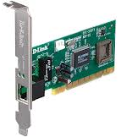
Case 1:
Open file table /
FD structures
[shared by all processes]
Descriptor table
[one table per process]
If parent forgets to close (connfd)
What will happen after thousands of new connections? …
Parent
listenfd=3
fd 0
fd 1
File pos
fd 2
fd 3
Refcnt=?
fd 4
...
Fd 5
Child
connfd=4 (John)
fd 0
echo
fd 1
Close(listenfd)
File pos
fd 2
exit
Refcnt=?
fd 3
fd 4
...
Child
connfd=5 (Sally)
fd 0
fd 1
fd 2
File pos
fd 3
Refcnt=?
fd 4
...
Fd 5
Notes:
- Runs out of file descriptor … memory leak ..

Slide 11
Case 1:
Memory leak!
  FD structures are not removed by the OS
    (even if the childrens already exit)
    Refcnt > 0
  Can’t accept new connections
    Process runs out of file descriptors
    Mac: 256 FDs/process
    Linux: 1024 FDs/process
Parent
listenfd
fd 0
fd 1
File pos
fd 2
fd 3
Refcnt=?
fd 4
...
Fd 5
connfd 4 (John)
File pos
Refcnt=?
...
connfd 5 (Sally)
File pos
Refcnt=?
...
Notes:
- Runs out of file descriptor … memory leak ..

Slide 12
The correct case
Parent only points to listenfd
  In this example, fd 4 is reused again and again
Each child points to its own connfd
  connfd=4
Parent
listenfd
fd 0
fd 1
File pos
fd 2
fd 3
Refcnt=1
fd 4
...
Fd 5
Child
Connfd (John)
fd 0
fd 1
File pos
fd 2
Refcnt=1
fd 3
fd 4
...
Child
Connfd (Sally)
fd 0
fd 1
fd 2
File pos
fd 3
Refcnt=1
fd 4
...
Fd 5

Slide 13
Cons of process-based concurrency
Listening Server Process
Sometimes
want to share
data
Client-1 Server Process
Typically
short-lived
Client 2 Server Process
– Additional overhead for creation of short-lived processes
(imagine millions of connections, process creations)
– Nontrivial to share data between processes
  Must require IPC (interprocess communication) mechanisms (last week)
Notes:
IMPORTANT

Slide 14
Ways to create concurrent flows
Allow server to handle multiple clients simultaneously
1. Processes
2. Threads
  (next)

Slide 15
Threads

Slide 16
Motivation
Concurrency
Multi-core/processor – parallelism
  Quad-core → 4 cores
  server: 64-128 cores per machine
How to exploit parallelism?
  A simple example: Count sum of a million numbers
// global array
Int arr[1000000];
for (int i=0…1000000) {
total += arr[i];
}

Slide 17
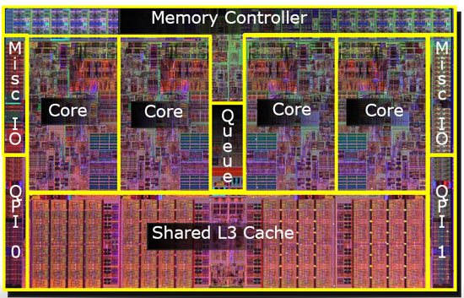
Exploiting Parallelism
…
Execution flow 1
T1= Total of arr
[0-250K)
Execution flow 2
T2 = Total of arr [250-500K)
Execution flow 3
T3 = Total of arr [500-750K)
Execution flow 4
T4 = Total of arr
[750-1000K)
All total = T1+ T2 + T3 + T4
4x faster!!

Slide 18
How???
Create multiple processes (e.g. 4 processes)
  Each process … for (250K count) T_{p} += arr[i]; …. (p = 1/2/3/4)
  How to write “alltotal = T1 + T2 + T3 + T4”?
    Each sub-total T1..4 is in each process’ address space
    No sharing!!, unless use IPC (too complex for a simple task)
  Goal of processes? ... (overkill for parallelism?)
Threads were invented
  Allow easy sharing (heap/global variables)
  Enable parallel executions within a process
Notes:
Goal of processes: abstraction and protection ………..

Slide 19

Thread Concept
Stack of thread 1
Stack of thread 2
A thread is a “lightweight process”
A process can spawn multiple threads
  A thread only belongs to a process
Sharing model:
  Threads in a process can share:
    Global variables
    Heap
    File descriptor table
    …
  Each thread has its own:
    Program counter
    Stack
    …
Heap
Code
Stack, PC, …
Heap
Data
Code
Stack, PC, …

Slide 20
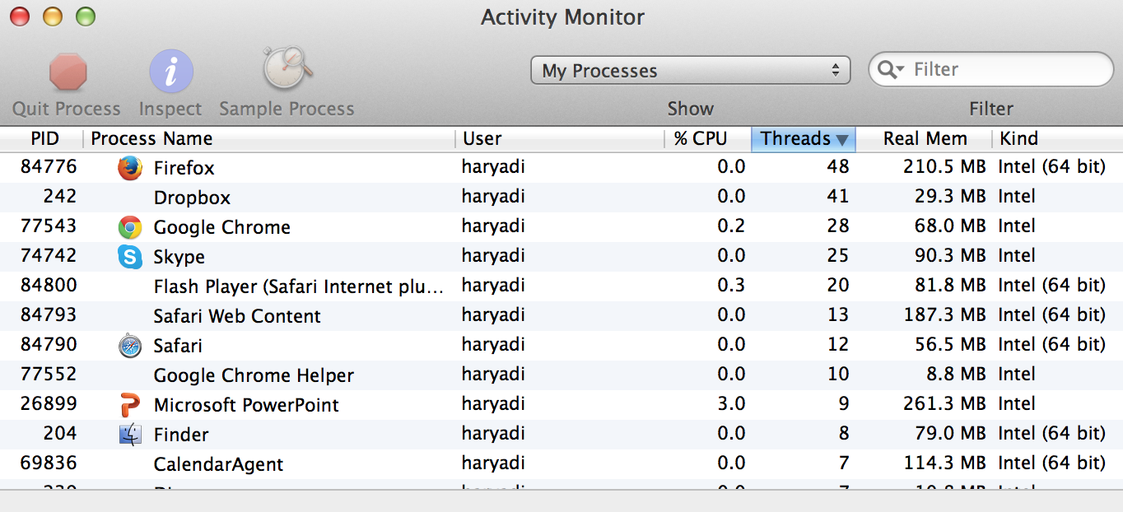
Threads are everywhere
…

Slide 21
Posix threads (Pthreads) interface
Pthreads: Standard interface for ~60 functions that manipulate threads from C programs
  Creating and reaping threads
    pthread_create()
    pthread_join() --- akin to wait()/waitpid()
  Determining your thread ID
    pthread_self()
  Terminating threads
    pthread_cancel()
    pthread_exit()
    exit() [terminates all threads] , RET [terminates current thread]
  Synchronizing access to shared variables (next lecture)
    pthread_mutex_init
    pthread_mutex_[un]lock
    pthread_cond_init
    pthread_cond_[timed]wait

Slide 22
The Pthreads "hello, world” program
The OS will return
the “tid”
wait until tid is done
Thread attributes
(usually NULL)
int main() {
pthread_t tid;
pthread_create(&tid, NULL, hellofunc, NULL);
printf(“MAIN-T”);
pthread_join(tid, NULL);
exit(0);
}
Thread arguments
(void *p)
The thread’s “main()”
(starting) function
/* thread routine */
void *hellofunc(void *vargp) {
printf(”HELLO!");
return NULL;
}
Notes:
Notice that, unlike the Unix wait function, the pthread_join function can only wait for a specific thread to terminate. There is no way to instruct pthread_ wait to wait for an arbitrary thread to terminate. This can complicate our code by forcing us to use other, less intuitive mechanisms to detect process termination. Indeed, Stevens argues convincingly that this is a bug in the specification [109].

Slide 23
Execution of threaded “hello, world”
main thread
pthread_create()
returns
peer thread
“sibling”
printf(“MAIN-T”)
printf(“HELLO”)
pthread_join()
return;
Wait …
(peer thread
terminates)
Returns (from join())
exit()
Any thread who calls
exit() will terminate
the entire process
(including all its running threads)
pthread_exit() != exit()
If we have two cores, both will run in parallel
(e.g. main thread in core1, peer thread in core2)
If we have one core, threads are scheduled just like process scheduling

Slide 24
Concurrency (another example)
pthread_create(tid2)
pthread_create(tid1)
printf(“HELLO¹”)
printf(“HELLO²”)
pthread_exit()
pthread_exit()
pthread_join(tid1)
printf(“MAIN-T”)
All possible outputs on the screen?
- HELLO² HELLO¹ MAIN-T (exit)
- HELLO¹ HELLO² MAIN-T (exit)
- HELLO¹ MAIN-T HELLO² (exit)
- HELLO¹ MAIN-T (exit) -- (no HELLO² , too late)
exit()

Slide 25
Memory view
A process address space
  main thread,
  peer thread
Each thread has its own
  PC
  Stack and SP
2^{n}-1
Main’s stack
Peer’s stack
Heap
Code
Main() {…}
Hello() {…}
main thread’s PC
peer thread’s PC
0

Slide 26
The Total example [READ OFFLINE]
int arr[1000000];
int subtotal[4+1];
int alltotal;
int main() {
pthread_create(…, runsub, 1);
pthread_create(…, runsub, 2);
pthread_create(…, runsub, 3);
pthread_create(…, runsub, 4);
pthread_join(…, NULL); // 4x
alltotal =
subtotal[1] + … + subtotal[4];
}
Global vars
in data seg
/* thread routine */
void *runsub(void *vargp) {
int portion = (int)vargp;
int begin = beginPortion(portion);
int end = endPortion(portion);
// 1 → [0-250K)
// 2 → [250K-500K)
// …
for (i=begin..end)
subtotal[portion] += arr[i];
…
}
All threads can directly access
the same “subtotal” and “arr”
global variables
Advantage? Fast! Easy Sharing!
  (sharing via heap: arr, subtotal, alltotal)
Notes:
More complex !!!!!

Slide 27
Threads vs. processes [READ OFFLINE]
How threads and processes are similar
  Each has its own logical control flow
  Each can run concurrently with others
    possibly on different CPU cores (or taking turn on using the CPU)
How threads and processes are different
  Threads: Easy sharing of code, data, heap
  Thread creation/deletion are less expensive than processes
    Why? No create/delete process address space

Slide 28
Webserver (echo) with threads

Slide 29
Thread-based concurrent echo server
int listenfd = open_listenfd(port);
int *connfdp;
while (1) {
*connfdp = malloc(sizeof(int));
*connfdp = accept(listenfd,(SA *) &clientaddr, &clientlen);
pthread_create(&tid, NULL, echo_thread, connfdp);
// no longer fork()
}
  Spawn new thread for each client
  Pass “connfd” to the peer threads with connfdp
Notes:
Why do we use Malloc?
-- To avoid use of stack
We will discuss the passing of pointer of connfdp soon

Slide 30
Threaded execution model
1 Process
Connection Requests
Listening Server Thread
Client 1 data
Client-1 Server Thread
Client 2 data
Client-2 Server Thread
Multiple threads within single process
Some state between them
  File descriptor table

Slide 31
Passing an Argument
Pass by reference (pointer to connfd in main’s stack)
Three ways to pass “connfd” argument to echo_thread
int connfd; // in main’s stack
while (1) {
connfd = accept(listenfd, …;
pthread_create(…, &connfd); // ref
}
void *echo_thread(void *vargp) {
int connfd = *(vargp);
...
}
int *connfdp;
while(1) { // in heap
*connfdp = malloc(sizeof(int));
*connfdp = accept(listenfd, …);
pthread_create(…, connfdp);
}
void *echo_thread(void *vargp) {
int connfd = *(vargp);
...
// must free(vargp) later
}
Pass by reference (to heap), must free() later
int connfd; // in main’s stack
while(1) {
connfd = accept(listenfd, …);
pthread_create(…, connfd); // val
}
void *echo_thread(void *vargp) {
int connfd = (int)(vargp);
...
}
Pass by value
Notes:
Time: 00:05
(go slow, 15 minutes left)

Slide 32
Case 1 (the lucky run)
int connfd; // in mt’s stack
while (1) {
connfd = accept(listenfd, …);
pthread_create(…, &connfd);
}
void *echo_thread(void *vargp) {
int connfd = *(vargp);
...
}
main thread
Main thread stack
connfd=4
Connfd=5
connfd = 4 (john)
peer₁
Peer₁ stack
connfd = *vargp
vargp
connfd = 4
Connfd = 4
connfd = 5 (sally)

Slide 33
Case 1 (the unlucky run)
int connfd;
while (1) {
connfd = accept(listenfd, …);
pthread_create(…, &connfd);
}
void *echo_thread(void *vargp) {
int connfd = *(vargp);
...
}
main thread
Main thread stack
connfd=4
connfd = 4 (john)
Connfd=5
(thread+stack created, but
just about to run echo_thread)
Peer₁ stack
(John’s)
connfd = 5 (sally)
Peer₁ (for John)
vargp
Data race!
connfd = *vargp
Connfd = ??
connfd = ???
sendMySSN(connfd)
Who sees whose?

Slide 34
Race condition
Outcome is non-deterministic
  Sometimes is right, sometimes is wrong
  (depends on arbitrary scheduling decisions)
Could lead to a severe implication
  In the previous example, the server send a wrong data to someone else
Notes:
Implication: Sally (connfd 5) will see John’s password … the webserver returns data that belongs to Gordon’s data

Slide 35
Passing connfd
int* connfdp
Int *connfdp;
while(1) {
*connfdp = malloc(sizeof(int));
*connfdp = accept(listenfd, …);
pthread_create(…, connfdp);
}
Pass pointer to heap
t1’s vargp
t2’s vargp
void *echo_thread(void *vargp) {
int connfd = *(vargp);
…
heap
(next one)
5
4
int connfd;
while(1) {
connfd = accept(listenfd, …);
pthread_create(…, connfd);
}
Pass by value
void *echo_thread(void *vargp) {
int connfd = (int)(vargp);
…
Connfd=..
t1’s vargp=4
Two correct ways
  Make sure each thread gets an argument exclusive for itself
  i.e. don’t the same memory location
  Which one is more powerful?
t2’s vargp=5
Notes:
The 2nd approach is limited because only pass an integer.
Passing by pointer is more powerful.

Slide 36
Pros and cons of thread-based designs
+ Easy to share data structures between threads
  e.g., logging information, file cache.
+ Threads are more efficient than processes.
– Unintentional sharing can introduce subtle and hard-to-
reproduce errors!
  Hard to know which data shared & which private
  Hard to detect by testing
    Probability of bad race outcome very low
    But nonzero!
  More in next lecture

Slide 37
Extra

Slide 38
Summary: Approaches to concurrency
Processes
  Hard to share resources: Easy to avoid unintended sharing
  High overhead in adding/removing clients
Threads
  Easy to share resources: Perhaps too easy
  Medium overhead
  Not much control over scheduling policies
  Difficult to debug
    Event orderings not repeatable
I/O Multiplexing
  Tedious and low level
  Total control over scheduling
  Very low overhead
  Cannot create as fine grained a level of concurrency
  Does not make use of multi-core

Slide 39
Yet another view
Logical view of threads
Threads associated with process form a pool of peers
Unlike processes which form a tree hierarchy
Threads associated with process foo
Process hierarchy
T2
P0
T4
T1
P1
shared code, data
and kernel context
sh
sh
sh
T5
T3
foo
bar

Slide 40
Traditional view of a process (DETAILS)
Process = process context + code, data, and stack
Process context
Code, data, and stack
Program context:
Data registers
Condition codes
Stack pointer (SP)
Program counter (PC)
Kernel context:
VM structures
Descriptor table
brk pointer
stack
SP
shared libraries
brk
run-time heap
read/write data
PC
read-only code/data
0

Slide 41
Alternate view of a process (DETAILS)
Process = thread + code, data, and kernel context
Thread (main thread)
Code and Data
shared libraries
SP
stack
brk
run-time heap
Thread context:
Data registers
Condition codes
Stack pointer (SP)
Program counter (PC)
read/write data
PC
read-only code/data
0
Kernel context:
VM structures
Descriptor table
brk pointer

Slide 42
A process with multiple threads (DETAIL)
Multiple threads can be associated with a process
  Each thread has its own logical control flow
  Each thread shares the same code, data, and kernel context
    Share common virtual address space (including stacks)
  Each thread has its own thread id (TID)
Thread 1 (main thread)
Shared code and data
Thread 2 (peer thread)
shared libraries
stack 1
stack 2
run-time heap
Thread 1 context:
Data registers
Condition codes
SP1
PC1
read/write data
Thread 2 context:
Data registers
Condition codes
SP2
PC2
read-only code/data
0
Kernel context:
VM structures
Descriptor table
brk pointer

Slide 43
Issues with thread-based servers
Must run “detached” to avoid memory leak.
  At any point in time, a thread is either joinable or detached.
  Joinable thread can be reaped and killed by other threads.
    must be reaped (with pthread_join) to free memory resources.
  Detached thread cannot be reaped or killed by other threads.
    resources are automatically reaped on termination.
  Default state is joinable.
    use pthread_detach(pthread_self()) to make detached
Must be careful to avoid unintended sharing.
  For example, passing pointer to main thread’s stack, as in
  Pthread_create(&tid, NULL, thread, (void *)&connfd);
All functions called by a thread must be thread-safe
  Stay tuned

Slide 44
Thread-based concurrent server (DETAIL)
/* thread routine */
void *echo_thread(void *vargp)
{
int connfd = *((int *)vargp);
pthread_detach(pthread_self());
free(vargp);
echo(connfd);
Close(connfd);
return NULL;
}
  Run thread in “detached” mode
    Runs independently of other threads (cannot be terminated)
    Reaped when it terminates: no need for explicit “join”
  Free storage allocated to hold clientfd
    “Producer-Consumer” model

Slide 45
Thread execution
Single-core processor
Simulate concurrency by time slicing
Dual-core processor
Can have true concurrency
Thread A
Thread B
Thread C
Thread A
Thread B
Thread C
Time
Run 3 threads on 2 cores

Slide 46
Logical concurrency
Two threads are (logically) concurrent if their flows overlap in time
Otherwise, they are sequential
Examples:
  Concurrent: A & B, A&C
  Sequential: B & C
Thread A
Thread B
Thread C
Time

