Slide 1
Active Learning
Prof. Diana Franklin

Slide 2
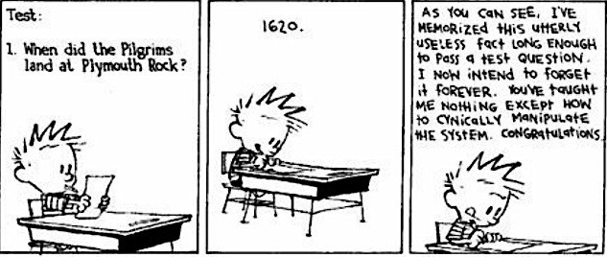
Passive Learning

Slide 3
Sage on the Stage

Slide 4
Active Learning
Really thinking about it (analyzing, synthesizing, evaluating) rather than passive (listening) or memorizing
Results in new knowledge
Students do not spontaneously engage in active learning – activities need to be structured to encourage it.

Slide 5
Constructivism vs Active Learning
Constructivism is a theory of what happens in brain
Construct understanding and knowledge through experiencing things and reflecting on them
Implies teaching strategies like active learning
Still applies to passive learning
Requires reflecting beyond active learning

Slide 6
Constructivism vs Active Learning
Active Learning is a teaching strategy
Find ways to engage students in their learning
Give them opportunities to construct their own knowledge
On their own through structured tasks
In groups through discussions or structured tasks

Slide 7
Developing Scenarios - Jigsaw
Get into groups of 2-3
Count off up to 12
Take one activity genre and find where you think it could have been applied to 152
Find 2 examples

Slide 8
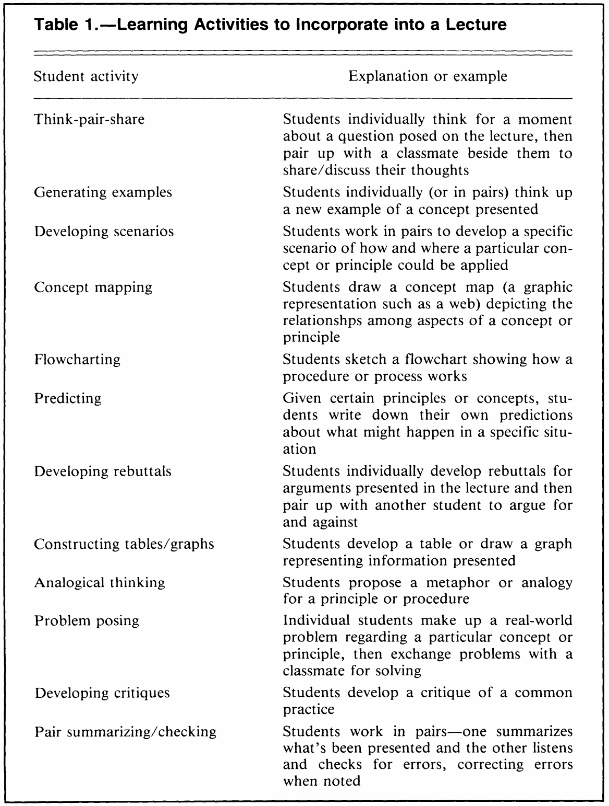
Active Learning Types
Applications in CS 152
(C, data structures)
Generate 2 examples

Slide 9
Guided Reciprocal Peer Questioning
Share your educational stories about active learning in lecture with your group with respect to active learning: 6 min
Focus on the structure of active learning activities
Individual activities
Group activities
What has worked well?
What has not worked well?
Each person generates two or three thought-provoking questions about the material: 5 min
Discuss those questions & identify any questions for class discussion: 5 min
Turn in your questions & answers (I will give them back next class)

Slide 10
Generic Questions
What are the strengths and weaknesses of…
How does … affect … ?
Explain how … helped you learn.

Slide 11
Active Learning Discussion
What were the most effective active learning techniques you learned about?
What made those techniques successful?

