Slide 1
The builder pattern
Hannah Kim

Slide 2
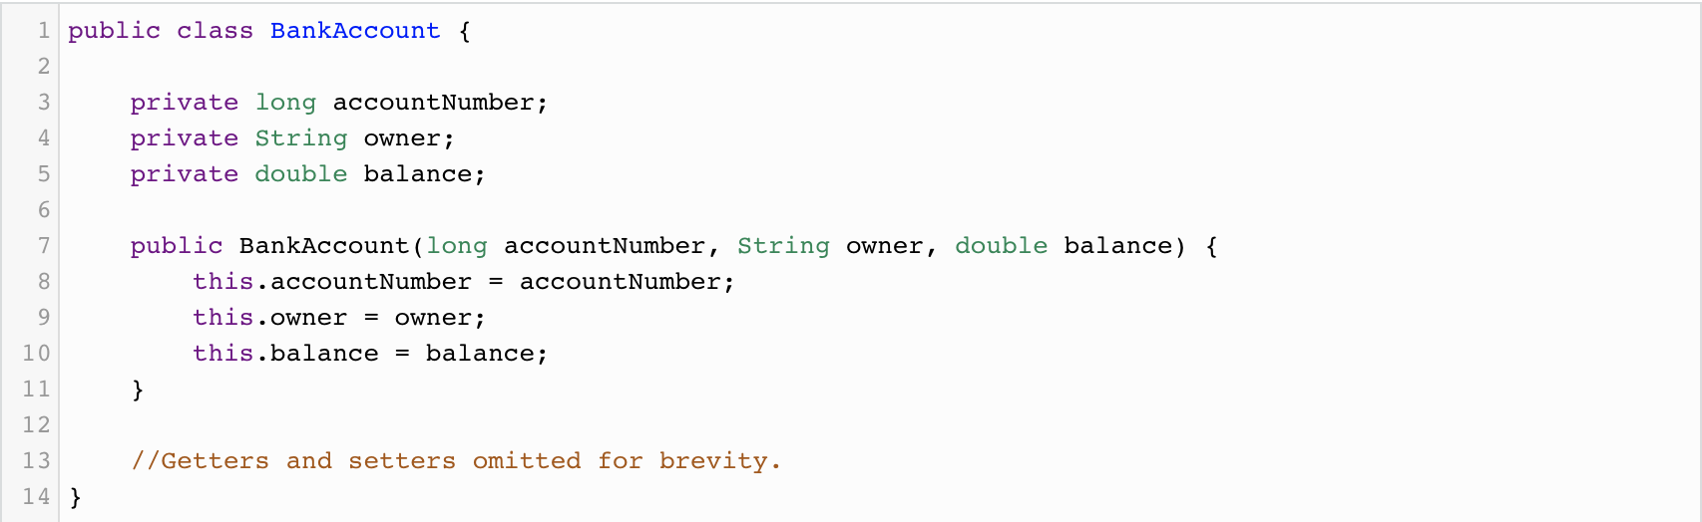
Example 1

Slide 3
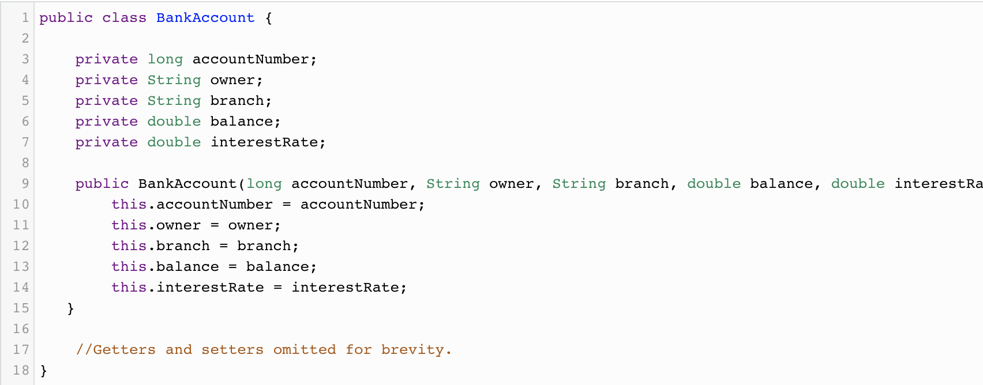

Slide 4
Problems We need to solve
Too many constructor arguments
Incorrect object state
To solve these problems… we need the Builder pattern!

Slide 5
The builder pattern
“The Builder pattern allows us to write readable, understandable code to set up complex objects. The builder will contain all of the fields that exist on the BankAccout class itself. We will configure all of the fields that we want on the builder, and then we’ll use the builder to create accounts."

Slide 6
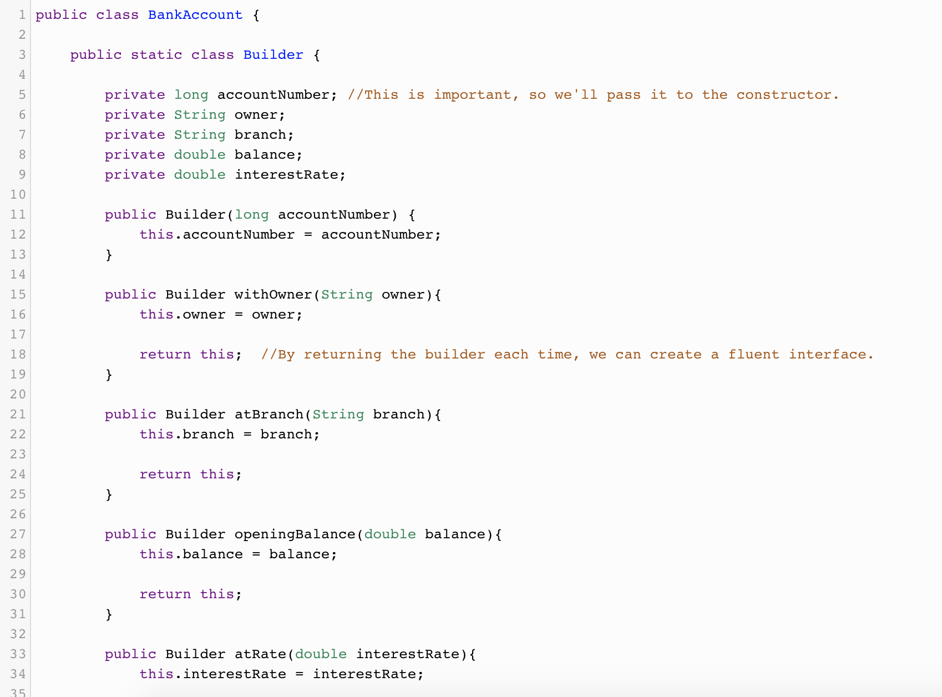

Slide 7
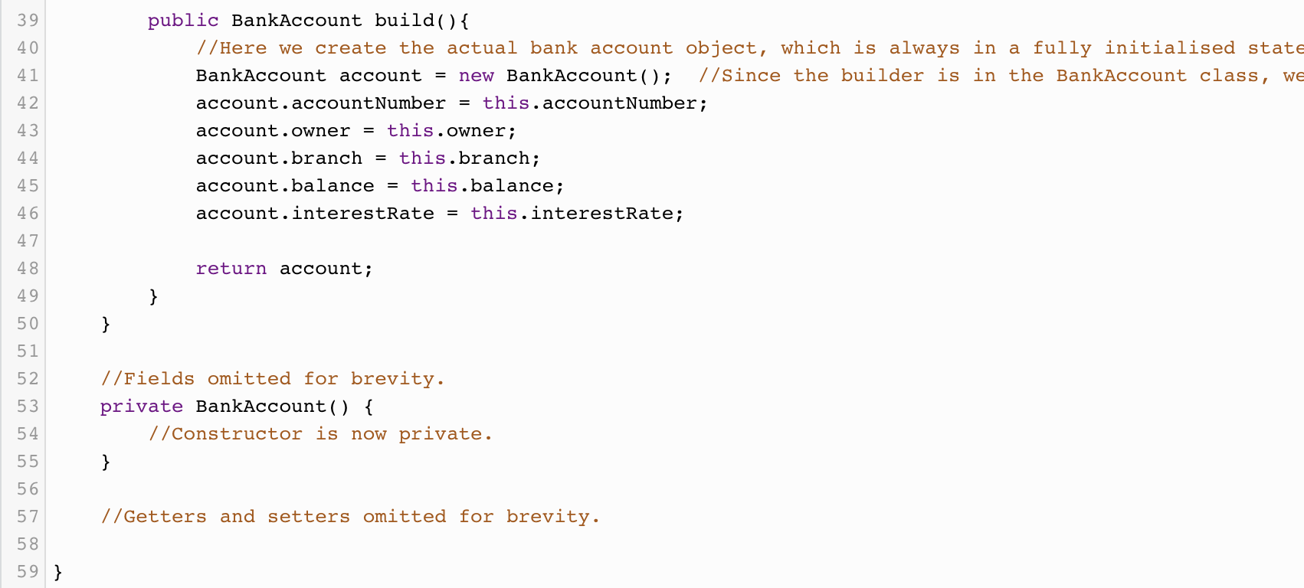

Slide 8
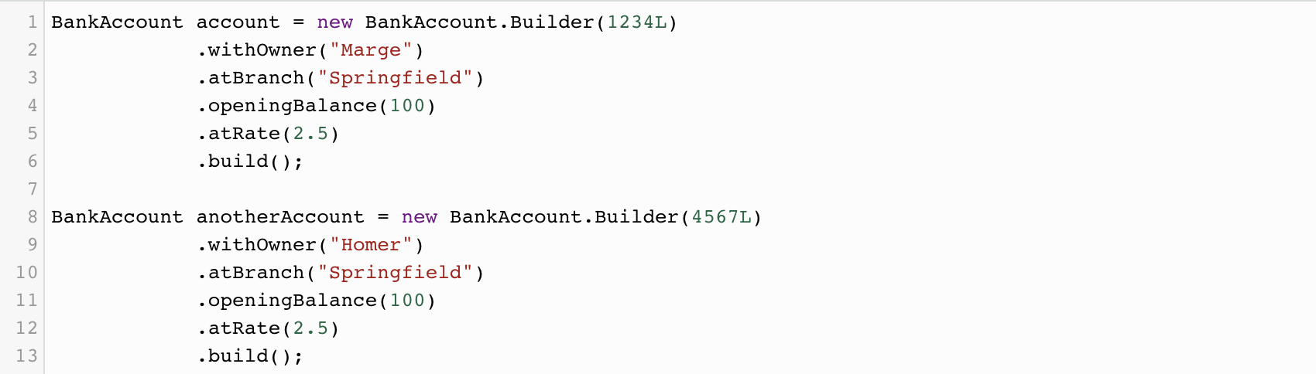

Slide 9
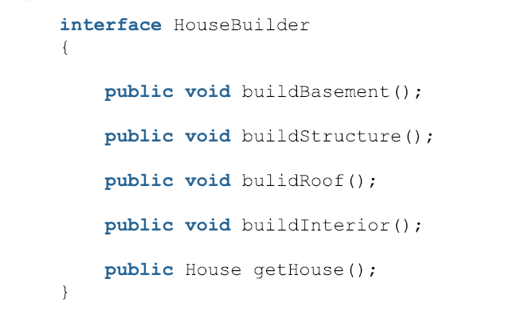
Example 2

Slide 10
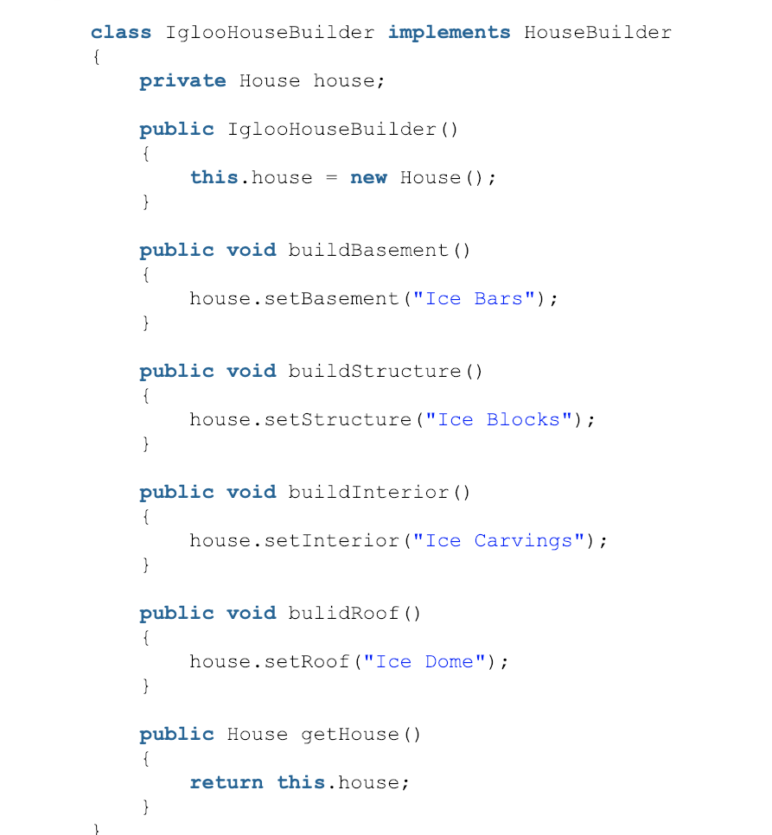
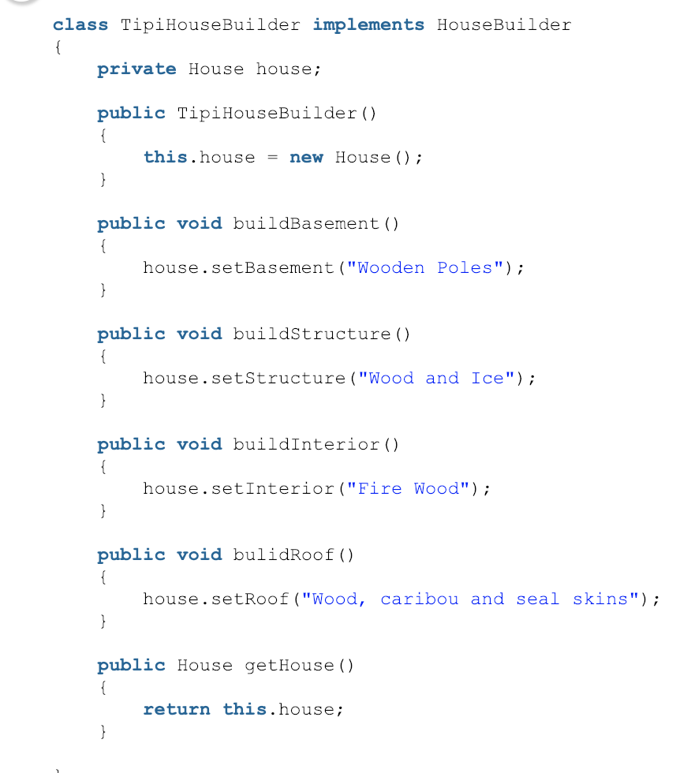

Slide 11
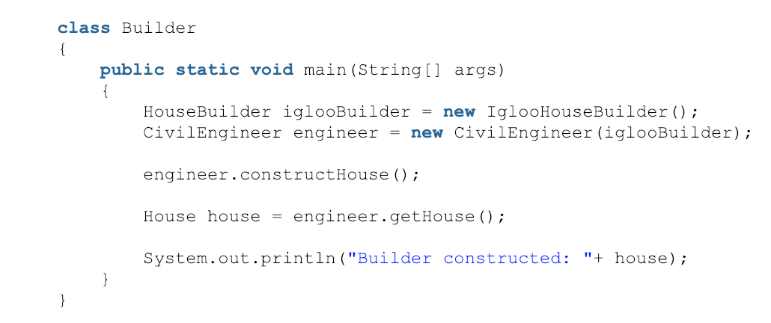

Slide 12
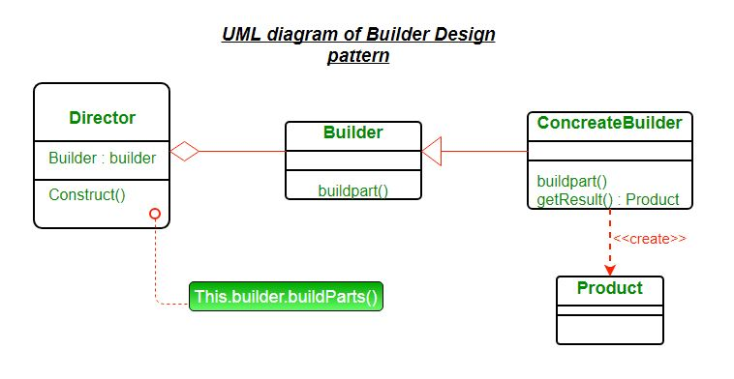

Slide 13
Advantages of using builder pattern
Builder pattern is used to construct a complex object step by step and the final step will return the object. The process of constructing an object should be generic so that it can be used to create different representations of the same object.
The parameters to the constructor are reduced and are provided in highly readable method calls.
Object is always instantiated in a complete state
Immutable objects can be build without much complex logic in object building process.

Slide 14
sources
https://dzone.com/articles/design-patterns-the-builder-pattern
https://www.geeksforgeeks.org/builder-design-pattern/

