Slide 1
Observer Pattern
By Rachel Whaley
Winter 2019

Slide 2


Pattern Definition
“Define a one-to-many dependency between objects so that when one object changes state, all its dependents are notified and updated automatically.” Gamma et al.
A podcaster publishes a new episode and the listeners receives a notification that a new episode is available
Subject Observer
1
Notes:
Two classes are involved

Slide 3
When To Use This Pattern
Used when some objects need to be notified when a specific object changes its state
Used when a change to one object necessitates changing its dependent objects (could be many or few; could be various types)
Used in layered software, when an object of a lower level needs to communicate upward

Slide 4
Why Use This Pattern
The observer pattern:
Allows you to vary/reuse subjects and observers separately (loosely coupled)
Add observers easily without modifying the subject
Supports broadcast-style communication (publish/subscribe)

Slide 5
Participants in Pattern
Subject knows its observers and has an interface for registering and unregistering Observers
Concrete Subject stores the state the Concrete Observers are observing, sends notification to observers when its state changes
Observer has interface for updating objects that should be notified of changes in the Subject
Concrete Observer holds reference to Concrete Subject object, stores state that needs updating, and implements the Observer-updating interface to keep state consistent with Subject
Additional consideration is which way to trigger the update notification (push/pull)
Notes:
Who triggers update? Two options:
Subjects call Notify after they change the state (clients get every single update, which might be inefficient/unnecessary)
Clients call Notify at the appropriate time (client can avoid unneeded intermediate updates)

Slide 6
Example
A science teacher teaches her students about space by tracking the International Space Station as it orbits the Earth
Subject is the International Space Station
The state of the Subject that the Observers are interested in is its location
Observer is the science teacher
Could be many science teachers
Could include other types of observers: stargazing enthusiasts, aliens, etc.

Slide 7
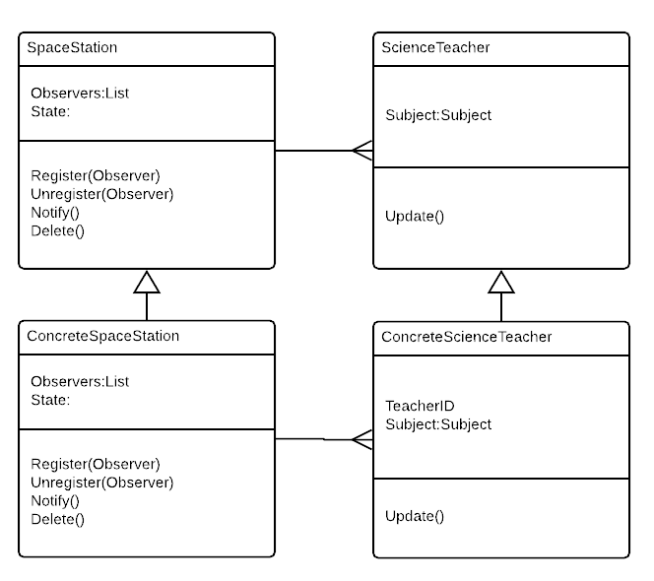
UML Diagram

Slide 8
Demo
www.pythonanywhere.com

Slide 9
Sources
Design Patterns, Gamma, et. al.
Domain-Driven Design: Tackling Complexity in the Heart of Software, Eric Evans
https://www.oodesign.com/observer-pattern.html
http://open-notify.org/Open-Notify-API/ISS-Location-Now/
https://geopy.readthedocs.io/en/latest/
https://docs.python.org/3/library/abc.html

