Slide 1
Memory Management OSTEP Book (See Schedule Page) http://pages.cs.wisc.edu/~remzi/OSTEP/ Chapter 12-16 Address Spaces, Memory API, Address Translation, Segmentation
Instructors:
Haryadi Gunawi
Notes:
Perfect timing.
Last couple of slides are summary slides only, so it’s fine if we skip that.

Slide 2
Intro to Memory Management/Virtual Memory Uniprogramming

Slide 3
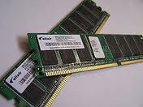
Why Study Memory Management
Code and Data location
Open Excel
Where’s excel code in memory
Function(int A, int B) {…}
Where’s A, B?
Where’s the stack?
int *P = malloc(1000);
Where’s P?
Where’s the heap?
Resource management
Sharing: How memory is shared across many processes

Slide 4
C Pointer Primer
int x = 7; (32b / 4B)
int *p = & x;
int y = (int) p;
int **pp = 0x4500;
Print:
x = ?, &x = ?
*p = ?, p = ?
*y = ?, y = ?
pp = ?, *pp = ?, **pp = ?, &pp?
x
7
0x4000
7
p
0x4000
0x4500
0x4000
y
0x4000
0x5000
0x4000
0x4500
0x5500
0x4500
pp
Notes:
7, 0x4000
7, 4000
7, 4000
4500, 4000, 7, & 5500

Slide 5
Process State: Process Address Space (A Simple View)
void f() { int arr [1000];
printf (“%08x ", arr);
f();
}
Infinite recursive program
What will grow? Stack/heap?
High to low? Or low to high?
Run infinite malloc
What will grow? Stack/heap?
High to low? Or low to high?
while(true) { int *p = malloc(4000);
printf( " %08x \n", p);
}
Stack
2^{n}-1
Heap
Code
Logical address
0

Slide 6
Process Address space
1st run (a process)
@ CSIL (linux3)
variable localVar is at 7ee960a4
variable heapVar is at 0141e010
variable globalVar is at 00601050
function main is at 004005c6
(run address.c)
#include <stdio.h>
#include <stdlib.h>
int globalVar = 10;
int main()
{
int localVar;
int *heapVar = malloc(4);
printf("\n variable localVar is at %08x \n", & localVar);
printf("\n variable heapVar is at %08x \n", heapVar);
printf("\n variable globalVar is at %08x \n", & globalVar);
printf("\n function main is at %08x \n", main);
return 0;
}
Another run (a different process):
variable localVar is at …
variable heapVar is at …
variable globalVar is at 00601050
function main is at 004005c6

Slide 7
Virtual memory
Wikipedia.org: http://en.wikipedia.org/wiki/Virtual_memory
In computing, virtual memory is a memory management technique that is implemented using both hardware and software. It maps memory addresses used by a program, called virtual addresses, into physical addresses in computer memory. Main storage as seen by a process or task appears as a contiguous address space or collection of contiguous segments. The operating system manages virtual address spaces and the assignment of real memory to virtual memory. Address translation hardware in the CPU, often referred to as a memory management unit or MMU, automatically translates virtual addresses to physical addresses.
Notes:
Don’t read this (too long), just read the hightlighted areas.

Slide 8
Process Address Space
Memory
invisible to
user code
Stack
Runtime stack (8MB limit)
E. g., local variables
Heap
Dynamically allocated storage
When call malloc(), calloc(), new()
Data
Statically allocated data
E.g., arrays & strings declared in code
Text/Code
Executable machine instructions
Read-only
Kernel virtual memory
0xc0000000
User stack
(created at runtime)
%esp
(stack
pointer)
Memory-mapped region for
shared libraries
0x40000000
brk
Run-time heap
(created by malloc)
Read/write segment
(.data, .bss)
Loaded
from
the
executable
file
Read-only segment
(.init, .text, .rodata)
0x08048000
Unused
0

Slide 9
Process Address Space
This is enough …
Note:
Each process address range starts at 0 to 2^{n}-1
This is virtual/logical address (not physical address)
Stack
2^{n}-1
Heap (malloc)
Data (global vars)
Code
0

Slide 10
Compiler
Compiler generates virtual addresses
Objdump –d hello
00000000004004f4 <main>:
4004f4: 55 push %rbp
4004f5: 48 89 e5 mov %rsp,%rbp
4004f8: bf fc 05 40 00 mov $0x4005fc,%edi
4004fd: e8 ee fe ff ff callq 4003f0 <puts@plt>
400502: b8 00 00 00 00 mov $0x0,%eax
400507: 5d pop %rbp
400508: c3 retq
400509: 90 nop
40050a: 90 nop
40050b: 90 nop
40050c: 90 nop
40050d: 90 nop
40050e: 90 nop
40050f: 90 nop

Slide 11
Where are they in memory?
Scattered
They don’t have to be in contiguous location
Thus, there must be an indirection (address translation)
CPU: store R1 Mem[0xBFFDD00] → store R1 Mem[0x28924500]
CPU uses with virtual/logical addresses for user programs
2^{n}-1
OS
Stack of 44
Heap of 44
Stack of 44
Code of 44
0
Heap of 44
Logical addr:
0xBFFFDD00
Physical addr:
0x28924500
2^{n}-1
Stack of 55
Stack of 55
Heap of 55
Code of 44
Code of 55
0
Code of 55
This is roughly what today’s OS support,
but let’s travel back in time in the next 2 lectures to see how we get here.
Heap of 55
Notes:
(Can skip for now, we will talk about this again in the future)

Slide 12
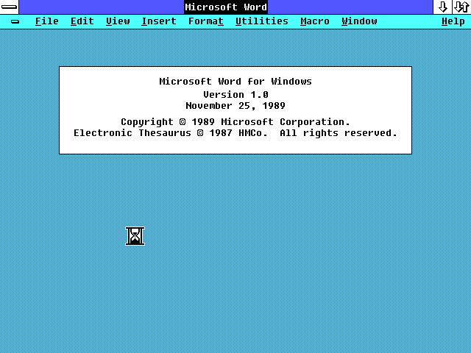
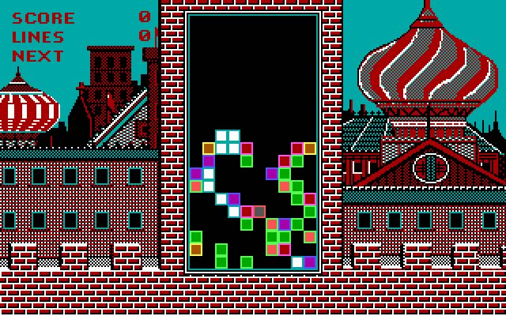
Uniprogramming
Uniprogramming: Only one process runs (or exists) at a time
Process address space: Memory size – OS size
Ex: 2 GB – 1 GB = 1 GB
Directly access physical memory
Access memory using its actual address
int *p = 0x05001000;
*p = 7 → mov $7 mem[0x05001000]
Physical Memory
Address Space
1 GB
OS
Stack
User Process
1 GB
0x05001000
Heap
0
Code

Slide 13
.
Uniprogramming disadvantages:
P1 code:
int *p = 0xC4531000;
*p = 0;
What happens here? …
Process P1
0xC4531000
OS
Stack
User Process
1 GB
Heap
0x0
Code

Slide 14
Dynamic Relocation (Base and Bound)
Today: OS supports multiprogramming standard
One simple solution: dynamic relocation (base and bound)

Slide 15
Dynamic Relocation (BB: Base and Bound)
OS
Goals:
Multiple processes (multiprogramming) resident at the same time
(even with 1 CPU)
Each address space may be placed anywhere in memory
Protect processes from one another
Transparent:
The OS hides the physical addresses so that the process doesn’t have to worry about what’s going on in the memory
Process 3
Process 2
Process 1

Slide 16
Dynamic Relocation (BB: Base and Bound)
OS
Process 3
Process uses logical/virtual address space
(“%08x”, pointer);
will print a virtual address
jmp 0x0600
jump to a virtual address
Base and Bound
P1’s base: 0x5000, bound:0x1000
P2’s base: 0x6000, bound:0x1000
Physical
Address:
0x6000
Process 2
Process 1
0x5000
Logical
Addr:
0x1000
Stack
Process
1
Heap
Code
0

Slide 17
BB: How it works
The OS assigns to each process a base and a bound
Stored in Process Control Block (PCB), maintained by the OS
Base: start location for the process’ address space in physical memory
Bound: size limit of address space
Example (bound=1000): P1 (5000-6000), P2 (2000-3000), P3 (7000-8000)
Virtual
Addresses
Physical
Addresses:
P1 bound
OS
Process 1
P3 base + bound
0
P2 bound
P3 base = 7000
Process 2
P1 base + bound
Process 1
0
P1 base = 5000
Process 2
P2 base + bound
P3 bound
Process 3
P2 base = 2000
Process 3
0
0

Slide 18
BB (view of a process)
Logical View
Physical View
Bound
Physical
Addresses:
P1’s Stack
(e.g, 3 MB)
P1’s Stack
Base + Bound
(unused)
Virtual
Addresses
(unused)
P1’s Heap
(e.g., 2 MB)
P1’s Heap
Code
(e.g., 1 MB)
Code
(e.g. Excel)
0
Base
0

Slide 19
Base and Bound (Disadvantages)
Fixed-size address space for each process
Must allocate relatively big stack and heap (e.g. 10 MB)
Ex: give 10 MB for “Hello World” program?
Can we predict memory usage?
How much memory a process needs? Not known a priori
Small processes get big memory (waste!) → internal fragmentation
Address space must be allocated contiguously
Cannot break address space!!
OS
Stack
e.g.
10 MB
Process 3
Heap
Code

Slide 20
Base and Bound (Disadvantages)
Processes can have different bounds
Over time, as hundreds of processes come and go, we have …
Lots of unusable holes (external fragmentation)
If lots of small holes, we may not be able to load new process
Hard to relocate processes from one part of memory to other part of the memory (must reshuffle)
OS
Process 4
Where??
Process 3
Process 2
Process 1

Slide 21
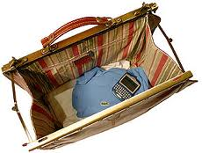
Analogies
Which one is internal fragmentation?
Which one is external fragmentation?
All “space (disk/memory) managements” must face these two issues
OS memory management (this class)
malloc() library (P5)
Java Garbage Collector → (no pointer, yeah!!, but “stop-the-world” GC)
Disk space management

Slide 22
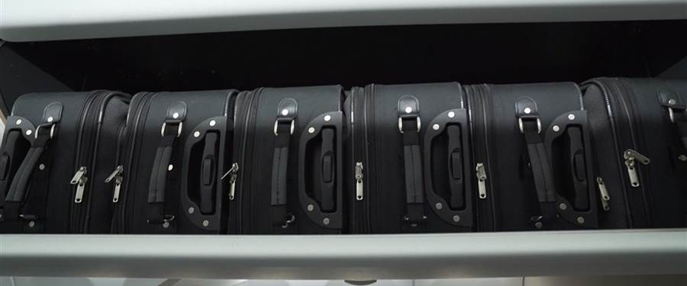
Internal vs. External Fragmentation
Process A
Just FYI, fast forward, today …
Memory is broken up into fixed-size pages
A passenger can only bring small fixed-size luggages
i.e., a process breaks its address space to many pages
No external fragmentation, a little bit internal fragmentation
Mechanisms: multi-level page tables + TLB (in CSAPP, Chapter 9)
cs154: (1) uniprogramming, (2) dynamic relocation/BB, (3) segmentation
cs230: (4) page table, (5) multi-level page-tables, (6) + TLB

Slide 23
BB: How it works
Need address translation
P1:
var = 7
CPU: mov $7 mem[100]
Mem[100] → physical memory [5100], who translates?
Requires hardware support: Memory Management Unit (MMU)
An MMU for every CPU
Physical
Addresses:
Virtual
Addresses
P1 base + bound
P1 bound
Process 1
MMU
Process 1
P1 base = 5000
mem[100] var=7
0

Slide 24
Memory Management Unit (MMU)
Translates virtual to physical addresses
Done on every memory reference by the CPU
For BB, MMU contains two registers: Base and Bound
OS sets the base and bound registers of the currently running process
Example: CPU is running Process 1
P1’s base is 5000
Must be done correctly during context switching
(More step-by-step examples when we discuss segmentation)
mov $7, mem[100]
Process 1 is running
CPU
MMU
(base=…)
(bound=…)
Memory
5000
Logical
address
Physical
address

Slide 25
MMU (BB) Translation Algorithm
Physical address = logical address + base
If (logical address > bound) SEGFAULT exception
CPU jumps to OS segfault_exception_handler();
Ex: a naïve hacker
char*p = 0xC0004000
strcpy(p, “hahaha!”)
mov “hahaha!” mem[0xC0004000]
Mov $7, mem[100]
5000+100
Mem[5100]
CPU
MMU
(base=…)
(bound=…)
Memory
Physical address
Logical address

Slide 26
Example
What are the physical addresses for the following 16-bit logical addresses?
Process 1: base: 0x4320, bound: 0x2220
CPU is accessing mem[…] below
0x 0100: 4320 + 100 = 0x4420
0x 1110: …
0x 3000: …
Process 2: base: 0x8540, bound: 0x3330
0x 0000: 8540
0x 1110: 9650
0x 3000: …
Notes:
P1: 4320 + 1110 = 5430
P1: 4320 + 3000 = 7320 (out of bound 3000 > 2220) → ERROR! (Other process’ address space protected)
P2: (3000 < 3330) 8540 + 3330 = B540

Slide 27
Context switching
OS
space
Mem[5100]=88
P1.pcb {
eax=???
ebx, etc.….
base=5000;
bound=…;
}
CPU:
MMU:
Running P1
Read Mem[100]
to eax (eax=???)
base=5000
Mem[???]
P2.pcb {
eax=777;
ebx, etc.….
base=2000;
bound=….;
}
Physical
Addresses:
Timer interrupt (10ms) –
must save P1’s context to P1’s PCB!!
Running OS
Mem[0xC001]
Base=X
Mem[???]
(reschedule processes, give CPU to P2)
must load P2’s context from P2’s PCB!!
eax = ???
Process 1
P1 base = 5000
Process 2
Running P2
eax→Mem[200]→???
Base=???
P2 base = 2000
Mem[???]
0
Physical
Addresses:

Slide 28
BB Disadvantages
OS
Process 1
Process 3
Process 2
Process 1
Process 3
Process 2
3 users open 10 MB Excel software, where’s the code segments? How much memory needed?
...
…
How about 50 users?

Slide 29
BB Advantages [Read offline, if no time]
Provides memory protection
(via virtual address)
Supports dynamic relocation
Easy relocation / move address spaces
Move P2? Simply change P2’s base and bound in P2’s PCB
Simple, inexpensive implementation
Two registers, little logic in MMU
OS sets the two registers on kernel-to-user mode switching
P1 bound
OS
Process 1
Process 3
0
Process 2
Process 1
P1 base
Process 3
Process 2

Slide 30
BB Disadvantages
OS
OS
Stack
Process 3
e.g.
10 MB
Process 3
Process 1
Heap
Process 2
Code
What’s the “bound” of your process?
Hard to know; must overestimate for safety → Internal fragmentation
Each process must be allocated contiguously in physical memory
Processes come and go → external fragmentation (memory holes)
Yes, address space can be relocated dynamically, but …
Relocation → memory reshuffling, processes must freeze!
(related story: Java garbage collection)
Small process needs to expand, but neighboring address is full
Inflexible to expand, must relocate processes

Slide 31
Hexadecimal Primer ( for next time, do it at home)
Hex Bits
0x0 0000
0x1 0001
0x2 0010
0x3 0011
0x4 0100
0x5 0101
0x6 0110
0x7 0111
Hex Bits
0x8 ?
0x9 ?
0xA ?
0xB ?
0xC ?
0xD ?
0xE ?
0xF ?
0x07 + 0x0C = ??

Slide 32
END

