Slide 1
Course Overview
CMSC 15400: Introduction to Computer Systems
1st Lecture
Reading: Chapter 1
Instructors:
Prof. Haryadi S. Gunawi
Prof. Junchen Jiang
Prof. Yanjing Li

Slide 2
What is a Computer System?

Slide 3
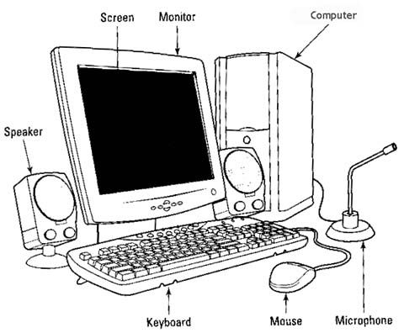
What is a Computer System?
20 years ago…

Slide 4
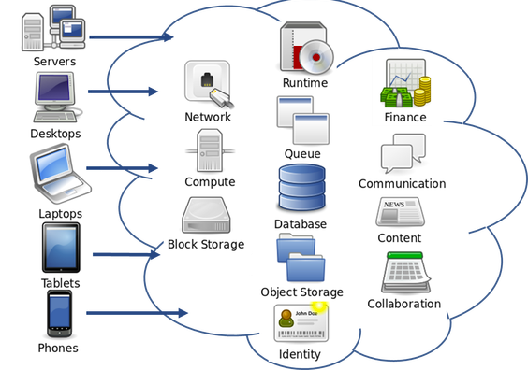
What is a Computer System?
Now
Picture from
https://icochat.wordpress.com/2018/01/08/whitepaper-analysis-titanium-blockchain-infrastructure-services/

Slide 5
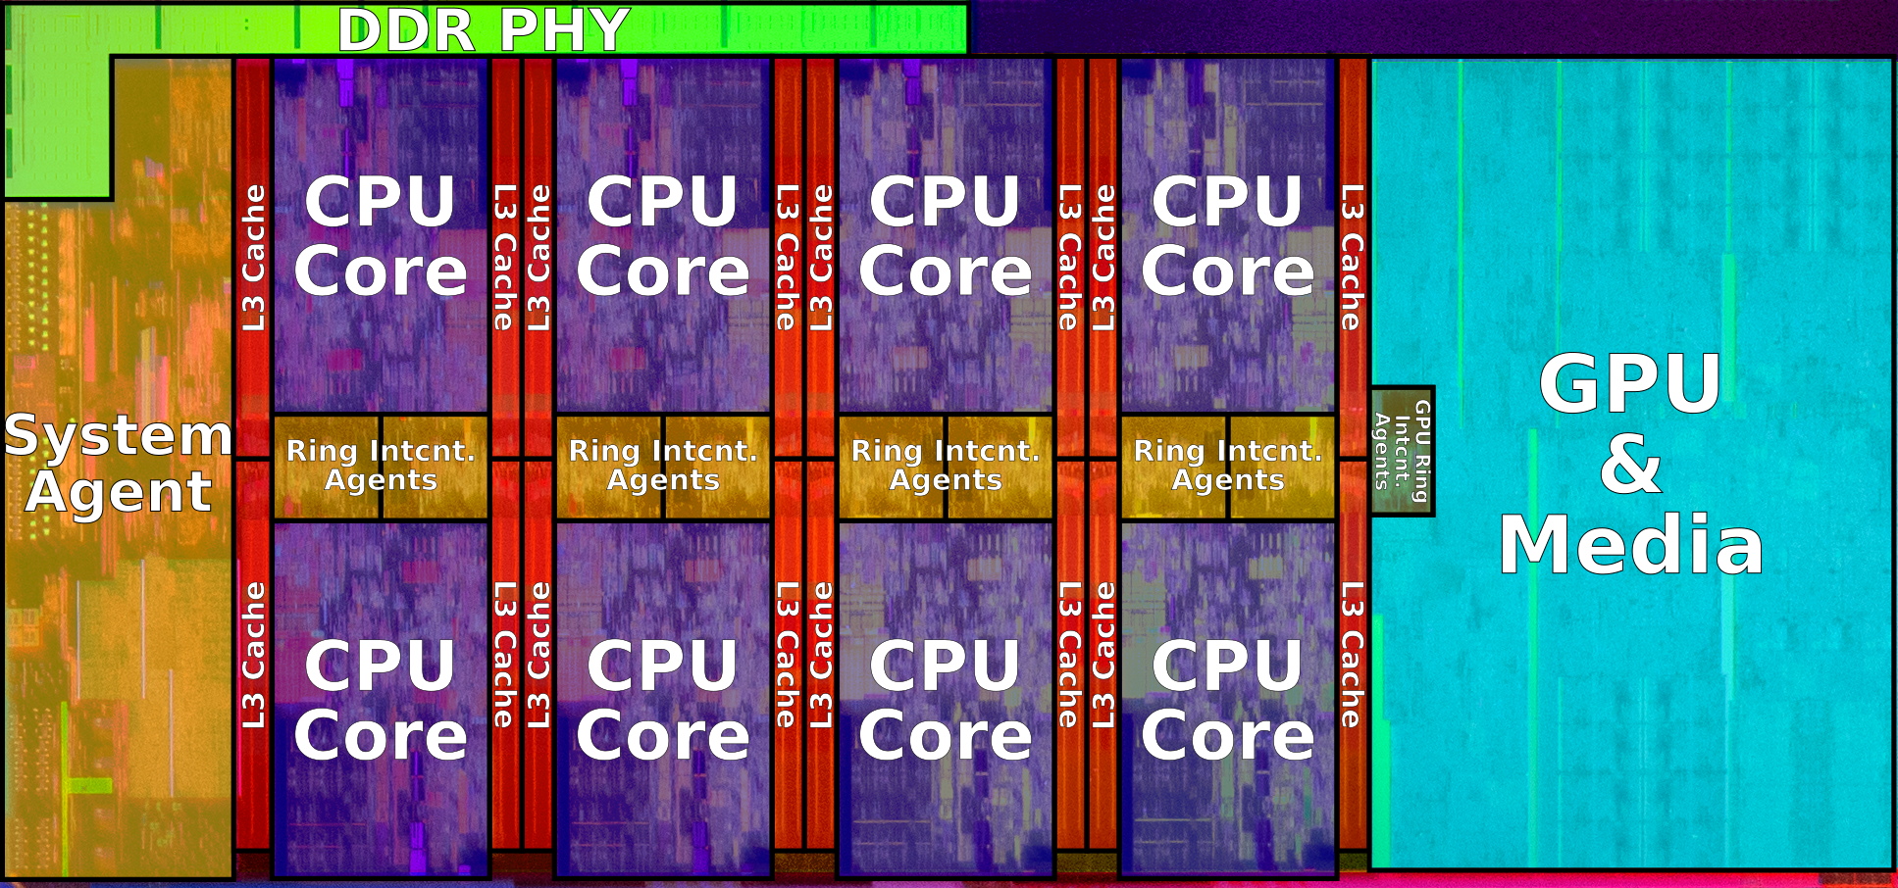
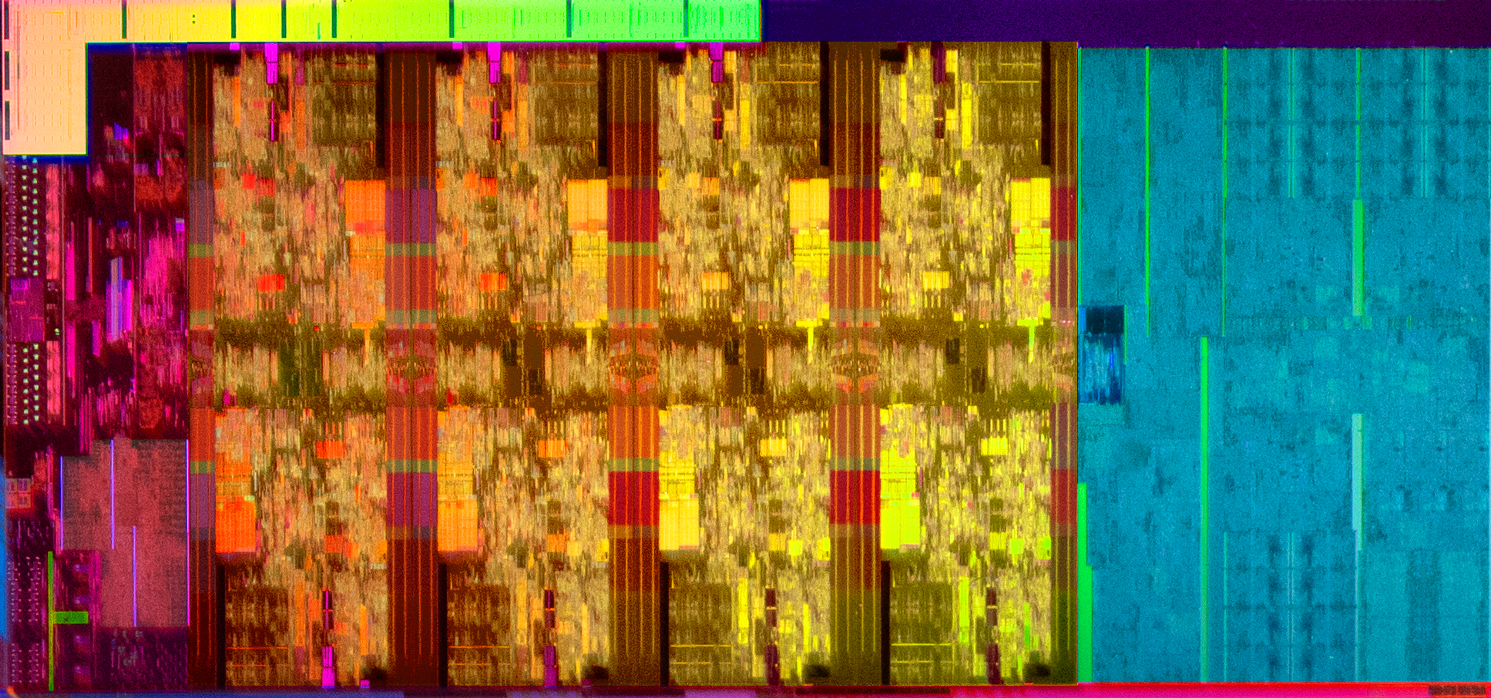
A Modern Computer System (the Chip)
3 Billion Transistors
Intel Coffee Lake (2019) - 14 nm++ process, 11 metal layers, ~174 mm² die size
8 CPU cores

Slide 6
What is a Computer System?
Software Application

Slide 7
What is a Computer System?
Application
Physics
Notes:
Bridging Abstractions!

Slide 8
What is a Computer System?
Application
Gap too large to
bridge in one step
Physics
Notes:
Bridging Abstractions!

Slide 9
What is a Computer System?
Application
In its broadest definition, a computer system is a series of
abstraction/implementation layers
that allow us to execute/process
applications
efficiently using manufacturing
technologies
Gap too large to
bridge in one step
Physics
Notes:
Bridging Abstractions!

Slide 10
Abstractions in Modern
Computing Systems
Application
Algorithm
Programming Language
Operating System/Virtual Machines
Instruction Set Architecture
Microarchitecture
Register-Transfer Level
Gates
Circuits
Devices
Physics
Notes:
Bridging Abstractions!

Slide 11
Abstractions in Modern
Computing Systems
Application
Algorithm
Programming Language
Operating System/Virtual Machines
Instruction Set Architecture
This class
Microarchitecture
Register-Transfer Level
Gates
Circuits
Devices
Physics
Notes:
Bridging Abstractions!

Slide 12
Overview
Application
Algorithm
Programming Language
Operating System/Virtual Machines
Instruction Set Architecture
Interfaces for controlling hardware
“Architecture”
Defines what is possible in software
(e.g. int, float, matrix, add, sub, move)
Instruction Set Architecture
Microarchitecture
Register-Transfer Level
Register-Transfer Level
Gates
Circuits
Devices
Physics
Notes:
Bridging Abstractions!

Slide 13
Overview
Application
Algorithm
Programming Language
Operating System/Virtual Machines
Instruction Set Architecture
Microarchitecture
Microarchitecture
The ISA implementation. Key to performance, efficiency, and recently security challenges (e.g., Meltdown and Spectre)
Register-Transfer Level
Register-Transfer Level
Gates
Circuits
Devices
Physics
Notes:
Bridging Abstractions!

Slide 14
Overview
More and more layers and abstractions in each layer
(cs 2xx series)
Application
Algorithm
Programming Language
Operating System/Virtual Machines
Instruction Set Architecture
Microarchitecture
Register-Transfer Level
Register-Transfer Level
Operating System
Interfaces for controlling and coordinating the use of hardware among various applications and users
Gates
Circuits
Devices
Physics
Notes:
Bridging Abstractions!

Slide 15
Goal of the Class
Give you the basis to understand how the OS, Architecture, and Microarchitecture affect the programmer
The book is an excellent technical reference
  Not great for big picture
Lectures ...
  designed to tie the technical content of book, homeworks, labs, and projects to big picture impact on computer systems

Slide 16
What will you learn?
Let’s see student evaluation.
“Understanding how computers work. Prior to this it was pretty much magic to me.”
“It was basically all of the things that I wanted to know about how computers work but was too afraid to ask.”
“I feel more comfortable talking about computers and how they work as not just a programmer but also a computer scientist”
“SO MUCH TECHNICAL KNOWLEDGE, AHH - I KNOW MORE ABOUT THE INNER WORKINGS OF COMPUTERS THAN I EVER WANTED ...”

Slide 17
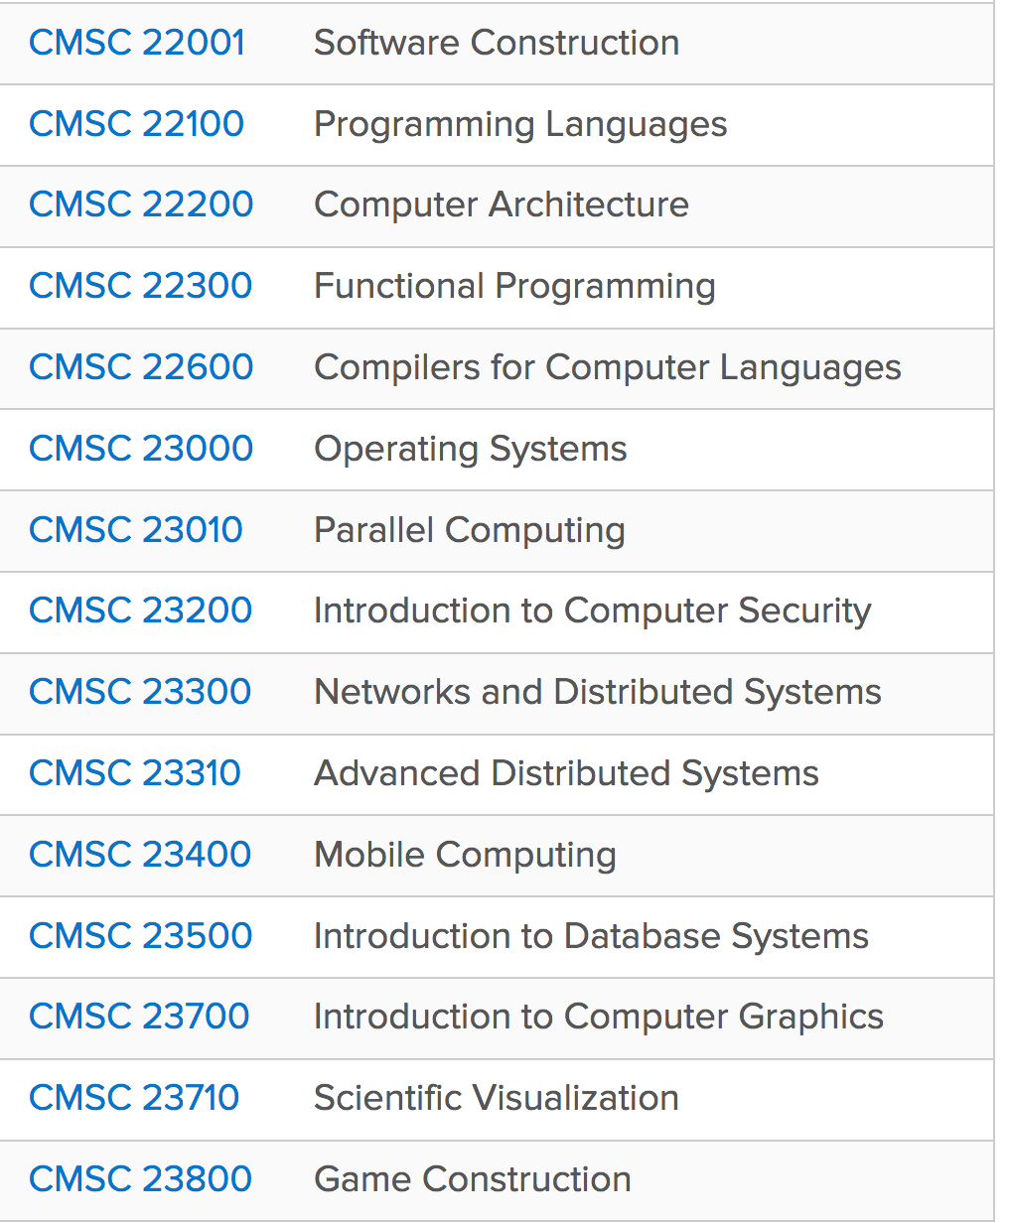
“SO MUCH TECHNICAL KNOWLEDGE, AHH - ...
... BUT IT ONLY GETS DEEPER FROM HERE.”
154 is the last gateway to all other systems classes
  http://collegecatalog.uchicago.edu/thecollege/computerscience/

Slide 18
Overview
Course Theme and Roadmap
Logistics
Getting help

Slide 19
154 Site
Website:
  Just google “cs154uchicago”, “or 154 chicago”
  Just find the google site link
  https://sites.google.com/site/cs154uchicago/
READ THE FAQs (A Must!)
  https://sites.google.com/site/cs154uchicago/main/course-faqs
Four most important links at the top
  Calendar/schedule
  Homeworks
  Projects
  Office Hours
  (and Piazza, implicitly)

Slide 20
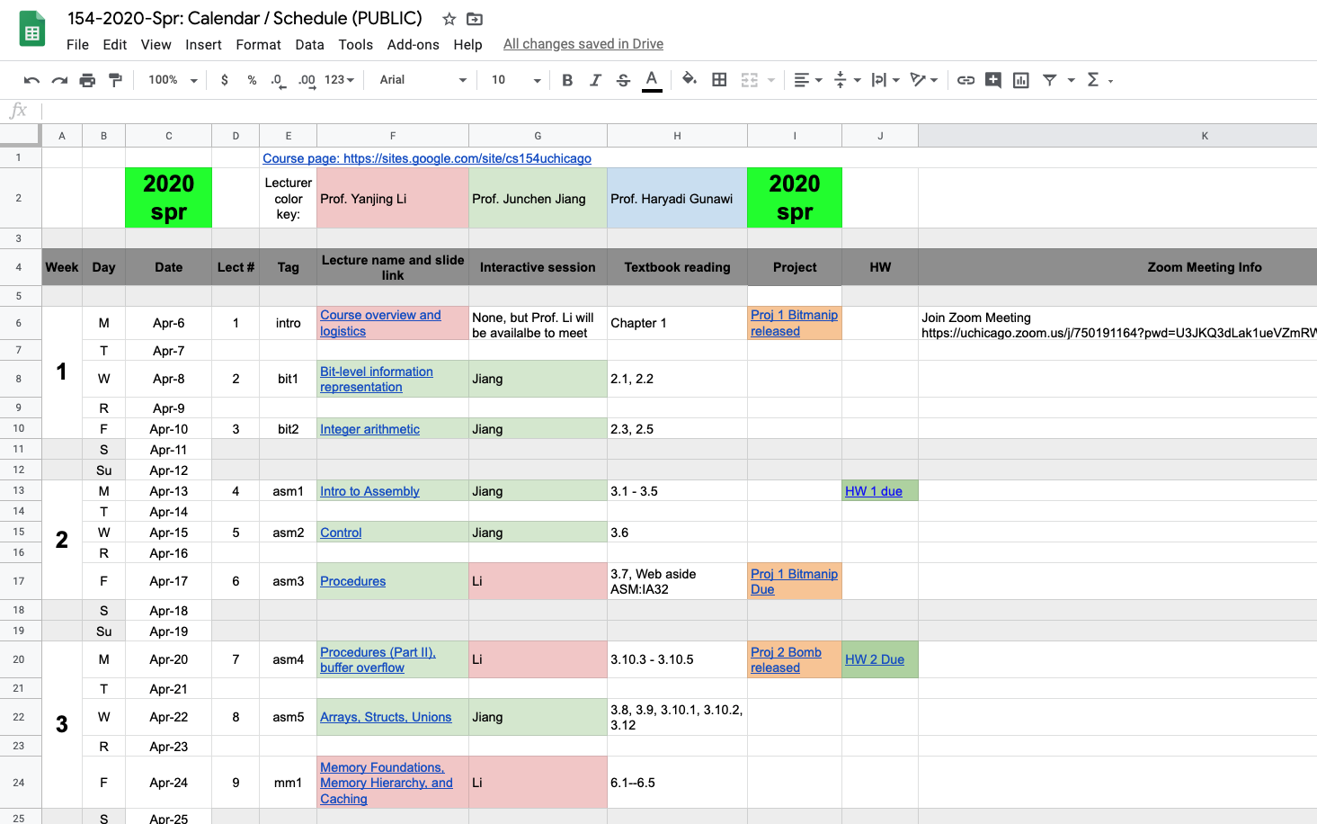
Calendar: Bookmark this link
Bookmark the link
Check each column
  Due dates, reading list,
Lecture Tags
  bit
  asm
  mm
  os
  mem
  sync

Slide 21
Projects
4 Projects
  Bit manipulation, defusing bombs (asm), cache, your shell,
  No project partnership
Great way to enhance your understanding of computer systems
Also makes you a better programmer

Slide 22
Labs
Labs are helpful for projects
You could use lab hours to work on projects as well
  TAs will be online

Slide 23
Homeworks
9 homeworks
Will remove the worst HW score (top-8 out of 9)
Due every Monday 11:59pm, Uchicago time
  One exception this quarter due to Memorial day; due on Wed. instead
Please read instructions carefully!! Word by word.
  How to hand in, format file name, always run “svn status”, …

Slide 24
Exams
2 Exams
  Exam I: covers first half of the course (Lectures 2-10)
  Exam II: covers second half of the course (lectures 13-22)
  Not cumulative
Taking exam remotely – details TBD

Slide 25
Overview
Course Theme and Roadmap
Logistics
Getting help

Slide 26
Help
I need help (HWs, projects, etc.), where should I go?
  Piazza
    We guarantee a fast response (30 min average response time)
    If not, re-post – we actively monitor this
    TAG your post properly (e.g., “hw1”, “p1”)
  Office hours (Virtual)
    10 hours/week for homeworks
    40+ hours/week for projects
Do NOT send emails to individual
faculty/TAs
  (unless necessary)
Vertical division of TA duties
TA | Duties
1. Kuntai | Proj 1
2. Dan | Proj 2
3. Meng | Proj 3
4. Zhengxu | Proj 4
5. Yuhao | Tech support
6. Mingzhe | Homeworks

Slide 27
Help, Help, Help!!! ... START EARLY
“Deadline is less than 24 hr, but I’m not getting enough help.”
  We’ll try our best, but … please start early!
  We cannot help 180+ students who start late
How to ask for help?
  Use Details -- “it doesn’t work” vs “I tried X, but got Y, then tried Z …”
  Help us help you -- svn commit code so far, so we can check it out
  Keep trying -- we will try to put you on the right path
  [Note: no feedback after projects submitted]
    The best way to get feedback is in office hours

Slide 28
What to do?
if (projects / homeworks / technology problems)
Piazza or TA’s virtual office hours
else if (lectures / exams)
Piazza or interactive lecture sessions or
contact instructors (private Piazza or email)
else
// life, inspiration, issues with class
Contact instructors (private Piazza or email)

Slide 29
Academic misconduct
Well … don’t cheat!
We run a very smart code comparator tool
  We’ve discovered code duplications before [almost every year!]
Involve department and university level, and potentially a Fail
  Don’t ruin your good reputation
Start early, go to office hours

Slide 30
Special Accommodation Requests
https://disabilities.uchicago.edu.
  links up for Spring-2020 specific accommodation requests
We follow recommendations and guidelines from SDS

Slide 31
Remote Teaching
All information can be found on the course FAQ page:
https://sites.google.com/site/cs154uchicago/main/course-faqs
These plans are subject to change.

Slide 32
How is 154 Different from a Normal Quarter?
Reduced workload to mitigate remote learning challenges
3 less lectures (21 vs. 24)
1 less project (4 vs. 5), less work for some projects, and more time per project
  Deadlines are firm unless you obtain special exceptions which will be granted due to extenuating circumstances
Exams… (TBD)

Slide 33
What Remains Unchanged?
You will still learn all core computer systems knowledge as promised, and be well-prepared for more advanced systems courses
We are always very generous in terms of final grades
  Only less than 5% get Cs in the past
  No problem to give all As if everyone deserves it

Slide 34
Lectures
Lectures are pre-recorded and uploaded to Canvas
  We will post lecture videos one day before the scheduled lecture time
Interactive sessions using Zoom during scheduled lecture times
  Mainly driven by students. We can go over any materials upon request, answer any questions you may have, etc. (a.k.a. instructor’s office hours)
  We recommend that you attend the session you signed up for to balance attendance and traffic across the three sessions
  Zoom meeting links are posted on course calendar
  How to Ask Questions?
    You should mute your microphone when you’re not speaking to minimize noises and interruptions for others
    If you wish to speak, please raise your hand first, wait until your name is called, and then unmute

Slide 35
TA’s Online Office Hours
Zoom meetings, links posted in TA office hour google sheet
Unlike lectures, TAs will meet students one-on-one during OH
  So you can discuss your specific implementation, show your code, etc., which should not be shared with other students
Mechanism
  When you sign in to TAs’ OH you will be placed in the waiting room. Please raise your hand or type your name in the chat box to claim your spot in the waiting queue immediately. This is important. The TA will go meet with students based on the order of the queue.
  When it’s your turn, the TA will move you to a different room. If there are other students waiting, your time with the TA is limited to 10 minutes.
  When your time is up, you may ask the TA to place you back in the waiting you if you need more time, and you need to claim a spot in the queue again.

Slide 36
Zoom Online Meetings
Secure measures
  You must sign in to Zoom using your cnetid
  You must provide a password (we use a central one for all 154 meetings this quarter, and it will be announced on Canvas)
  The host may mute all participants. Unmute before you speak.
Robustness handling
  What if the host is disconnected and you cannot join the meeting any more?
  We will try our bust to provide timely information
    Through chat messages on Canvas
For students with limited internet access: you can call in to a meeting using a phone

Slide 37
How to Work on Projects / Labs?
Preferred Method
  Work on your programming tasks on uchicago CS machines through ssh or remote desktop connection
  Detailed tutorials will be available
Alternative Methods
  Write your code on your local machine, push to SVN, and compile/debug on uchicago CS machines.
  Implement and debug your code in your own computer. When it’s ready, push it to svn and make sure that it compiles/runs correctly on uchicago machines. We will also provide detailed tutorials on how to setup up the project environment on your computer. This is the fallback plan so please do not use this method unless it's absolutely necessary.

Slide 38
Homework Assignments
We do not anticipate issues for you to complete and submit homework assignments
If you run into any problem, please bring it to our attention

Slide 39
Summary: Tools
Zoom
  Interactive lecture sessions, online office hours
Canvas
  Lecture videos, security-sensitive information (e.g., Zoom meeting password), real-time chats in case Zoom fails
Piazza
  All announcements and non-real-time Q&As (project, homework, exam, lecture, logistics, etc.)
  Same as previous quarters
SSH, remote desktop connection, etc.
  Project development
??
  For exams, TBD

Slide 40
Conclusion
“Difficult but rewarding would sum up this course”
Learn, enjoy, don’t stress, and don’t hesitate to ask for help
We are also experimenting, so bear with us and provide feedback

