Slide 1
Bits, Bytes, and Integers (II)
CS154 Spring 2020
Lecture 3
Sections 2.3, 2.5
Notes:
continue the discussion about information representation

Slide 2
Today: Bits, Bytes, and Integers
Representing information as bits
Bit-level manipulations
Integers
  Representation: unsigned and signed
  Conversion, casting
  Expanding, truncating
  Arithmetic
Notes:
start with how to encode integers using bit vectors.

Slide 3
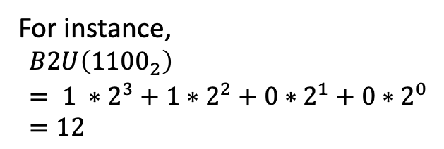
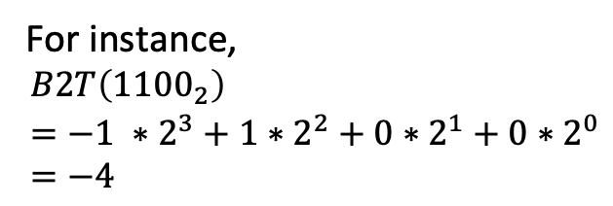
Encoding Integers Using Bit Vectors
Let integer X be a bit vector of width w
How to determine its value?
X = [ x_{w-1} x _{w-2} … x₁ x₀]
Unsigned
Two’s Complement (Signed)
Sign bit (most significant bit)
0: nonnegative
1: negative
For instance,
$$B2U\left({1100}_{2}\right)= 1 ∗2^{3}+1∗2^{2}+0∗2^{1}+0∗2^{0}=12$$
For instance,
$$B2T\left({1100}_{2}\right)=−1 ∗2^{3}+1∗2^{2}+0∗2^{1}+0∗2^{0}=−4$$
Notes:
use bit vectors to encode positive and negative values.
The standard way of doing this is called “two’s complement”.
The key idea here is to use the most significant as a sign bit.
The encoding must specify the width of the bit vector.

Slide 4
Encodings for All Four-Bit Integers
X
B2U(X)
B2T(X)
0000
0
0
0001
1
1
0010
2
2
0011
3
3
0100
4
4
0101
5
5
0110
6
6
0111
7
7
1000
8
–8
1001
9
–7
1010
10
–6
1011
11
–5
1100
12
–4
1101
13
–3
1110
14
–2
1111
15
–1
Notes:
the encodings for nonnegative values (those in green) are the same between unsigned and two’s complement.
each bit vector is uniquely mapped to a value in either encoding method.

Slide 5
Special Integer Values
X
B2U(X)
B2T(X)
0000
0
0
0: all 0’s in binary, same for both signed and unsigned
0001
1
1
0010
2
2
0011
3
3
0100
4
4
0101
5
5
0110
6
6
Tmax (2^{w-1}-1): max value for signed
0111
7
7
1000
8
–8
Tmin (-2^{w-1}): min value for signed
1001
9
–7
1010
10
–6
1011
11
–5
1100
12
–4
1101
13
–3
1110
14
–2
1111
15
–1
All 1’s in binary: -1 for signed,
Max value for unsigned
Umax (2^{w}-1)
Notes:
the ranges of integers are different between unsigned and two’s complement
Notice that the max value and the min value are next to each other.

Slide 6
Properties of Integer Values
X
B2U(X)
B2T(X)
|Tmin| = Tmax + 1
  Range asymmetric!
Umax = |Tmin| + Tmax = 2Tmax+1
0000
0
0
0001
1
1
0010
2
2
0011
3
3
0100
4
4
0101
5
5
0110
6
6
0111
7
7
Tmax
1000
8
–8
Tmin
1001
9
–7
1010
10
–6
1011
11
–5
1100
12
–4
1101
13
–3
1110
14
–2
1111
15
–1
Umax

Slide 7
Properties of Integer Values
X
B2U(X)
B2T(X)
Given signed integer t and unsigned integer u, both of which are w bits wide
(t mod 2^{w}) == (u mod 2^{w}) iff t and u have the same binary representation
  E.g,. w = 4, 2⁴ = 16
  8 mod 16 == -8 mod 16
  9 mod 16 == -7 mod 16
  Etc.
0000
0
0
0001
1
1
0010
2
2
0011
3
3
0100
4
4
0101
5
5
0110
6
6
0111
7
7
1000
8
–8
1001
9
–7
1010
10
–6
1011
11
–5
1100
12
–4
1101
13
–3
1110
14
–2
1111
15
–1
Notes:
values under unsigned encoding and undertwo’s complement are either the same or have a distance of 2^w.
difference between unsigned encoding and two’s complement encoding lies in how they interpret a bit vector.
The same bit vector can be interpreted either as unsigned or two’s complement signed integer.

Slide 8
Properties of Integer Values
X
B2U(X)
B2T(X)
For any given signed integer X (except Tmin), -X = ~X + 1
  Why?
Binary arithmetic:
  X + ~X = 11…11₂ =-1
  All 1’s in binary is the representation of -1
0000
0
0
0001
1
1
0010
2
2
0011
3
3
0100
4
4
0101
5
5
0110
6
6
0111
7
7
Tmax
1000
8
–8
Tmin
1001
9
–7
1010
10
–6
1011
11
–5
1100
12
–4
1101
13
–3
1110
14
–2
1111
15
–1
Umax
Notes:
Why not simply convert it back to integer, get its negative value, and convert it back to bit vector?
the advantage of using bit-wise operations is that it can be done directly on hardware

Slide 9
Today: Bits, Bytes, and Integers
Representing information as bits
Bit-level manipulations
Integers
  Representation: unsigned and signed
  Conversion, casting
  Expanding, truncating
  Arithmetic

Slide 10
Mapping Signed ↔ Unsigned
Keep bit representations and reinterpret
Bits
0000
0001
0010
0011
0100
0101
0110
0111
1000
1001
1010
1011
1100
1101
1110
1111
Signed
0
1
2
3
4
5
6
7
-8
-7
-6
-5
-4
-3
-2
-1
Unsigned
0
1
2
3
4
5
6
7
8
9
10
11
12
13
14
15
=
+/- 16
(mod 16 gives
same result)
Notes:
casting doesn’t change bit-level representation. It only merely re-interpret the same bit vector.

Slide 11
Signed vs. Unsigned in C
Constants
  By default are considered to be signed integers
  Unsigned if have “U” as suffix
    0U, 4294967259U
Casting
  Explicit casting between signed & unsigned
  int tx, ty;
    unsigned ux, uy;
    tx = (int) ux;
    uy = (unsigned) ty;
  Implicit casting occurs via assignments
    tx = ux; // cast to signed
    uy = ty; // cast to unsigned
Notes:
how casting works in C.
For variables, you can explicitly cast a signed variable to unsigned.
Casting on variable can be done implicitly as well.
no ambiguity about the type of variable which you are assigning the value to
Again, to cast a variable to another type, what computer does is simply copying the same bit vector to the new variable.
Note that, some of other modern languages like Python do not have built-in support for unsigned types.

Slide 12
Casting Surprises in C
Expression Evaluation
  If there is a mix of unsigned and signed in single expression,
  signed values implicitly cast to unsigned
  Including comparison operations <, >, ==, <=, >=
Constant₁ Constant₂ Relation Evaluation
  0 0U
  -1 0
  -1 0U
  0 0U == unsigned
  -1 0 < signed
  -1 0U > unsigned
  2147483647 -2147483648 > signed
  2147483647U -2147483648 < unsigned
  -1 -2 > signed
  (unsigned) -1 -2 > unsigned
  2147483647 2147483648U < unsigned
  2147483647 (int) 2147483648U > signed
Notes:
Because the evaluation is on the basis of treating both of them as unsigned (because one of them is unsigned). Now, if we interpret -1’s bit vector as an unsigned, the value will be (Umax) the max value under unsigned encoding, so it’s greater than 0.

Slide 13
Summary
Casting Signed ↔ Unsigned: Basic Rules
Bit pattern is maintained
But reinterpreted
Expression containing signed and unsigned int
  int is cast to unsigned!!

Slide 14
Today: Bits, Bytes, and Integers
Representing information as bits
Bit-level manipulations
Integers
  Representation: unsigned and signed
  Conversion, casting
  Expanding, truncating
  Arithmetic

Slide 15

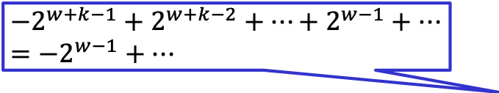
Sign Extension
Task:
  Given w-bit signed integer X
  Convert it to w+k-bit integer X’ with same value
Rule:
  Make k copies of sign bit:
  X' = x_{w–1} ,…, x_{w–1} , x_{w–1} , x_{w–2} ,…, x₀
k copies of the most significant bit
w
$$−2^{w−1}+…$$
X
• • •
Why they are the same value?
$$−2^{w+k−1}+2^{w+k−2}+…+2^{w−1}+…=−2^{w−1}+…$$
• • •
X’
• • •
• • •
k
w
Notes:
By copying the most significant bit for k times, what we have is the following, which is mathematically equivalent to the original encoding.

Slide 16
Sign Extension Example
short int x = 15213;
int ix = (int) x;
short int y = -15213;
int iy = (int) y;
Decimal
Hex
Binary
x
15213
3B 6D
00111011 01101101
ix
15213
00 00 3B 6D
00000000 00000000 00111011 01101101
y
-15213
C4 93
11000100 10010011
iy
-15213
FF FF C4 93
11111111 11111111 11000100 10010011
Converting from smaller to larger integer data type
C automatically performs sign extension
Casting keeps the bit vector, but extension keeps the actual value

Slide 17
Truncating
E.g., int (32 bits) to short (16 bits)
Unsigned: mod operation
  E.g., 0xAB₂ (171₁₀) → 0xB (11₁₀)
  171 mod 2⁴ = 11
  In general, truncating unsigned int X to k bits is equivalent to performing X mod 2^{k}
Signed: similar to mod
  E.g., 0xAB₂ (-85₁₀) → 0xB (-5₁₀)
  (-85 mod 2⁴) = 11, treat 11 as unsigned and convert it to signed yields -5
  In general, truncating int X to k bits is equivalent to converting X mod 2^{k} (a k-bit unsigned value) to signed
Notes:
the same operation on the bit-level can have different implications on unsigned and signed integers.

Slide 18
Today: Bits, Bytes, and Integers
Representing information as bits
Bit-level manipulations
Integers
  Representation: unsigned and signed
  Conversion, casting
  Expanding, truncating
  Arithmetic

Slide 19
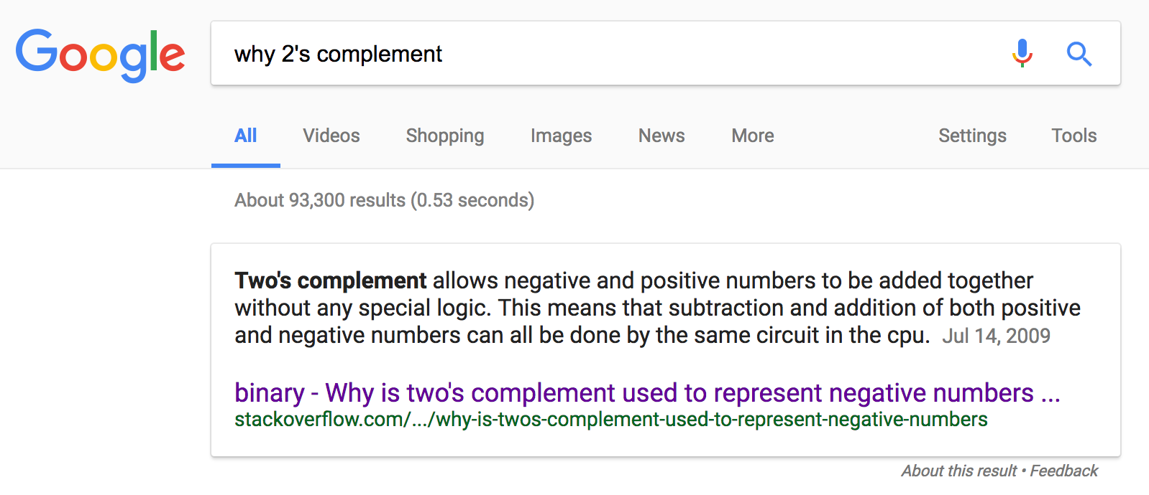
Why Two’s Complement?

Slide 20
Unsigned Addition (UAdd)
u
Operands: w bits
• • •
+
v
• • •
True Sum: w+1 bits
u + v
• • •
Discard Carry: w bits
UAdd_{w}(u , v)
• • •
Standard Addition Function
  Ignores carry output (similar to truncation)
Implements Modular Arithmetic
  s = UAdd_{w}(u , v)
  = u + v mod 2^{w}

Slide 21
Visualizing “True Sum”
Integer Addition
  4-bit integers u, v
  Compute true sum Add₄(u , v)
  Values increase linearly with u and v
  Forms planar surface
Add₄(u , v)
v
u

Slide 22
Visualizing Unsigned Addition
Wraps Around
  If true sum ≥ 2^{w}
  At most once
Overflow
UAdd₄(u , v)
True Sum
2^{w+1}
Overflow
2^{w}
v
0
Modular Sum
u

Slide 23
Two’s Complement Addition (TAdd)
Operands: w bits
u
• • •
+
v
• • •
True Sum: w+1 bits
u + v
• • •
Discard Carry: w bits
TAdd_{w}(u , v)
• • •
TAdd and UAdd have Identical Bit-Level Behavior
  Signed vs. unsigned addition in C:
  int s, t, u, v;
  s = (int) ((unsigned) u + (unsigned) v);
  t = u + v
  s and t have the same binary representation, but different interpretation
Notes:
On the bit-level, the behavior is the same to unsigned addition.
the signed and unsigned operations share the same bit-level behavior, but the interpretation of the same bit-level behavior likely be different.

Slide 24
Odd Behaviors in TAdd
Let x, y, z be 4-bit signed integers
x=-8, y=-5, z=x+y
  What is the value of z?
  Math says -13, but computer will give 3
  Negative overflow (happens when we add two very small, negative numbers)
x= 5, y=5, z=x+y
  What is the value of z?
  Math says 10, but computer will give -6
  Positive overflow (happens when we add two very large numbers)
1000 (-8)
1011 (-5)
10011 (3)
0101 (5)
0101 (5)
1010 (-6)

Slide 25
Visualizing 2’s Complement Addition
Values
  4-bit two’s comp.
  Range from -8 to +7
Wraps Around
  If sum ≥ 2^{w–1}
    Becomes negative
    At most once
  If sum < –2^{w–1}
    Becomes positive
    At most once
Negative overflow
TAdd₄(u , v)
v
u
Positive overflow

Slide 26
We did not cover the following slides in class. However, you may find the materials helpful.

Slide 27
TAdd Overflow
Let x, y, z be w-bit signed integers, z=x+y
True sum x+y
x + y
Positive overflow iff x>0, y>0, but s<=0
Negative overflow iff x<0, y<0, but s>=0
(proofs in textbook)
+2^{w}
Positive overflow
Case 4
z
x +^{t} y
+2^{w –1}
+2^{w –1}
Case 3
0
Normal
0
Case 2
–2^{w –1}
–2^{w –1}
Case 1
Negative overflow
–2^{w}
Notes:
Draw the same figure on the board using w=4 as an example (focus on case 1 and 4)
Tmin in 4-bit is -8 = -2^3 = -2^(w-1)
Tmax in 4-bit is 7, 2^3-1
True Max of x+y = Tmax + Tmax = 2*Tmax = 2^w – 2 (14 in 4 bit)
True Min of x+y = Tmin + Tmin = -2^w (-16 in 4 bit)
In order to present the range from -16 to 14, we need w+1 == 5 bits
But 4 bit restricts the value from -8 to 7
So if you get a number >7, we know that it’s between 7 and 14, bit representation is 0b1xxx, but in signed integer, this 1 means negative
If the true sum is -9, -10, …, -16, bit representation requires 5 bits, all in the form ob10xxx, but because we’re truncating to 4 bits, the values 0xxx is positive

Slide 28
Unsigned Multiplication in C
u
• • •
Operands: w bits
*
v
• • •
True Product: 2*w bits
u · v
• • •
• • •
UMult_{w}(u , v)
Discard w bits: w bits
• • •
    Result range: 0 ≤ x * y ≤ (2^{w} – 1) ² = 2^{2w} – 2^{w+1} + 1
      Requires up to 2*w bits
Standard Multiplication Function
  Ignores high order w bits
Implements Modular Arithmetic
  UMult_{w}(u , v) = u · v mod 2^{w}

Slide 29
Signed Multiplication in C
u
• • •
Operands: w bits
*
v
• • •
True Product: 2*w bits
u · v
• • •
• • •
TMult_{w}(u , v)
Discard w bits: w bits
• • •
Standard Multiplication Function
  Bit-level representation exactly the same as unsigned
  Interpreted differently
Notes:
Two’s complement min (negative): Up to 2w-1 bits. (Tmin*Tmax)
Result range: x * y ≥ (–2^{w–1})*(2^{w–1}–1) = –2^{2w–2} + 2^{w–1}
Two’s complement max (positive): Up to 2w bits, but only for (TMin_{w})²
Result range: x * y ≤ (–2^{w–1}) ² = 2^{2w–2}

Slide 30
Power-of-2 Multiply with Shift
Operation
  u << k gives u * 2^{k}
  Both signed and unsigned
Examples
  u << 3 == u * 8
  (u << 5) – (u << 3) == u * 24
  Most machines shift and add faster than multiply
    Compiler generates this code automatically
k
u
• • •
Operands: w bits
*
2^{k}
0
•••
0
1
0
•••
0
0
True Product: w+k bits
u · 2^{k}
• • •
0
•••
0
0
Discard k bits: w bits
UMult_{w}(u , 2^{k})
•••
0
•••
0
0
TMult_{w}(u , 2^{k})
Notes:
Mathmatically why is this true;
X = xw-1, xw-2, …., x1, x0
Value of X = sum from i=0 to w-1 xi*2^I
X<<1 = xw-1, …., x0, 0
X<<1 = 0*2^0 + x0*2^1 + … xw-1*2^w = sum from i=0 to w-1 xi*2^(i+1) = 2*sum from i=0 to w-1 xi*2^I = 2*value of X
Unsigned is the same

Slide 31
Unsigned Power-of-2 Divide with Shift
u >> k gives ⎣ u / 2^{k} ⎦
  Uses logical shift
k
Discard
u
•••
•••
Operands:
/
2^{k}
0
•••
0
1
0
•••
0
0
Division:
u / 2^{k}
0
.
0
•••
0
0
•••
•••
Result:
⎣ u / 2^{k} ⎦
0
0
•••
0
0
•••
Notes:
Show example of 6 in 4 bit integer
6 == 0110
>> 1
3 == 0011
>>1
1 == 0001 = floor of 3/2

Slide 32
Signed Power-of-2 Divide with Shift
t >> k gives ⎣ t / 2^{k} ⎦
  Uses arithmetic shift
k
Discard
t
s
•••
•••
Operands:
/
2^{k}
0
•••
0
1
0
•••
0
0
Division:
t / 2^{k}
0
.
s
•••
s
s
s
•••
•••
Result:
⎣ t / 2^{k} ⎦
0
s
•••
s
s
s
•••
However, negative numbers should round towards 0!!
How to correctly perform power-of-2 divide with shifts for negative numbers?
  Adding a “bias” before the shift
  See textbook for details
Notes:
Show example of -6 in 4 bit integer
-6 == 1010
>> 1
-3 == 1101
>>1
-2 == 1110
Bias = 2^k-1
‘?
Adding bias 1 to -3
1101 → 1110
>>1
-1 = 1111

Slide 33
Unsigned Integer Encoding Example
unsigned short x = 15213; // 00111011 01101101

Slide 34
Two’s Complement Encoding Example
short x = 15213; // 00111011 01101101
short y = -15213: // 11000100 10010011

Slide 35
Exam I
Covers materials in week 1 – 4
May 2nd, Thursday, 7pm-8:30pm, Kent 107
Notes:
The exam 1 will be on May 2nd, in less than a month
The time should be on the schedule.
The exam will cover the topics in the first 4 weeks.

Slide 36
Impact of Endianness on C program
int x = 0x01234567
0x100
0x101
0x102
0x103
01
23
45
67
Big Endian
01
23
45
67
0x100
0x101
0x102
0x103
67
45
23
01
Little Endian
67
45
23
01
unsigned short a[] = {0x0123, 0x4567}
0x100
0x101
0x102
0x103
Big Endian
01
23
45
67
01
23
45
67
a[0] = 0x0123
((unsigned char*)a)[1] = 0x23
0x100
0x101
0x102
0x103
Little Endian
67
45
23
01
23
01
67
45
a[0] = 0x0123
((unsigned char*)a)[1] = 0x01
Notes:
Before we start today’s material, I’d like to go back to a point in the last lecture. I talked about it on Wednesday, but I should’ve spent more time on it.
The point is whether the endianness (big endian vs little endian) affects the result of a C program.
I said it doesn’t affect C program for most time, but I didn’t explain when it does and when it does not.
So let me explain that with the example we used before.

Slide 37
Conversion Visualized
2’s Comp. → Unsigned
  Ordering Inversion
  Negative → Big Positive
UMax
UMax – 1
TMax + 1
Unsigned
Range
TMax
TMax
2’s Complement Range
0
0
–1
–2
TMin

Slide 38
Why Does Sign Extension Work?
Consider sign extension from X (w = 3) to X’ (w’ = 4)
For nonnegative values, simply add a 0 (same as unsigned)
For negative values, X = [1 x₁ x₀] → X’ = [1 1 x₁ x₀]
  In X, we have -4 + 2*x₁ + x₀
  In X’, we have -8 + 4 + 2*x₁ + x₀
  -8 + 4 == -4
In general, -2^{w}+2^{w-1} = -2^{w-1}
Notes:
Prove by induction for any w and w’, w’>w

Slide 39
Why Does Sign Extension Work?
(1101)₂
= -2³ + 2² + 2⁰
= -5
(11…1101)₂
= -2^{w-1} + 2^{w-2} + 2^{w-3} + … + 2⁴ + 2³ + 2² + 2⁰
= -2^{w-2} + 2^{w-3} + … + 2⁴ + 2³ + 2² + 2⁰
…
= -2⁴ + 2³ + 2² + 2⁰
= -2³ + 2² + 2⁰
= -5
w-bit
In general, -2^{w}+2^{w-1} = -2^{w-1}

Slide 40
Casting Surprises in C
Expression Evaluation
  If there is a mix of unsigned and signed in single expression,
  signed values implicitly cast to unsigned
  Including comparison operations <, >, ==, <=, >=
  Examples for W = 32: TMIN = -2,147,483,648 , TMAX = 2,147,483,647
Constant₁ Constant₂ Relation Evaluation
  0 0U
  -1 0
  -1 0U
  2147483647 -2147483647-1
  2147483647U -2147483647-1
  -1 -2
  (unsigned)-1 -2
  2147483647 2147483648U
  2147483647 (int) 2147483648U
  0 0U == unsigned
  -1 0 < signed
  -1 0U > unsigned
  2147483647 -2147483648 > signed
  2147483647U -2147483648 < unsigned
  -1 -2 > signed
  (unsigned) -1 -2 > unsigned
  2147483647 2147483648U < unsigned
  2147483647 (int) 2147483648U > signed

