Slide 1
Machine-Level Programming II: Control or
What Condition Your Condition is in
CMSC 15400: Introduction to Computer Systems
Junchen Jiang

Slide 2
Consider this code..
Carnegie Mellon
Assembly language doesn’t support if, while, or for.
Today
  Condition codes + Jump command
  if conditional branches
  while and for loops
  Develop a mental model of program execution
long arith
(long x, long y, long z)
{
long t1 = x+y;
while (t1 > 0) {
long t2 = z+t1;
long t3 = x+4;
long t4 = y * 48;
t1 = t3 + t4;
}
long rval = t2 * t1;
return rval;
}

Slide 3
Today
Control: Condition codes
Conditional branches
Loops

Slide 4
Control Flow in x86
CPU
Memory
Registers
Addresses
PC
Object Code
Program Data
OS Data
Data
Condition
Codes
Instructions
ALU
Stack
CF
ZF
SF
OF

Slide 5
Condition Codes (Implicit Setting)
Single bit registers
  CF Carry Flag (for unsigned) SF Sign Flag (for signed)
  ZF Zero Flag OF Overflow Flag (for signed)
Implicitly set (think of it as side effect) by arithmetic operations
  Example: addq Src,Dest ↔ t = a+b
  CF set if carry out from most significant bit (unsigned overflow)
  ZF set if t == 0
  SF set if t < 0 (as signed)
  OF set if two’s-complement (signed) overflow
  (a>0 && b>0 && t<0) || (a<0 && b<0 && t>=0)
Not set by leaq instruction

Slide 6
Examples
Assuming 8-bit addition
add operands |  | result | Condition codes
a | b | t=a+b | CF | ZF | SF | OF
11111111 (Umax_8) | 11111111 (Umax_8) | 11111111 +11111111 111111110

Slide 7
Examples
Assuming 8-bit addition
add operands |  | result | Condition codes
a | b | t=a+b | CF | ZF | SF | OF
11111111 (Umax_8) | 11111111 (Umax_8) | 11111111 +11111111 111111110 | 1
Overflow when interpreted as unsigned

Slide 8
Examples
Assuming 8-bit addition
add operands |  | result | Condition codes
a | b | t=a+b | CF | ZF | SF | OF
11111111 (Umax_8) | 11111111 (Umax_8) | 11111111 +11111111 111111110 | 1 | 0
Not zero

Slide 9
Examples
Assuming 8-bit addition
add operands |  | result | Condition codes
a | b | t=a+b | CF | ZF | SF | OF
11111111 (Umax_8) | 11111111 (Umax_8) | 11111111 +11111111 111111110 | 1 | 0 | 1
Negative (when interpreted as signed)

Slide 10
Examples
Assuming 8-bit addition
add operands |  | result | Condition codes
a | b | t=a+b | CF | ZF | SF | OF
11111111 (Umax_8) | 11111111 (Umax_8) | 11111111 +11111111 111111110 | 1 | 0 | 1 | 0
When interpreted as signed, a = -1, b = -1, and t = -2, so no signed overflow

Slide 11
Examples
Assuming 8-bit addition
add operands |  | result | Condition codes
a | b | t=a+b | CF | ZF | SF | OF
11111111 (Umax_8) | 11111111 (Umax_8) | 11111111 +11111111 111111110 | 1 | 0 | 1 | 0
10000000 (Tmin_8) | 10000000 (Tmin_8) | 10000000 +10000000 100000000 | 1 | 1 | 0 | 1

Slide 12
Examples
Assuming 8-bit addition
add operands |  | result | Condition codes
a | b | t=a+b | CF | ZF | SF | OF
11111111 (Umax_8) | 11111111 (Umax_8) | 11111111 +11111111 111111110 | 1 | 0 | 1 | 0
10000000 (Tmin_8) | 10000000 (Tmin_8) | 10000000 +10000000 100000000 | 1 | 1 | 0 | 1
01111111 (Tmax_8) | 01111111 (Tmax_8) | 01111111 +01111111 11111110 | 0 | 0 | 1 | 1

Slide 13
Condition Codes (Explicit Setting: Test)
Explicit Setting by Test instruction
  testq Src2, Src1
    testq b,a like computing a&b without setting destination (unlike andq)
  Sets condition codes based on value of Src1 & Src2
  Test sign of a value
  Useful to have one of the operands be a mask
  ZF set when a&b == 0
  SF set when a&b < 0
  OF and CF are set to 0

Slide 14
Condition Codes (Explicit Setting: Compare)
Explicit Setting by Compare Instruction
  cmpq Src2, Src1
  cmpq b,a like computing a-b without setting destination (unlike subq)
  CF set if carry out from most significant bit (used for unsigned comparisons)
  ZF set if a == b
  SF set if (a-b) < 0 (as signed)
  OF set if two’s-complement (signed) overflow
  (a>0 && b<0 && (a-b)<0) || (a<0 && b>0 && (a-b)>=0)

Slide 15
Examples
Assuming 8-bit addition
Operands |  | cmpq b,a | Condition codes
a | b | a-b | CF | ZF | SF | OF
10110011 | 10110011 | 10110011 -10110011 00000000 | 0 | 1 | 0 | 0

Slide 16
Examples
Assuming 8-bit addition
Operands |  | cmpq b,a | Condition codes
a | b | a-b | CF | ZF | SF | OF
10110011 | 10110011 | 10110011 -10110011 00000000 | 0 | 1 | 0 | 0
11111110 (-2) | 11111111 (-1) | 11111110 -11111111 111111111 | 1 | 0 | 1 | 0

Slide 17
Examples
Assuming 8-bit addition
Operands |  | cmpq b,a | Condition codes
a | b | a-b | CF | ZF | SF | OF
10110011 | 10110011 | 10110011 -10110011 00000000 | 0 | 1 | 0 | 0
11111110 (-2) | 11111111 (-1) | 11111110 -11111111 111111111 | 1 | 0 | 1 | 0
10000000 (Tmin_4) | 01111111 (Tmax_4) | 10000000 -01111111 00000001 | 0 | 0 | 0 | 1

Slide 18
Examples
Assuming 8-bit addition
Operands |  | cmpq b,a | Condition codes
a | b | a-b | CF | ZF | SF | OF
10110011 | 10110011 | 10110011 -10110011 00000000 | 0 | 1 | 0 | 0
11111110 (-2) | 11111111 (-1) | 11111110 -11111111 111111111 | 1 | 0 | 1 | 0
10000000 (Tmin_4) | 01111111 (Tmax_4) | 10000000 -01111111 00000001 | 0 | 0 | 0 | 1
a < b, iff SF ^ OF

Slide 19
Reading Condition Codes
SetX Instructions
  Does not alter remaining 7 bytes
SetX | Condition | Description
setl | (SF^OF) | Less (Signed)
setne | ~ZF | Not Equal / Not Zero
sets | SF | Negative
setns | ~SF | Nonnegative
setg | ~(SF^OF)&~ZF | Greater (Signed)
setge | ~(SF^OF) | Greater or Equal (Signed)
setl | (SF^OF) | Less (Signed)
setle | (SF^OF)|ZF | Less or Equal (Signed)
seta | ~CF&~ZF | Above (unsigned)
setb | CF | Below (unsigned)

Slide 20
Reading Condition Codes
SetX Instructions
  Does not alter remaining 7 bytes
SetX | Condition | Description
setl | (SF^OF) | Less (Signed)
setne | ~ZF | Not Equal / Not Zero
sets | SF | Negative
setns | ~SF | Nonnegative
setg | ~(SF^OF)&~ZF | Greater (Signed)
setge | ~(SF^OF) | Greater or Equal (Signed)
setl | (SF^OF) | Less (Signed)
setle | (SF^OF)|ZF | Less or Equal (Signed)
seta | ~CF&~ZF | Above (unsigned)
setb | CF | Below (unsigned)
long less (long x, long y)
{
return x < y;
}
cmpq %rsi,%rdi # Compare x:y
setl %al # Set when <
movzbq %al,%rax # Zero rest of %rax
ret
Register | Use(s)
%rdi | Argument x
%rsi | Argument y
%rax | Return value

Slide 21
Reading Condition Codes
SetX Instructions
  Does not alter remaining 7 bytes
SetX | Condition | Description
setl | (SF^OF) | Less (Signed)
setne | ~ZF | Not Equal / Not Zero
sets | SF | Negative
setns | ~SF | Nonnegative
setg | ~(SF^OF)&~ZF | Greater (Signed)
setge | ~(SF^OF) | Greater or Equal (Signed)
setl | (SF^OF) | Less (Signed)
setle | (SF^OF)|ZF | Less or Equal (Signed)
seta | ~CF&~ZF | Above (unsigned)
setb | CF | Below (unsigned)
long less (long x, long y)
{
return x < y;
}
cmpq %rsi,%rdi # Compare x:y
setl %al # Set when <
movzbq %al,%rax # Zero rest of %rax
ret
Register | Use(s)
%rdi | Argument x
%rsi | Argument y
%rax | Return value
x = 2, y = 3
SF = ?
OF = ?
%rax
%al

Slide 22
Reading Condition Codes
SetX Instructions
  Does not alter remaining 7 bytes
SetX | Condition | Description
setl | (SF^OF) | Less (Signed)
setne | ~ZF | Not Equal / Not Zero
sets | SF | Negative
setns | ~SF | Nonnegative
setg | ~(SF^OF)&~ZF | Greater (Signed)
setge | ~(SF^OF) | Greater or Equal (Signed)
setl | (SF^OF) | Less (Signed)
setle | (SF^OF)|ZF | Less or Equal (Signed)
seta | ~CF&~ZF | Above (unsigned)
setb | CF | Below (unsigned)
long less (long x, long y)
{
return x < y;
}
cmpq %rsi,%rdi # Compare x:y
setl %al # Set when <
movzbq %al,%rax # Zero rest of %rax
ret
x = 2, y = 3
00…10
-00…11
11…11
Register | Use(s)
%rdi | Argument x
%rsi | Argument y
%rax | Return value
1
0
SF = ?
OF = ?
%rax
%al

Slide 23
Reading Condition Codes
SetX Instructions
  Does not alter remaining 7 bytes
Refer to textbook 3.4 on p180 for references to lower bytes of x86-64 registers
SetX | Condition | Description
setl | (SF^OF) | Less (Signed)
setne | ~ZF | Not Equal / Not Zero
sets | SF | Negative
setns | ~SF | Nonnegative
setg | ~(SF^OF)&~ZF | Greater (Signed)
setge | ~(SF^OF) | Greater or Equal (Signed)
setl | (SF^OF) | Less (Signed)
setle | (SF^OF)|ZF | Less or Equal (Signed)
seta | ~CF&~ZF | Above (unsigned)
setb | CF | Below (unsigned)
long less (long x, long y)
{
return x < y;
}
cmpq %rsi,%rdi # Compare x:y
setl %al # Set when <
movzbq %al,%rax # Zero rest of %rax
ret
Register | Use(s)
%rdi | Argument x
%rsi | Argument y
%rax | Return value
x = 2, y = 3
1
0
SF = ?
OF = ?
1
%rax
%al

Slide 24
Reading Condition Codes
SetX Instructions
  Does not alter remaining 7 bytes
Refer to textbook 3.4.2 on p184 for details on movzbq and similar instructions
SetX | Condition | Description
setl | (SF^OF) | Less (Signed)
setne | ~ZF | Not Equal / Not Zero
sets | SF | Negative
setns | ~SF | Nonnegative
setg | ~(SF^OF)&~ZF | Greater (Signed)
setge | ~(SF^OF) | Greater or Equal (Signed)
setl | (SF^OF) | Less (Signed)
setle | (SF^OF)|ZF | Less or Equal (Signed)
seta | ~CF&~ZF | Above (unsigned)
setb | CF | Below (unsigned)
long less (long x, long y)
{
return x < y;
}
cmpq %rsi,%rdi # Compare x:y
setl %al # Set when <
movzbq %al,%rax # Zero rest of %rax
ret
Register | Use(s)
%rdi | Argument x
%rsi | Argument y
%rax | Return value
x = 2, y = 3
1
0
SF = ?
OF = ?
0 … … 0
1
%rax
%al

Slide 25
Reading Condition Codes
SetX Instructions
  Does not alter remaining 7 bytes
SetX | Condition | Description
sete | ZF | Equal / Zero
setne | ~ZF | Not Equal / Not Zero
sets | SF | Negative
setns | ~SF | Nonnegative
setg | ~(SF^OF)&~ZF | Greater (Signed)
setge | ~(SF^OF) | Greater or Equal (Signed)
setl | (SF^OF) | Less (Signed)
setle | (SF^OF)|ZF | Less or Equal (Signed)
seta | ~CF&~ZF | Above (unsigned)
setb | CF | Below (unsigned)

Slide 26
Reading Condition Codes
SetX Instructions
  Does not alter remaining 7 bytes
SetX | Condition | Description
sete | ZF | Equal / Zero
setne | ~ZF | Not Equal / Not Zero
sets | SF | Negative
setns | ~SF | Nonnegative
setg | ~(SF^OF)&~ZF | Greater (Signed)
setge | ~(SF^OF) | Greater or Equal (Signed)
setl | (SF^OF) | Less (Signed)
setle | (SF^OF)|ZF | Less or Equal (Signed)
seta | ~CF&~ZF | Above (unsigned)
setb | CF | Below (unsigned)
cmpq b, a
a < b, iff SF != OF

Slide 27
Reading Condition Codes
SetX Instructions
  Does not alter remaining 7 bytes
SetX | Condition | Description
sete | ZF | Equal / Zero
setne | ~ZF | Not Equal / Not Zero
sets | SF | Negative
setns | ~SF | Nonnegative
setg | ~(SF^OF)&~ZF | Greater (Signed)
setge | ~(SF^OF) | Greater or Equal (Signed)
setl | (SF^OF) | Less (Signed)
setle | (SF^OF)|ZF | Less or Equal (Signed)
seta | ~CF&~ZF | Above (unsigned)
setb | CF | Below (unsigned)
cmpq b, a
a > b, iff !(a<b) & a!=b

Slide 28
Today
Control: Condition codes
Conditional branches
Loops

Slide 29
Conditional Branch Example (jX)
jX | Condition | Description
jl | (SF^OF) | Less (Signed)
long absdiff
(long x, long y)
{
long result;
if (x >= y)
result = x-y;
else
result = y-x;
return result;
}
absdiff:
cmpq %rsi, %rdi # x:y
jl .L4 # jmp if x<y
movq %rdi, %rax
subq %rsi, %rax
ret
.L4: # x < y
movq %rsi, %rax
subq %rdi, %rax
ret
Register | Use(s)
%rdi | Argument x
%rsi | Argument y
%rax | Return value

Slide 30
Jumping
jX Instructions
  Jump to different part of code depending on condition codes
jX | Condition | Description
jmp | 1 | Unconditional
je | ZF | Equal / Zero
jne | ~ZF | Not Equal / Not Zero
js | SF | Negative
jns | ~SF | Nonnegative
jg | ~(SF^OF)&~ZF | Greater (Signed)
jge | ~(SF^OF) | Greater or Equal (Signed)
jl | (SF^OF) | Less (Signed)
jle | (SF^OF)|ZF | Less or Equal (Signed)
ja | ~CF&~ZF | Above (unsigned)
jb | CF | Below (unsigned)
cmpq b, a
jl Line
# Jump to Line if a < b

Slide 31
Jumping
jX Instructions
  Jump to different part of code depending on condition codes
jX | Condition | Description
jmp | 1 | Unconditional
je | ZF | Equal / Zero
jne | ~ZF | Not Equal / Not Zero
js | SF | Negative
jns | ~SF | Nonnegative
jg | ~(SF^OF)&~ZF | Greater (Signed)
jge | ~(SF^OF) | Greater or Equal (Signed)
jl | (SF^OF) | Less (Signed)
jle | (SF^OF)|ZF | Less or Equal (Signed)
ja | ~CF&~ZF | Above (unsigned)
jb | CF | Below (unsigned)
testq a,a
js Line
# Jump to Line if a < 0

Slide 32
Jumping
jX Instructions
  Jump to different part of code depending on condition codes
jX | Condition | Description
jmp | 1 | Unconditional
je | ZF | Equal / Zero
jne | ~ZF | Not Equal / Not Zero
js | SF | Negative
jns | ~SF | Nonnegative
jg | ~(SF^OF)&~ZF | Greater (Signed)
jge | ~(SF^OF) | Greater or Equal (Signed)
jl | (SF^OF) | Less (Signed)
jle | (SF^OF)|ZF | Less or Equal (Signed)
ja | ~CF&~ZF | Above (unsigned)
jb | CF | Below (unsigned)

Slide 33
Expressing with Goto Code
C allows goto statement (Jump to position designated by label)
long absdiff(long x, long y)
{
long result;
if (x >= y)
result = x-y;
else
result = y-x;
return result;
}
absdiff:
cmpq %rsi, %rdi # x:y
jl .L4 # jmp if x<y
movq %rdi, %rax
subq %rsi, %rax
ret
.L4: # x < y
movq %rsi, %rax
subq %rdi, %rax
ret

Slide 34
Expressing with Goto Code
C allows goto statement (Jump to position designated by label)
long absdiff(long x, long y)
{
long result;
if (x >= y)
result = x-y;
else
result = y-x;
return result;
}
absdiff:
cmpq %rsi, %rdi # x:y
jl .L4 # jmp if x<y
movq %rdi, %rax
subq %rsi, %rax
ret
.L4: # x < y
movq %rsi, %rax
subq %rdi, %rax
ret
long absdiff_j(long x, long y)
{
long result;
int ntest = (x < y);
if (ntest) goto Else;
result = x-y;
goto Done;
Else:
result = y-x;
Done:
return result;
}
“jX” of assembly equivalent to “goto” in C

Slide 35
General Conditional Expression Translation (Using Branches)
C Code
val = Test ? Then_Expr : Else_Expr;
val = x>y ? x-y : y-x;
Goto Version
ntest = !Test;
if (ntest) goto Else;
val = Then_Expr;
goto Done;
Else:
val = Else_Expr;
Done:
. . .
  Create separate code regions for then & else expressions
  Execute appropriate one

Slide 36
Today
Control: Condition codes
Conditional branches
Loops

Slide 37
“Do-While” Loop Example
C Code
long pcount_do
(unsigned long x) {
long result = 0;
do {
result += x & 0x1;
x >>= 1;
} while (x);
return result;
}
Count number of 1’s in argument x
Use conditional branch to either continue looping or to exit loop

Slide 38
“Do-While” Loop Example
C Code
Goto Version
long pcount_do
(unsigned long x) {
long result = 0;
do {
result += x & 0x1;
x >>= 1;
} while (x);
return result;
}
long pcount_goto
(unsigned long x) {
long result = 0;
loop:
result += x & 0x1;
x >>= 1;
if(x) goto loop;
return result;
}
Count number of 1’s in argument x
Use conditional branch to either continue looping or to exit loop

Slide 39
“Do-While” Loop Compilation
Goto Version
long pcount_goto
(unsigned long x) {
long result = 0;
loop:
result += x & 0x1;
x >>= 1;
if(x) goto loop;
return result;
}
Register | Use(s)
%rdi | Argument x
%rax | result
movq $0, %rax # result = 0
.L2: # loop:
movq %rdi, %rdx
andq $1, %rdx # t = x & 0x1
addq %rdx, %rax # result += t
shrq %rdi # x >>= 1
jne .L2 # if (x) goto loop
ret
Jump if ZF is not set to 1

Slide 40
General “Do-While” Translation
C Code
Goto Version
do
Body
while (Test);
loop:
Body
if (Test) goto loop
Body:
{
Statement₁;
Statement₂;
…
Statement_{n};
}

Slide 41
General “While” Translation
While version
while (Test)
Body

Slide 42
General “While” Translation
Goto Version
goto test;
loop:
Body
test:
if (Test)
goto loop;
done:
“Jump-to-middle”
(used with –Og)
While version
while (Test)
Body

Slide 43
General “While” Translation
Goto Version
goto test;
loop:
Body
test:
if (Test)
goto loop;
done:
“Jump-to-middle”
(used with –Og)
While version
while (Test)
Body
if (!Test)
goto done;
loop:
Body
if (Test)
goto loop;
done:
“Guided-do”
(used with –O1)

Slide 44
Example
Goto Version
long pcount_goto_jtm
(unsigned long x) {
long result = 0;
goto test;
loop:
result += x & 0x1;
x >>= 1;
test:
if(x) goto loop;
return result;
}
C Code
long pcount_while
(unsigned long x) {
long result = 0;
while (x) {
result += x & 0x1;
x >>= 1;
}
return result;
}
Jump-to-middle
long pcount_goto_dw
(unsigned long x) {
long result = 0;
if (!x) goto done;
loop:
result += x & 0x1;
x >>= 1;
if(x) goto loop;
done:
return result;
}
Guided-do

Slide 45
“For” Loop Form
General Form
for (Init; Test; Update )
Body

Slide 46
“For” Loop Form
General Form
for (Init; Test; Update )
Body
Init
Test
Update
i = 0
i < 64
i++
Body
long pcount_for (unsigned long x)
{
size_t i;
long result = 0;
for (i = 0; i < 64; i++)
{
unsigned bit = (x >> 1) & 0x1;
result += bit;
}
return result;
}
unsigned bit =
(x >> i) & 0x1;
result += bit;

Slide 47
“For” Loop → While Loop
General Form
for (Init; Test; Update )
Body
While Version
Init;
while (Test ) {
Body
Update;
}

Slide 48
“For” Loop Form
Init
Test
Update
General Form
i = 0
i < 64
i++
Body
for (Init; Test; Update )
Body
unsigned bit =
(x >> i) & 0x1;
result += bit;
long pcount_while (unsigned long x)
{
size_t i;
long result = 0;
i = 0;
while (i < 64)
{
unsigned bit = (x >> 1) & 0x1;
result += bit;
i++;
}
return result;
}
While Version
Init;
while (Test ) {
Body
Update;
}

Slide 49
“For” Loop Do-While Conversion
Goto Version
C Code
long pcount_for_goto_dw
(unsigned long x) {
size_t i;
long result = 0;
i = 0;
if (!(i < 64))
goto done;
loop:
{
unsigned bit =
(x >> 1) & 0x1;
result += bit;
}
i++;
if (i < 64)
goto loop;
done:
return result;
}
long pcount_for
(unsigned long x)
{
size_t i;
long result = 0;
for (i = 0; i < 64; i++)
{
unsigned bit =
(x >> 1) & 0x1;
result += bit;
}
return result;
}
Init
!Test
Body
Update
Test

Slide 50
“For” Loop Do-While Conversion
Goto Version
C Code
long pcount_for_goto_dw
(unsigned long x) {
size_t i;
long result = 0;
i = 0;
if (!(i < 64))
goto done;
loop:
{
unsigned bit =
(x >> 1) & 0x1;
result += bit;
}
i++;
if (i < 64)
goto loop;
done:
return result;
}
long pcount_for
(unsigned long x)
{
size_t i;
long result = 0;
for (i = 0; i < 64; i++)
{
unsigned bit =
(x >> 1) & 0x1;
result += bit;
}
return result;
}
Init
!Test
Body
Update
Test
Initial test can be optimized away

Slide 51
“Goto” easily abused => Spaghetti code
Goto version
Non-goto version
test = 1;
loop:
if(test == 0)
goto loopend;
if(var == 1)
{
var = 3;
goto preloop;
}
If($var == 2)
goto L_7;
if($var == 7)
{
L_7:
var = 9;
goto preloop;
}
var = var + 5;
test = 0;
preloop:
var = var - 1;
goto loop;
loopend:
test = true;
while(test)
{
switch(var)
{
case 1:
var = 3;
break;
case 2:
case 7:
var = 9;
break;
default:
var += 5;
test = false;
break;
}
var -= 1;
}

Slide 52
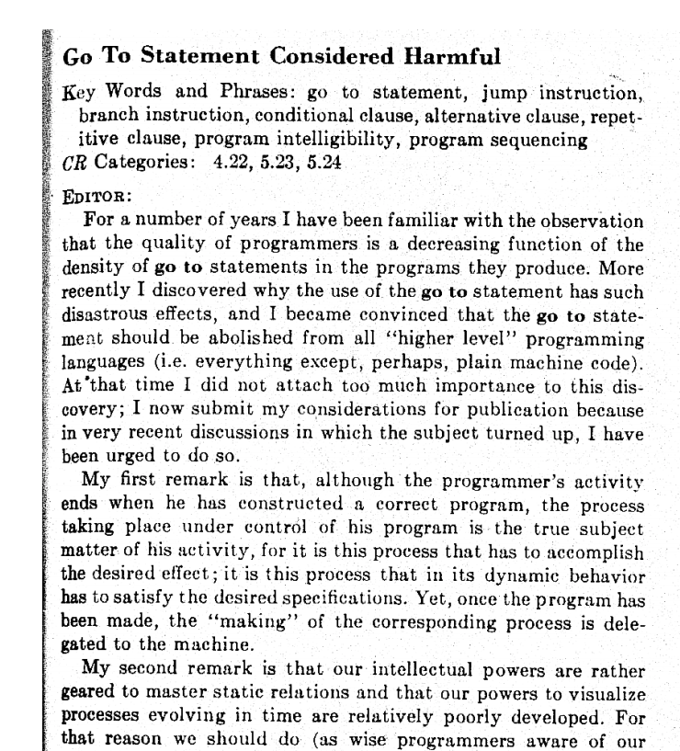
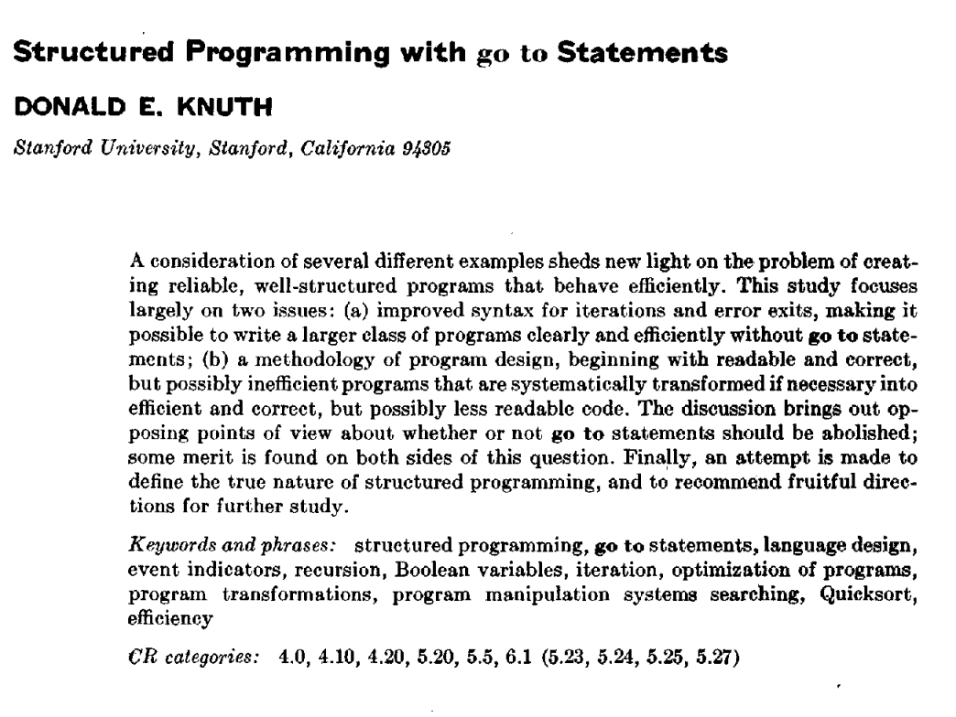
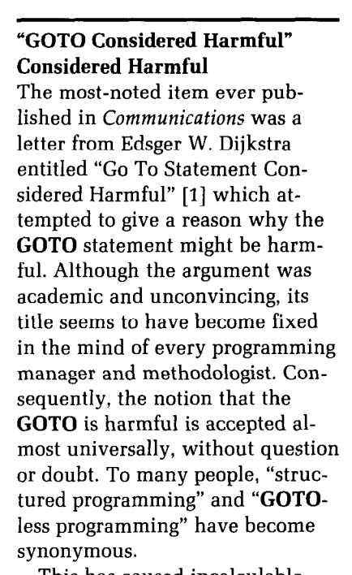
Debate around “goto” statement
Computing Survey, 1974
Communication of ACM, 1968
Communication of ACM, 1987

