Slide 1
The Memory Hierarchy and Caches CS154, Spring 2020, Prof. Yanjing Li Intro to Computer Systems Book Sections 6.1-6.5

Slide 2
Lecture Goals
Current topics:
Intro to memory hierarchy
Caches
Application
Algorithm
Programming Language
Operating System/Virtual Machines
Instruction Set Architecture
Microarchitecture
Register-Transfer Level
Register-Transfer Level
Gates
Circuits
Devices
Physics

Slide 3
Some numbers
Instruction Type | Frequency
Memory → Register Move | 22%
Conditional Branch | 20%
Compare | 16%
Register → Memory Move | 12%
Add | 8%
And | 6%
Sub | 5%
Register → Register Move | 4%
Function call | 1%
Function return | 1%
Total | 96%
From H&P: Computer Architecture a Quantitative Approach
> 34% of instructions access data memory!
100% of instructions are stored in instruction memory!

Slide 4
The CPU-Memory Gap
The gap widens between DRAM, disk, and CPU speeds.
Disk
SSD
DRAM
CPU

Slide 5
Synthesize This
> 34% of instructions access data memory
100% of instructions access instruction memory
Memory is many orders of magnitude slower than the processor
For example: Four-issue 2 GHz superscalar accessing 100 ns DRAM could execute 800 instructions during the time for one memory access!
These numbers don’t make sense

Slide 6
There must be a way to speed up memory access!

Slide 7
Why Are Memories Slow in the First Place?
Not all memories are slow
But, bigger means slower ← Fundamental Tradeoff
Technology differences
Hard disk (slow) vs. SSD vs. DRAM vs. SRAM (fast)
Just physics
Signals in longer wires take longer to travel
Notes:
Slower technologies are cheaper, so they can be made bigger while are still affordable

Slide 8
Key Idea: Memory Hierarchy
L0:
Regs
CPU registers hold words retrieved from the L1 cache.
Smaller,
faster,
and
costlier
(per byte)
storage
devices
L1:
L1 cache
(SRAM)
L1 cache holds cache lines retrieved from the L2 cache.
L2:
L2 cache
(SRAM)
L2 cache holds cache lines
retrieved from L3 cache
L3:
L3 cache
(SRAM)
L3 cache holds cache lines
retrieved from main memory.
Larger,
slower,
and
cheaper
(per byte)
storage
devices
L4:
Main memory
(DRAM)
Main memory holds disk blocks retrieved from local disks.
L5:
Local secondary storage
(local disks)
Local disks hold files retrieved from disks
on remote servers
L6:
Remote secondary storage
(e.g., Web servers)

Slide 9
Memory Hierarchy
Processor
Small Fast
Memory
(Cache)
Big Slow
Memory
(DRAM)
Capacity: Register << Cache << DRAM
Speed: Register >> Cache >> DRAM
On a data access:
if data is in fast memory -> low-latency access (to cache or register)
if data is not in fast memory -> long-latency access to DRAM
Notes:
Most of what a program needs would be from the DRAM (let’s focus on this part)

Slide 10
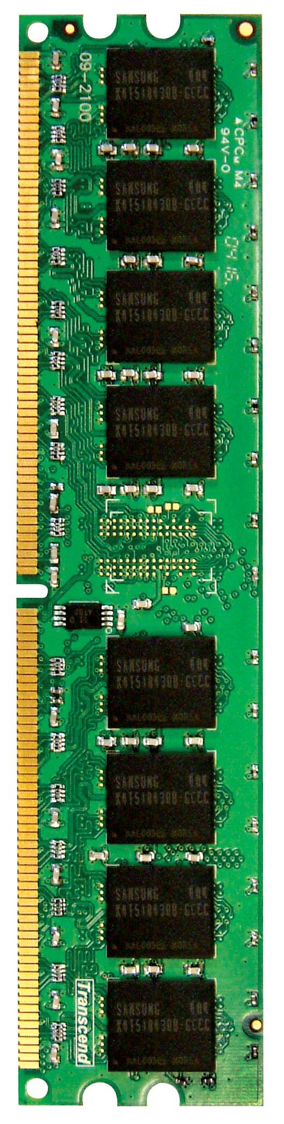
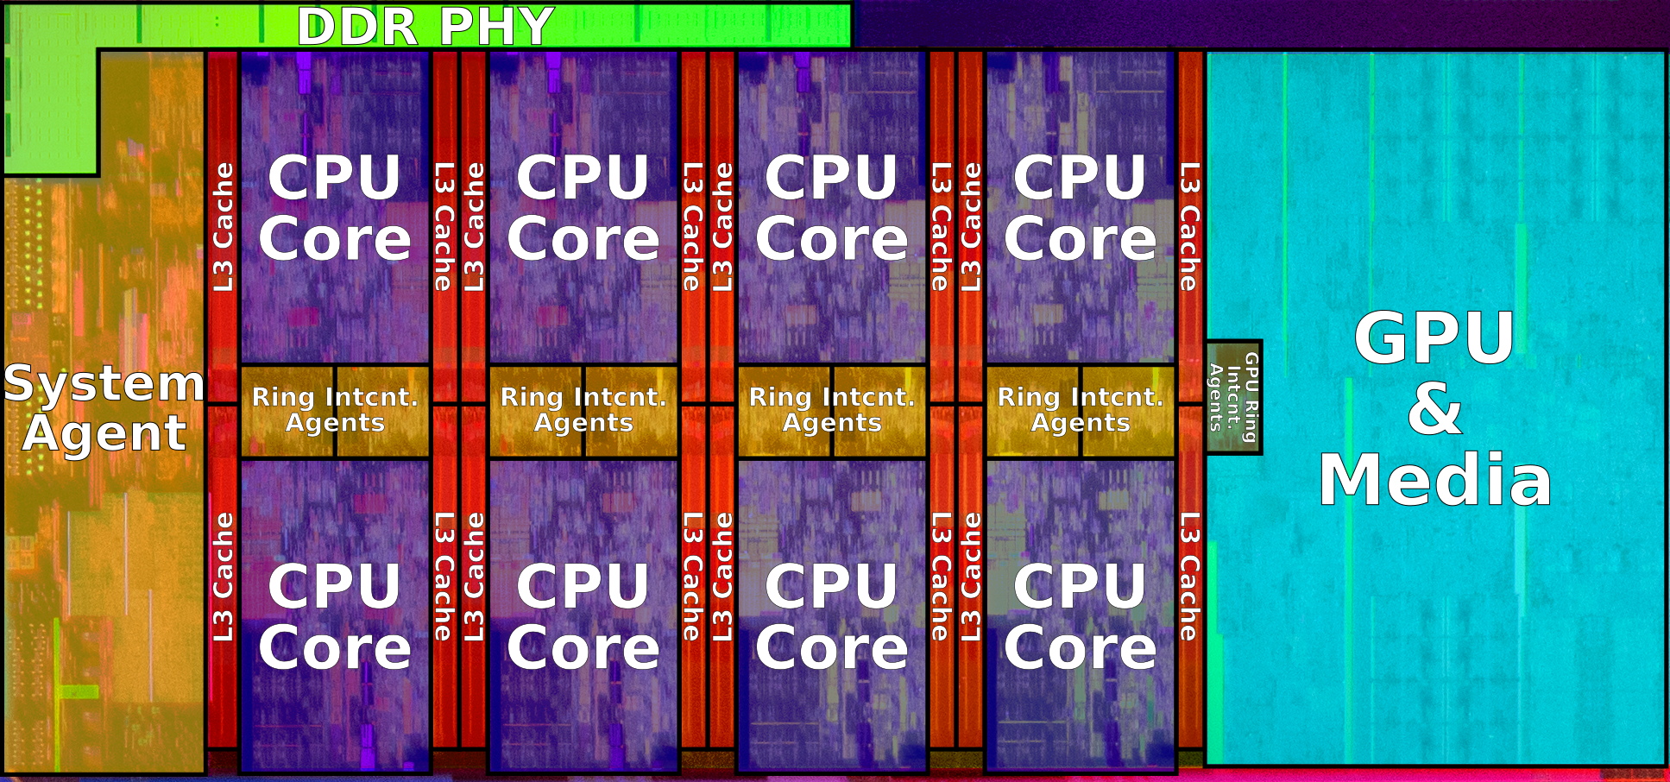
DRAM BANKS
Intel Skylake Server
CPU Core (incl L1, L2), L3, and DRAM

Slide 11
Why Does Memory Hierarchy Work?
Memory hierarchies only work if …
The small, fast memory actually stores data that is used/re-used by the processor at a given time
Do they???

Slide 12
Locality!
The key to bridging this CPU-Memory gap is a fundamental property of computer programs known as locality

Slide 13
Locality
Principle of Locality: Programs tend to use data and instructions with addresses near or equal to those they have used recently
Temporal locality:
Recently referenced items are likely to be referenced again in the near future
Spatial locality:
Items with nearby addresses tend to be referenced close together in time

Slide 14
Locality Example
sum = 0;
for (i = 0; i < n; i++)
sum += a[i];
return sum;
Data references
Reference array elements in succession (stride-1 reference pattern).
Reference variable sum each iteration.
Instruction references
Reference instructions in sequence.
Cycle through loop repeatedly.
Spatial locality
Temporal locality
Spatial locality
Temporal locality

Slide 15
Locality Example
Claim: Being able to look at code and get a qualitative sense of its locality is a key skill for a professional programmer.
Question: Can you permute the loops so that the function scans the 3-d array a with a stride-1 reference pattern (and thus has good spatial locality)?
int sum_array_3d(int a[M][N][N])
{
int i, j, k, sum = 0;
for (i = 0; i < M; i++)
for (j = 0; j < N; j++)
for (k = 0; k < N; k++)
sum += a[k][i][j];
return sum;
}

Slide 16
Now, Back to Memory Hierarchy
Why do memory hierarchies work?
Because of locality, programs tend to access the data at level k more often than they access the data at level k+1.
Thus, the storage at level k+1 can be slower, and thus larger and cheaper per bit.
The memory hierarchy creates a large pool of storage that costs as much as the cheap storage near the bottom, but that serves data to programs at the rate of the fast storage near the top.
Cache: Fundamental idea of a memory hierarchy:
A smaller, faster memory that acts as a staging area for a subset of the data in a larger, slower memory
For each k, the faster, smaller device at level k serves as a cache for the larger, slower device at level k+1.

Slide 17
General Cache Concepts
Smaller, faster, more expensive
memory caches a subset of
the blocks
Cache
4
10
Data is copied in block-sized transfer units
called “cache blocks”
(Typical: 32, 64 bytes)
4
10
Larger, slower, cheaper memory
viewed as partitioned into “blocks”
Memory
0
1
2
3
4
4
5
6
7
8
9
10
10
11
12
13
14
15

Slide 18
General Cache Concepts: Hit
Request: 14
Data in block b is needed
Block b is in cache:
Hit!
Cache
8
9
14
3
14
The degree to which the cache exploits locality can be quantified as hit rate =
# hits / # accesses
Memory
0
1
2
3
4
5
6
7
8
9
10
11
12
13
14
15

Slide 19
General Cache Concepts: Miss
Request: 12
Data in block b is needed
Cache
Block b is not in cache:
Miss!
8
9
14
3
12
Block b is fetched from
memory
12
Request: 12
The degree to which the cache fails to exploit locality is its miss rate =
# misses / # accesses
Memory
0
1
2
3
4
5
6
7
8
9
10
11
12
12
13
14
15

Slide 20
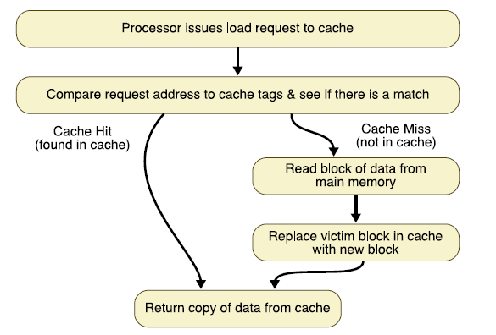
Basic Flow for a “Mem → Reg” mov
How to check if there’s a match?
Which block to replace?

Slide 21
General Cache Design and Organization (S, E, B)
E lines per set
set
line (cache block)
S = 2^{s} sets
Cache size:
C = S x E x B data bytes
v
tag
0
1
2
B-1
valid bit
B = 2^{b} bytes per cache block (the data)

Slide 22
Cache Read: How Do I Find My Data?
Locate set
Check if any line in set has matching tag
Yes + line valid: hit
Locate data starting at offset
E lines per set
Address of word:
t bits
s bits
b bits
S = 2^{s} sets
tag
set
index
block
offset
data begins at this offset
v
tag
0
1
2
B-1
valid bit
B = 2^{b} bytes per cache block (the data)
Notes:
Locating set:
Can only be one set
Set number = Memory block number % number of sets

Slide 23
Example: Direct mapped cache (E = 1)
Direct mapped: One block per set
Assume: cache block size 8 bytes (B=8, b=3)
Address of word (8 bytes):
t bits
s bits
b bits
tag
set
index
block
offset
v
tag
0
1
2
3
4
5
6
7
t bits
01
100
v
tag
0
1
2
3
4
5
6
7
find set
S = 2^{s} sets
(s=2)
v
tag
0
1
2
3
4
5
6
7
v
tag
0
1
2
3
4
5
6
7
Notes:
Ask: if s = 2, i.e., a total of 4 sets,
And the address is 8 bits, how many bits of tag there are?
Answer: 64 – 3 – 2 = 59

Slide 24
Example: Direct mapped cache (E = 1)
Direct mapped: One block per set
Assume: cache block size 8 bytes
Address of int:
valid? +
match: assume yes = hit
t bits
0…01
100
v
tag
0
1
2
3
4
5
6
7
Set 1
tag
block offset

Slide 25
Example: Direct mapped cache (E = 1)
Direct mapped: One block per set
Assume: cache block size 8 bytes
Address of int:
valid? +
match: assume yes = hit
t bits
0…01
100
v
tag
0
1
2
3
4
5
6
7
block offset
int (4 Bytes) is here
No match: old block is evicted and replaced

Slide 26
Example: 2-way set associative cache
E = 2: Two blocks per set
Assume: cache block size 8 bytes
Address of short:
t bits
0…01
100
v
tag
0
1
2
3
4
5
6
7
v
tag
0
1
2
3
4
5
6
7
v
tag
0
1
2
3
4
5
6
7
v
tag
0
1
2
3
4
5
6
7
find set
v
tag
0
1
2
3
4
5
6
7
v
tag
0
1
2
3
4
5
6
7
v
tag
0
1
2
3
4
5
6
7
v
tag
0
1
2
3
4
5
6
7

Slide 27
Example: 2-way set associative cache
Address of short:
compare both
t bits
0…01
100
valid? +
match: yes = hit
v
tag
0
1
2
3
4
5
6
7
tag
v
tag
0
1
2
3
4
5
6
7
block offset

Slide 28
Example: 2-way set associative cache
Address of short int:
compare both
t bits
0…01
100
valid? +
match: yes = hit
v
tag
0
1
2
3
4
5
6
7
v
tag
0
1
2
3
4
5
6
7
block offset
short int (2 Bytes) is here
No match:
One block in set is selected for eviction and replacement

Slide 29
Set Associativity Affects Data Placement
Block number
1 1 1 1 1 1 1 1 1 1 0 1 2 3 4 5 6 7 8 9
2 2 2 2 2 2 2 2 2 2 0 1 2 3 4 5 6 7 8 9
3 3
0 1
0 1 2 3 4 5 6 7 8 9
Memory
Where can block 12 be placed?
Set Number
0 1 2 3 4 5 6 7
0 1 2 3
Cache
Direct
Mapped
2-way set
associative
fully
associative
Only into
set 4
(12 mod 8)
Anywhere
in set 0
(12 mod 4)
Anywhere
Notes:
Each memory block is B bytes, B=2^b

Slide 30
Other Basic Cache Design Considerations
Block Replacement:
Which block should be replaced on a miss?
Write Strategy:
What happens on a write?

Slide 31
Block Replacement: Which block to vote off?
No choice in a direct mapped cache
In an associative cache, which block from set should be evicted when the set becomes full?
Random
Least Recently Used (LRU)
LRU cache state must be updated on every access
True implementation only feasible for small sets (2-way)
Pseudo-LRU binary tree often used for 4-8 way
First In, First Out (FIFO) aka Round-Robin
Used in highly associative caches
Not Most Recently Used (NMRU)
FIFO with exception for most recently used block(s)

Slide 32
Write Strategy: How are writes handled?
Cache Hit
Write Through – write to memory immediately, generally higher traffic but simpler to design
Write Back – write cache only, memory is written when evicted, dirty bit per block avoids unnecessary write backs, more complicated
Cache Miss
No Write Allocate – only write to main memory
Write Allocate – fetch block into cache, then write
Common Combinations
Write Through & No Write Allocate (old)
Write Back & Write Allocate (new)

