Slide 1
Files
CMSC 15400: Introduction to Computer Systems
Chapter 10
Instructor:
Haryadi Gunawi

Slide 2
Files and File Descriptors

Slide 3
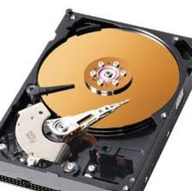
Unix Files and I/Os
OS provides abstraction
  Processes abstracts the processors
    You: simply just run processes
    OS: set up all the details, loading program to memory, set up process control block, context switching, etc. etc.
  Files abstracts the storage(disk/ssd/cloudStore/etc.)
    You: simply open/read/write/close files
    OS: manage bit locations on the storage hardware, provide a consistent interface (file system calls) for users
Open(…/Dropbox/file)
Dropbox
Open(localfile)

Slide 4
Basic Unix I/O operations (system calls):
Opening and closing files
  open()and close()
Reading and writing a file
  read() and write()
Changing the current file position (seek)
  indicates next offset into file to read or write
  lseek(offset, …)
    Ex: skip DVD chapters / fast forward
(read the manuals for more – will go fast in lecture)
    man 3 open ; man 3 close, man 3 read, … in CSIL / Linux
    man 2 open … in Mac

Slide 5
Opening files
Open in read/write modes
  Firefox open .html pages in read only mode
  Microsoft word open .docx pages in write mode
Returns a small identifying positive integer file descriptor
  fd == -1 indicates that an error occurred
  What does integer fd represent? (later)
    For now: one fd per open call
int fd; /* file descriptor */
fd = open("/etc/hosts", O_RDONLY);
if (fd < 0) {
perror("open");
exit(1);
}
Notes:
O_RDONLY
O_WRONLY
O_RDWR

Slide 6
Closing files
int fd = open(…);
int retval = close(fd)
if (retval < 0) {
perror("close");
exit(1);
}
Use “fd” to close the file
Always check return codes, even for seemingly benign functions such as close()
  Indeed, textbook uses Capitalized system calls (e.g. Open(), Close()) to do error handling in unobtrusive way
Notes:
“Moral” doesn’t follow??

Slide 7
Reading files
Read: copies bytes from the current file position to memory, and then updates file position
Returns number of bytes read from file fd into buf
  nbytes < 0 indicates that an error occurred
Read a 500-KB file?
  Call read (…, 1024) 500 times
char buf[1024]; → 1 KB
int fd;
int nbytes;
nbytes = read(fd, buf, 1024);
if (nbytes < 0) {
perror("read");
exit(1);
}
2^10 1K 1024
2^20 1M
2^30 1G
K = 1024
k = 1000
B = byte
b = bit
B₀
B₁
Byte₂• • •
B_{k-1}
B_{k}
B_{k+1}
• • •
Every read() moves forward
the current file offset (position)
Notes:
What is the largest number of bytes we can read? 2GB because signed

Slide 8
Writing files
Writing a file copies bytes from memory to the current file position, and then updates current file position
Returns number of bytes written from buf to file fd
  nbytes < 0 indicates that an error occurred
Downloading 1MB file with 1KB buffer
  Call write() 1024 times
char buf[1024];
int fd;
int nbytes;
nbytes = write(fd, buf, 1024);
if (nbytes < 0) {
perror("write");
exit(1);
}
Notes:
Skip this … quickly… no time

Slide 9
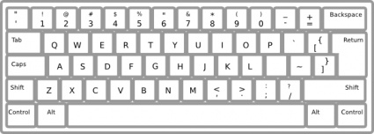

FD Table
The OS maintains a file descriptor table for every process
  (part of the process’ PCB – invisible to you)
The first 3 file descriptors
  Each process begins life with three open files associated with a terminal
  0: standard input (default: keyboard)
  1: standard output (default: screen)
  2: standard error (default: screen)
Open a new file
  Starts from fd = 3
fd | File information
0 | stdin
1 | stdout
2 | stderr
3 | (unused)
…

Slide 10
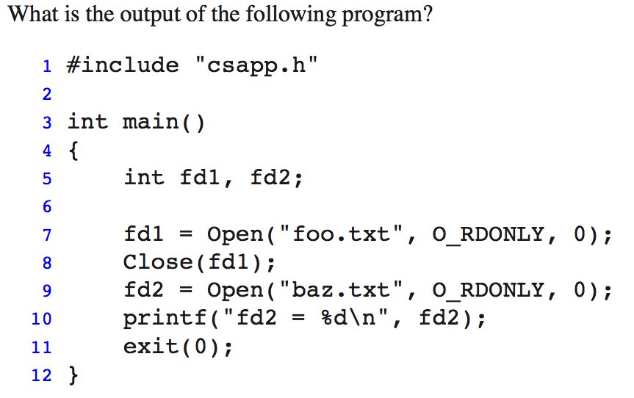
Practice problem
fd | File information
0 | stdin
1 | stdout
2 | stderr
3 | (unused)
…
Notes:
3

Slide 11
File descriptors
(Sharing and redirection)
Metadata, sharing, and redirection

Slide 12
File descriptor
User: “fd” is just a number
  Ex: A Microsoft word’s FD table
OS: “fd” represents a pointer to file descriptor structure)
  Describe file access information
  Current position, read/write mode, etc.
// Inside OS:
struct fd {
WRITE mode
curpos=0
file = hw6.doc
(more in the next lecture)
}
fd | (Descriptor Tbl)
0 | stdin
1 | stdout
2 | stderr
3
4
READ mode
curpos=1000000 (bytes)
file = avengersSpoiler.doc

Slide 13
(Another View)
FDs = represent open files
File metadata
(“stat()” syscall)
See book
Descriptor table
(file descriptor numbers)
Open file table
(File descriptor structures)
stdin
fd 0
stdout
fd 1
pos=0
stderr
fd 2
fd 3
refcnt=1
File metadata
(“stat()” syscall)
See book
fd 4
...
pos=100
refcnt=1
...
Notes:
Closing a file decrements the reference count. Kernel deletes entry if ref count = 0.
File position …

Slide 14

How the Unix kernel represents open files
User:
  “fd” is a number (a “handler”)
OS:
  “fd” is actually a file descriptor structure
  fd describes file access information
    Current position, open in read/write mode, etc.
  However, “fd” is not file metadata
    Fd does not describe the file
File METADATA
(from “stat” structure)
This is NOT a file descriptor
(see the BOOK regarding file metadata and the stat() system call)
Notes:
Closing a file decrements the reference count. Kernel deletes entry if ref count = 0.

Slide 15
File sharing
Two distinct FDs sharing the same disk file
  E.g., Calling open twice with the same filename argument
    fd3=open(“file.txt”),
    fd4=open(“file.txt”),
    read(fd4, buf, 1000)
Descriptor table
FD
File metadata
of
file.txt
stdin
fd 0
stdout
fd 1
pos=0
stderr
fd 2
fd 3
refcnt=1
fd 4
...
FD
pos=1000
refcnt=1
...
Notes:
Why would you want to do that? Read different parts of the file …

Slide 16
I/O redirection (Project 4)
Question: How does a shell implement I/O redirection?
  ls > foo.txt
  “>” is a shell feature
  The Q: How do you build a new shell feature (e.g. “>”) with syscalls
Answer: By calling the dup2(fdsrc, fddst) syscall
  Copies (per-process) descriptor table entry fdsrc to entry fddst
Descriptor table
before dup2(3,1)
Descriptor table
after dup2(3,1)
fd 0
fd 0
fd 1
monitor
fd 1
foo
fd 2
fd 2
fd 3
foo
fd 3
foo
fd 4
fd 4
Notes:
= right angle bracket (greater than)
Fd1 points to a monitor

Slide 17
Ex:
Shell code:
rv = fork();
if (rv == 0) {
// the child
fd = open(“out.txt”)
dup2(fd, stdout) // dup2(3,1)
execve(prog);
}
prog > out.txt
  fork() → OS clones the parent’s fd table to the child
  open() → only modify the child’s FD table!!
  dup2() → manipulate fds
    Child’s fdTable[1] → Out.txt
    Shell’s fdTable[1] → stdout
    Child’s fdTable[3] → Out.txt
    Shell’s fdTable[3] → ??
“prog” code:
Main() {
printf(“hello world”);
// write(1, “hello world”, ..);
}
fd | (child)
0 | stdin
1 | stdout
2 | stderr
3
4 | ..
fd | (parent)
0 | stdin
1 | stdout
2 | stderr
3
Out.txt
out.txt
Notes:
If there is only one process, one shell running, how many fd table there is in OS?
After fork, how many fd tables.
The four answers: out.txt, stdout, out.txt, none ..

Slide 18
I/O redirection example (cont.)
call dup2(4,3)
  Both fd entries point to the same file descriptor!!
dup2(4,3); // read@
read(4,buf,1); // pos=10
read(3,buf,1); // pos=11
lseek(3,20);
read(4,buf,1); // pos=20
FD A
File metadata
stdin
fd 0
stdout
fd 1
pos=5
stderr
fd 2
fd 3
refcnt=1→0
fd 4
...
FD B
File metadata
pos=10
0
1
…
10
11
…
Refcnt=1→2
...
Notes:
Pos = 10
Pos = 11
Pos = 20

Slide 19
Fun with file descriptors (1)
int fda, fdb, fdc;
char c1, c2, c3;
fda = Open(fname, O_RDONLY, 0);
fdb = Open(fname, O_RDONLY, 0);
fdc = Open(fname, O_RDONLY, 0);
dup2(fdb, fdc);
read(fda, &c1, 1);
read(fdb, &c2, 1);
read(fdc, &c3, 1);
// c1, c2, c3 = a, a, b
Animation in lecture video 28:05
(slide 42)
ffiles1.c
What would this program print for file containing “abcde”?
01234
Notes:
Draw 3 file descriptor structures.
c1 = a, c2 = a, c3 = b

Slide 20
How processes share files: Fork()
A child process inherits its parent’s open files
  Note: situation unchanged by exec functions (use fcntl to change)
Before fork() call:
Descriptor table
[one table per process]
Open file table / FD structures
[shared by all processes]
File A (terminal)
stdin
fd 0
stdout
fd 1
File pos
stderr
fd 2
fd 3
refcnt=1
fd 4
...
File B (disk)
File pos
refcnt=1
...

Slide 21
How processes share files: Fork()
A child process inherits its parent’s open files
After fork():
  Child’s table same as parent’s, and +1 to each refcnt
Descriptor table
[one table per process]
Open file table
[shared by all processes]
Parent
FD structure for A (terminal)
fd 0
fd 1
File pos
fd 2
fd 3
refcnt=2
fd 4
...
Child
FD structure for B (disk file)
fd 0
fd 1
File pos
fd 2
refcnt=2
fd 3
fd 4
...
Notes:
Only copy the descriptor table !!!!

Slide 22
Fun with file descriptors (2)
ffiles2.c
int fd; char c1, c2;
fd = open(fname, O_RDONLY, 0);
read(fd, &c1, 1);
rv = fork();
if (rv > 0) // Parent
sleep(1);
read(fd, &c2, 1);
print (c1, c2); // ???
else // Child
sleep(0);
read(fd, &c2, 1);
print (c1, c2); // ???
(next slide for animation)
What would this program print for file containing “abcde”?
(or, if child calls sleep(2)?)
Notes:
If parent sleep for 1 second:
Child: c1 = a, c2 = b
Parent: c1 = a, c2 = c
If child sleep for 1 second:
Child: c1 = a, c2 = c
Parent: c1 = a, c2 = b

Slide 23
Fun with file descriptors (2)
ffiles2.c
int fd; char c1, c2;
fd = open(fname, O_RDONLY, 0);
read(fd, &c1, 1);
rv = fork();
if (rv > 0) // Parent
sleep(1);
read(fd, &c2, 1);
print (c1, c2); // ??? (a, c)
else // Child
sleep(0);
read(fd, &c2, 1);
print (c1, c2); // ??? (a, b)
Animation in lecture video 30:48
(slide 43)
What would this program print for file containing “abcde”?
(or, if child calls sleep(2)?)
Notes:
If parent sleep for 1 second:
Child: c1 = a, c2 = b
Parent: c1 = a, c2 = c
If child sleep for 1 second:
Child: c1 = a, c2 = c
Parent: c1 = a, c2 = b

Slide 24
Fun with file descriptors (3)
int fd1, fd2, fd3;
char *fname = argv[1];
fd1 = Open(fname, O_CREAT|O_TRUNC|O_RDWR, S_IRUSR|S_IWUSR);
Write(fd1, "pqrs", 4);
fd3 = Open(fname, O_APPEND|O_WRONLY, 0);
Write(fd3, "jklmn", 5);
fd2 = dup(fd1); /* dup fd1 to fd2 – see manual */
Write(fd2, "wxyz", 4);
Write(fd3, "ef", 2);
Always write to the end of file
(ignore the offset)
ffiles3.c
What would be the contents of the resulting file?
Try yourself! Answer: pqrswxyznef
  (Remember: After dup2(src, dst), both fd entries point to the same (src) file descriptor!! )

Slide 25
O_APPEND
Position is always updated to the end of the file
Lseek on O_APPEND fd will be ignored
int fda, fdb;
char buf[100];
fda = open("outfile", O_CREAT|O_TRUNC|O_RDWR, S_IRUSR|S_IWUSR);
fdb = open("outfile", O_APPEND|O_WRONLY, 0);
write(fda, "aa", 2); // file is "aa"
write(fdb, "bb", 2); // file is "aabb"
write(fda, "cc", 2); // file is "aacc"
write(fdb, "dd", 2); // file is "aaccdd"
lseek (fdb, 0, SEEK_SET); // ignored by the OS, fdb always append
write(fdb, "ff", 2); // file is "aaccddff"

Slide 26
Shortcounts
In book: robust I/O package

Slide 27
Reading files
char buf[1000];
int fd;
int nbytes;
nbytes = read(fd, buf, 1000);
if (nbytes < 0) {
perror("read");
exit(1);
}
Returns number of bytes read from file fd into buf
  nbytes < 0 indicates that an error occurred
  nbytes == 1000 → great!
  nbytes == 500??
    Short counts (nbytes < readSize)
    Not errors!! E.g. file is only 500 bytes long
Notes:
What is the largest number of bytes we can read? 2GB because signed

Slide 28
Dealing with short counts
Put simply
  You want to read N bytes
  OS returns less than N bytes
Short counts can occur in these situations:
  Encountering (end-of-file) EOF on reads
  Reading text lines from a terminal
  Reading and writing network sockets or Unix pipes
Short counts never occur in these situations:
  Reading from disk files (except for EOF)
  Writing to disk files
One way to deal with short counts in your code:
  Use the RIO (Robust I/O) package from your textbook’s csapp.c file (Appendix B)
FYI only

Slide 29
Buffering
In book: robust I/O package

Slide 30
read() vs. rio_read()
Simple example:
  A big file contains a list of 16-digit (16-char/byte) numbers
  Boss: “compute the total!!!”
My read()
  One read system call for every 16-byte read!
  If file is big? 16 MB → 1+ million system calls. Good/bad?
rio_read()
  Buffering!
  Read 8 KB (8192 bytes) per read system call, but return to caller 16 bytes at a time
int total = 0;
rio_t *rp = malloc(rio_t);
…
while (rio_read(rp,buf,16)) {
total += atoi(buf);
}
int total = 0;
while (read(fd,buf,16)) {
total += atoi(buf);
}

Slide 31
int total = 0;
rio_t *rp = malloc(rio_t);
rp->fd = open(…);
// rp->buffer[8192] → 8 KB
// “rp” is wrapper for fd
// “rio_read” is an efficient wrapper for “read”
// see the book, for more
while (rio_read(rp,buf,16)) {
total += atoi(buf);
}

Slide 32
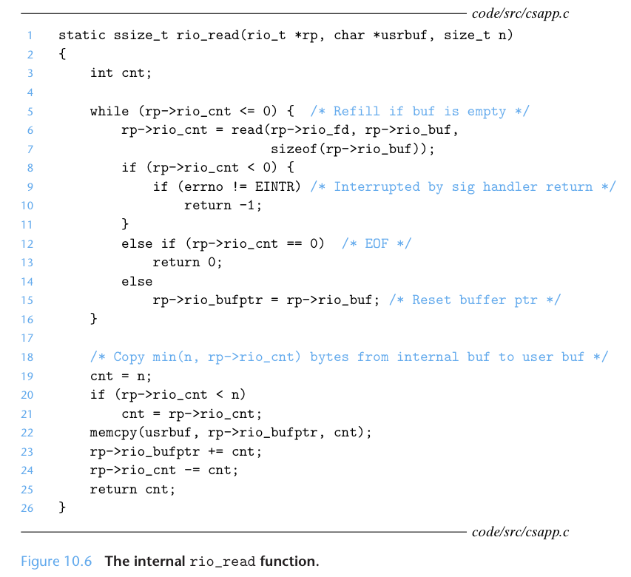
rio_read, a wrapper of read()
Ex: 16 bytes
Ex: 8 KB (8096 bytes)
Dealing
With
short counts
Copy 16 bytes
to caller
Buffer
already read
unread
csapp.c
Notes:
Please read the book to understand what each line by line is doing here.

Slide 33
Another illustration
rio_read(rp, yourBuf, 1KB) from a 7 KB file
  rp→buffer is 8 KB
1st 1KB
…
2nd 1KB
3rd 1KB
4
5
6
7
Savings: # rio_read() calls / # read() calls = ?? (7)
  Savings if rio_read(1B)?? (7000)
read(8KB) syscall (retval = 7KB)
Memcpy to yourBuf
Notes:
Shortcount !! At 7 KB …. Does not return 8 KB
7x (but imagine, rio_read(1byte) → 7000x saving!)

Slide 34
Yet Another illustration
rio_read(rp, yourBuf, 1KB) on 7 KB file
  rp→buffer is 3 KB
1
..
2
3
4
..
5
6
7
Savings: # rio_read() calls / # read() calls = ?? (7/3)
read(3 KB) syscall → get the first 3 KB
Buffer is all read!
read(3 KB) syscall → get the next 3 KB
Notes:
Savings: 7/3 = 2.3x

Slide 35
Buffered I/O: Implementation
For reading from file
File has associated buffer to hold bytes that have been read from file but not yet read by user code
Layered on Unix file:
rio_cnt
Buffer
already read
unread
rio_buf
rio_bufptr
short_count
Buffered Portion
not in buffer
already read
unread
unseen
Current File Position

Slide 36
Buffering in Standard I/O
Standard I/O functions use buffered I/O
Buffer flushed to output fd on “\n” or fflush() call
printf("h");
printf("e");
printf("l");
Other alternatives to open/read/write:
fopen, fread, fwrite
printf("l");
printf("o");
buf
printf("\n");
h
e
l
l
o
\n
.
.
fflush(stdout);
write(1, buf, 6);

Slide 37
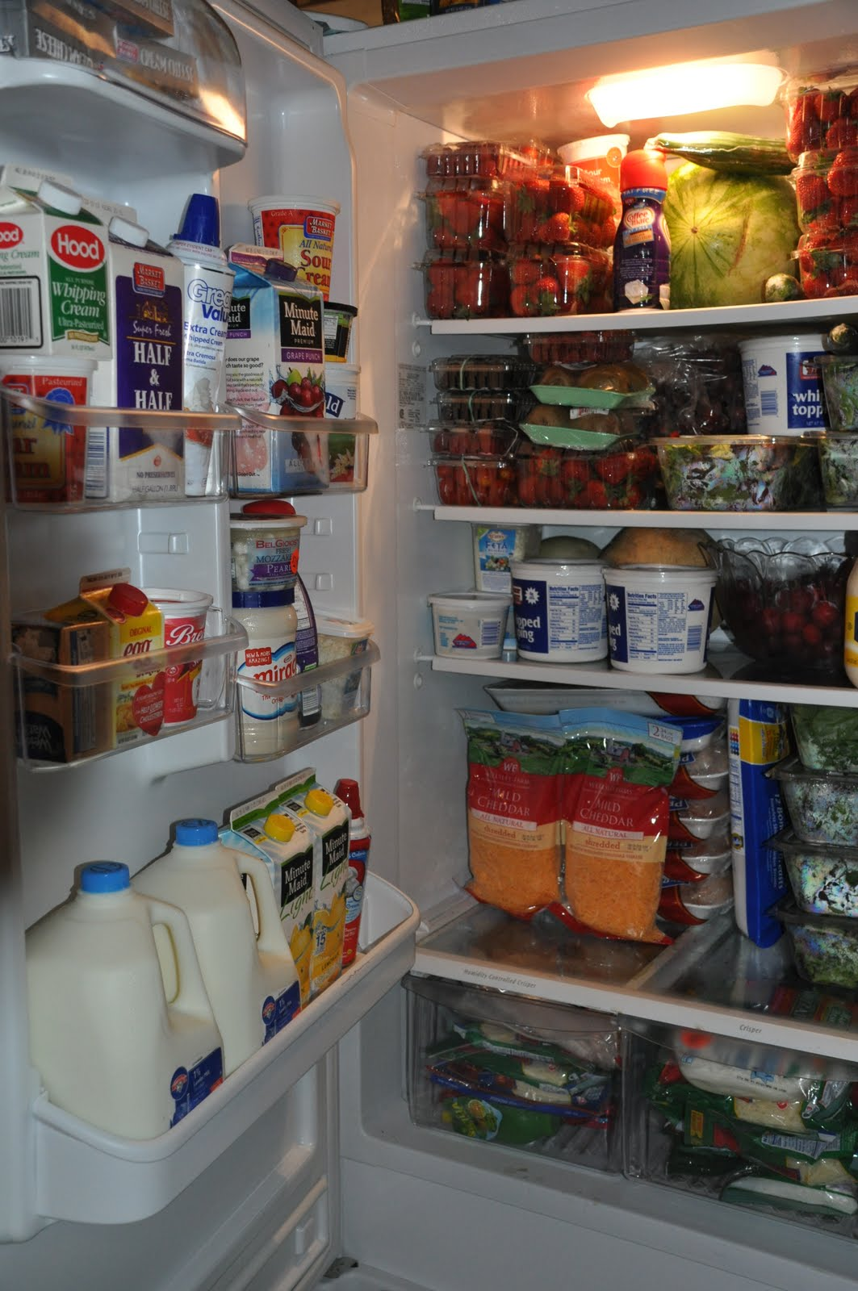
Buffering Summary
Prevalent topic!
  High-performance computing, storage systems, networking, …
Reduce overhead cost
  At what other cost?
  (Nothing is perfect; all about tradeoffs)
Principle: trade X for Y
  Trade space for performance
  Space = memory is big (big buffer is fine)
  Syscall = expensive
Real-life analogy?
  If grocery near, buy small fridge (buffer)
  If grocery far (expensive syscall), buy very large fridge (buffer)
Notes:
At what other cost?
Performance vs. code complexity …
Some extra buffer in memory.

Slide 38
Extra Slides

Slide 39
Unix files
A Unix file is a sequence of m bytes:
  B₀ , B₁ , .... , B_{k} , .... , B_{m-1}
All I/O devices are represented as files:
  /dev/sda2 (/usr disk partition)
  /dev/tty2 (terminal)
On Linux: even the kernel is represented as a file:
  /dev/kmem (kernel memory image)
  /proc (kernel data structures)

Slide 40
Unix file types
Regular file
  File containing user/app data (binary, text, whatever)
  OS does not know anything about the format
    other than “sequence of bytes”, akin to main memory
Directory file
  A file that contains the names and locations of other files
Character-special and block-special files
  Terminals (character special) and disks (block special)
FIFO (named pipe)
  A file type used for inter-process communication
Socket
  A file type used for network communication between processes

Slide 41
Buffered I/O: Motivation
Applications often read/write one character at a time
  getc, putc, ungetc
  gets, fgets
    Read line of text on character at a time, stopping at newline
Implementing as Unix I/O calls expensive
  read and write require Unix kernel calls
    > 10,000 clock cycles
Solution: Buffered read (user/library implements this)
  Use Unix read to grab block of bytes
  User input functions take one byte at a time from buffer
    Refill buffer when empty
Buffer
already read
unread
short_count

Slide 42
File content: “abcde”
pos = 0
“abcde”
1
…
fda
“abcde”
pos = 0
2
1
fdb
fdc
pos = 0
“abcde”
read(fda, &c1, 1); // c1
read(fdb, &c2, 1); // c2
read(fdc, &c3, 1); // c3
= a
= a
= b
Notes:
Draw 3 file descriptor structures.
c1 = a, c2 = a, c3 = b

Slide 43
File content: “abcde”
Parent
c1
c2
= a
…
= c
fd
pos = 0
“abcde”
2
3
1
Child
…
fd
c1
c2
= a
= b
Notes:
Draw 3 file descriptor structures.
c1 = a, c2 = a, c3 = b

