Slide 1
Memory Management (Cont’d)
Segmentation, Virtual Memory
OSTEP Book (See Schedule Page) http://pages.cs.wisc.edu/~remzi/OSTEP/
Chapter 12-16
Address Spaces, Memory API, Address Translation, Segmentation
Instructor:
Haryadi Gunawi

Slide 2
Segmentation
...

Slide 3
Last lecture: Base & Bound
Virtual
Addresses
Physical
Addresses:
P1 bound
OS
Process 1
Process 3
0
P3 base = 7000
Process 2
Process 1
P1 base = 5000
Process 3
Process 2
P2 base = 2000
0

Slide 4
BB Disadvantage #1
OS
Process 1
Process 3
Code
Process 2
Code
Process 1
Code
Code
Process 3
Process 2
Code
Code
3 users open 10 MB Excel software, where’s the code segments? How much memory needed?
  … (30MB)
  …
  How about 50 users?

Slide 5
BB disadvantage #2
Logical View
Physical View
Bound
Physical
Addresses:
P1’s Stack
(e.g, 3 MB)
P1’s Stack
Base + Bound
(unused)
Process
address
space
(virtual
addresses)
(unused !!
Internal
fragmentation)
P1’s Heap
(e.g., 2 MB)
P1’s Heap
Code
(e.g., 1 MB)
Code
(e.g. Excel)
0
Base
0

Slide 6
This lecture: Segmentation
2^30 = Giga B
2^40 = Tera B
2^50 = Petta B
2^60 = Exa B
Physical View
2^{n}
Logical View
Physical
Addresses:
P1’s Stack
(3 MB)
0x 9000 0000 +
3 MB
P1’s Stack
Process
address
space
(virtual
addresses)
(allocated
by demand)
0x 9000 0000
0x 8000 0000 +
2 MB
P1’s Heap
(2 MB)
P1’s Heap
0x 8000 0000
Code
(1 MB)
0x 2000 0000 +
1 MB
Code
(e.g. Excel)
0
0x 2000 0000
0
Notes:
Ask more via sbrk.
Hidden under malloc library()

Slide 7
Segmentation
Physical
Memory
P1
Divide address space into logical segments
  Ex: Code, stack, heap
Goals
  Remove internal fragmentation
  More sharing
    Per-segment base&bound allows sharing
2^{n}
Stack
Heap
Heap
0
Code
Heap
Excel
Code
Sharing!
2^{n}
Stack
Stack
Heap
Stack
0
Code
P2

Slide 8
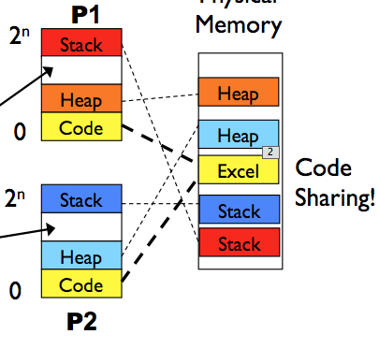
Segmentation
Each segment has its own base and bound
Each segment can independently …
  be placed separately in physical memory
  grow (more space)
  be protected (R/W bits)
    int *p = main;
    *p = 7; → segfault/bus-error
    Code segment (R=1, W=0)
Physical View
0x 9000 0000 +
3 MB
P1’s Stack
0x 9000 0000
0x 8000 0000 +
2 MB
P1’s Heap
0x 8000 0000
0x 2000 0000 +
1 MB
P1’s Code
(e.g. Excel)
0x 2000 0000
0
Notes:
Ask more via sbrk.
Hidden under malloc library()

Slide 9
Growing / migrating
Physical View
2^{n}
Logical View
P1’s Stack
(3 MB)
0x90000000 + 3 MB
P1’s Stack
0x 9000 0000
(allocated
by demand)
Used space
P1’s Heap
(2 MB)
0x80000000 + 2 MB
P1’s Heap
0x80000000
Code
Code
0
Notes:
Slide the stack and heap

Slide 10
Segment table
Segment table
  Each process has a segment table
  Stored in PCB
  Also installed to the MMU
  Thus, MMU is more complex now, not just has two (base&bound) registers, but now a table
    (see next slide)
Physical View
0x 9000 0000 +
3 MB
P1’s Stack
0x 9000 0000
0x 8000 0000 +
2 MB
P1’s Heap
0x 8000 0000
Seg | Base | Bound | RW Bits
Stack | 9000 0000 | 3 MB | 1 1
Heap | 8000 0000 | 2 MB | 1 1
Code | 2000 0000 | 1 MB | 1 0
0x 2000 0000 +
1 MB
P1’s Code
(e.g. Excel)
0x 2000 0000
0
Notes:
Ask more via sbrk.
Hidden under malloc library()

Slide 11

Segment Table
Seg | Base | Bound | RW Bits
Stack | 9000 0000 | 3 MB | 1 1
Heap | 8000 0000 | 2 MB | 1 1
Code | 2000 0000 | 1 MB | 1 0
Physical View
P1’s Stack
0x 9000 0000
Input: 0x48001000
Output = base + input
“hmmm .. stack? heap? or
code? Which base to use?”
P1’s Heap
mov %ebx
mem[0x48001000]
CPU
0x 8000 0000
MMU
(base=..; bound=..)
Now: Segment
table
Logical
address
Physical
address
P1’s Code
(e.g. Excel)
0x 2000 0000
0
Notes:
Ask more via sbrk.
Hidden under malloc library()

Slide 12
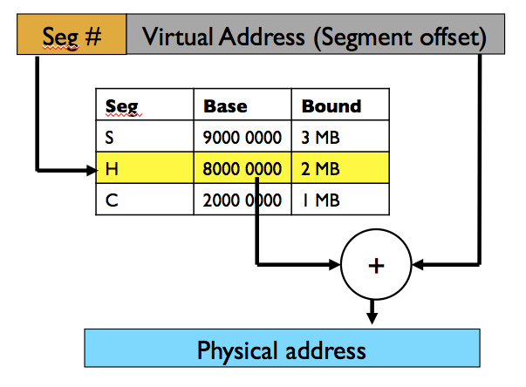
Address translation with segmentation
Logical address
e.g. 32-bit address
How to convert a logical address to a physical address with segmentation?
Divide the logical address
  Top bits of logical address select segment
  Low bits of logical address select offset within segment

Slide 13
Segmentation Addressing
e.g. 32 bit
Logical address (e.g. mov %ebx mem[0x48001000])
Seg # (2 bits)
30-bit Virtual Address
(Segment offset)
0100
P1
Memory
P1’s segment table
MMU
Stack
Seg | Base | Bound
Stack (10) | 9000 0000 | 3 MB
Heap (01) | 8000 0000 | 2 MB
Code (00) | 2000 0000 | 1 MB
Stack
Heap
Code
Heap
Excel
+
Physical address (e.g. 0x88001000)
1 MB = 0100 0000

Slide 14
Segmentation Implementation
Example: 14 bit logical address, 3 segments
  (i.e. use top-2 bits for segment indexing, and low-12 bits for offset)
Translate logical addresses to physical addresses:
  Read mem[0x265c]: …
  Read mem[0x1108]: …
  Write mem[0x0240]: …
  Read mem[0x3002]: …
14-bit
Segment | Base | Bound | R W
0 (code) | 0x2000 | 0x06ff | 1 0
1 (heap) | 0x0000 | 0x04ff | 1 1
2 (stack) | 0x3000 | 0x0fff | 1 1
3 | 0x0000 | 0xffff | 0 0
In this class, always use “+” (phy = base + log).
In OSTEP book, stack uses “-”
Notes:
- 2 – 65c : 3000 + 65c = 365c
- heap, 0000 + 108 = 0108
- code, invalid!! Can’t write. (00-0010-0100-0000) stack, 2000 + 240 = 2240
- invalid! Why?

Slide 15
Segmentation Implementation
Example: 14 bit logical address, 3 segments
  (i.e. use top-2 bits for segment indexing, and low-12 bits for offset)
Translate logical addresses to physical addresses:
  Read mem[0x265c]: (seg bits “10”, offset “65c”) 0x3000+65c = 0x365c
  Read mem[0x1108]: (seg bits “01”, offset “108”) 0x0000+108 = 0x0108
  Write mem[0x0240]: (seg bits “00”, offset “240”) 0x2000 segfault (read only!)
  Read mem[0x3002]: (seg bits “11”, offset “002”) 0x0000 segfault
14-bit
Segment | Base | Bound | R W
0 (code) | 0x2000 | 0x06ff | 1 0
1 (heap) | 0x0000 | 0x04ff | 1 1
2 (stack) | 0x3000 | 0x0fff | 1 1
3 | 0x0000 | 0xffff | 0 0
In this class, always use “+” (phy = base + log).
In OSTEP book, stack uses “-”
Notes:
- 2 – 65c : 3000 + 65c = 365c
- heap, 0000 + 108 = 0108
- code, invalid!! Can’t write. (00-0010-0100-0000) stack, 2000 + 240 = 2240
- invalid! Why?

Slide 16
Dangling pointer
2^{n}
.
func(){
int *p = rand();
*p = 7;
// what happens?
}
Stack
Int *p
P1’s Heap
(2 MB)
Code
(1 MB)
0

Slide 17
Dangling pointer
2^{n}
Stack
Int *q
func(){
int *q = rand();
*q = 7;
// what happens?
}
P1’s Heap
(2 MB)
Code
(1 MB)
0

Slide 18
Example: 16-bit addressing e.g. Mem[0x4012]
16-bit
How many bits for segment indexing?
  Say, we need 3 segments, for code, stack, and heap
  … (2 bits)
How many bits for the virtual address (the segment offset part)?
  … (14 bits)
What’s the largest size of a segment?
  … (2^14 = 16KB)
  Implication to malloc()? Not > 16KB
  Implication to program/code size? Not > 16KB
P1
Stack
Stack
Heap
Code
Heap
Excel
Notes:
Try 1 bit?
Use top-2 bits of the virtual address for segment indexing
Use low-14 bits for offset
Imagine 2-bit addressing? 4 bytes
4-bit addressing? 16 bytes
A segment could be as large as 2^14 bytes
We have 3 segments
Total: 3 * 2^14 bytes

Slide 19
Recap
So far, in our lecture:
  00 – code
  01 – heap
  02 – stack
  03 – unused
Who decides?
  Contract between OS, architecture, and compilers
    E.g. compilers create jump addresses that start with 00
    Try: compile the same program on different OSes
    Then print function pointers, heap and stack addresses (might get different results)
It’s also possible in some other OS/architecture:
  00 – code
  01 – data
  02 – heap
  03 – mmap segments (shared with other processes)
  04 – unused
  05 – stack thread 1
  06 – stack thread 2
  07 -- .. (other purposes)
Always read the specification
  Every OS/architecture doesn’t work the same
  (That’s why you must always recompile your program if you want to run it on another machine)

Slide 20
Segmentation Advantages
10 users open 5 MB Excel software, how much memory used?
  … (5MB)
Enables sparse allocation of address space (i.e. 0 – 2^{n})
  Illusion of large address space: 2^32 = 4 GB, 2^64 = 16 Exabytes!!
  Stack and heap can grow independently
  Heap: If full, dynamic memory allocator requests more from OS
    (e.g., malloc() library calls sbrk() system call – next lecture)
  Stack: OS recognizes reference outside legal segment, extends stack implicitly
Is there Internal fragmentation? … (No)
Different protection for different segments (sharing!)
  Read-only status for code segment (can share code segments!)
  Enables sharing of selected segments
  Supports dynamic relocation of each segment
Notes:
Sharing!
Can easily share a segment (e.g. code segment)
How to do that? Just share the base and bounds of the segment (i.e. base and bounds of P1’s and P2’s code segment are the same)
Not much internal fragmentation !! Allocate as needed.

Slide 21
Inter-Process Comm. via shared memory
P1
Memory
Shared memory
  (e.g. in segmentation, use free segment slots)
    Ex: 4 segment bits → 16 segments
    3 for code/heap/stack
    Have 13 free slots
  Today: “unlimited” shared slots
System calls (see manual)
  shmat, shmctl, shmget, …
Stack
shmap
Heap
Code
shmap1
P2
Stack
shmap2
shmap
shmap
Heap
Code
P3
Stack
shmap
Heap
Code

Slide 22
IPC: Inter-Process Communication
Shared memory
  (previous slide)
Files
  Process 1: write to file A
  Process 2: read from file A (simultaneously)
Pipe
  ps –e | grep emacs | wc –l
  (how many emacs processes are running in my machine)
… signals, (many more)
https://en.wikipedia.org/wiki/Inter-process_communication

Slide 23
Segmentation Disadvantages
External fragmentation (luggage overhead bin analogy)?
  Variable sized segments
  Lots of small holes that can’t be used for processes with large segments
  In such case, must relocate segments
Each segment must be allocated contiguously
  Some processes might have big segments (big heap/stack)
  No memory slot for a big segment → reshuffle/migration

Slide 24
What’s after segmentation?
Let’s recap
...

Slide 25
Dynamic Relocation (BB)
Logical View
Physical View
Bound
Physical
Addresses:
P1’s Stack
(3 MB)
P1’s Stack
0x 9000 0000 +
3 MB
(unused)
Virtual
Addresses
In MMU:
Base and bound
(2 registers)
(internal
fragmentation!!)
P1’s Heap
(2 MB)
P1’s Heap
Code
(1 MB)
Code
(e.g. Excel)
0
0

Slide 26
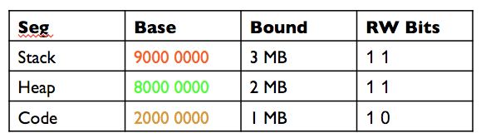
Segmentation
Logical View
Physical View
2^{n}
Physical
Addresses:
P1’s Stack
(3 MB)
0x 9000 0000 +
3 MB
P1’s Stack
In MMU:
Segment table
Virtual
Addresses
0x 9000 0000
0x 8000 0000 +
2 MB
P1’s Heap
(2 MB)
P1’s Heap
No internal
Fragmentation!!
(unallocated)
0x 8000 000
Code
(1 MB)
0x 2000 0000 +
1 MB
Code
(e.g. Excel)
External
Fragmentation!!
External
Fragmentation!!
0
0x 2000 0000
0

Slide 27

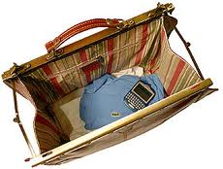
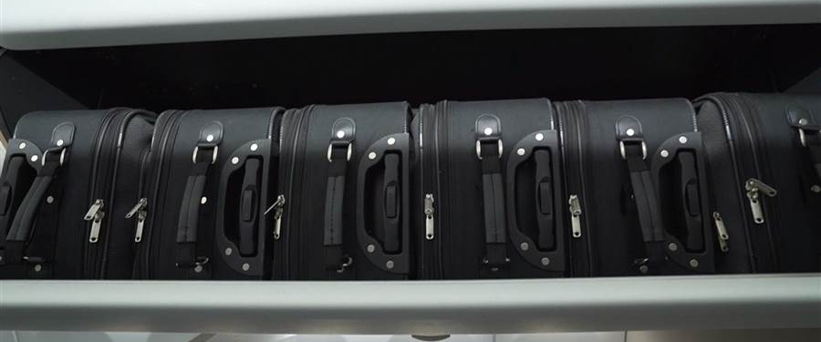
How to fix both internal and external frags?
Today: small fixed-size luggage
Process A

Slide 28
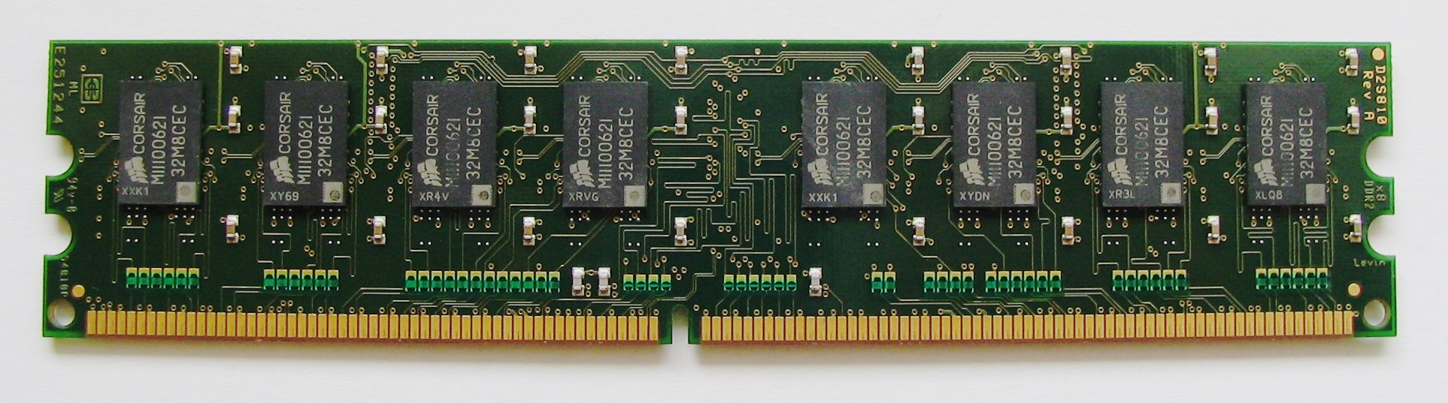
Paging (a process’ view)
Logical View
Physical View
2^{n}
pg 1048576
stack
(e.g. 16 KB)
heap
(e.g. 12 KB)
pg 2
code
(e.g. 6 KB)
pg 1
fr 3
pg 0
0
fr 2
Process 3
Physical View
4KB pages
(or frames)
fr 1
fr 0

Slide 29
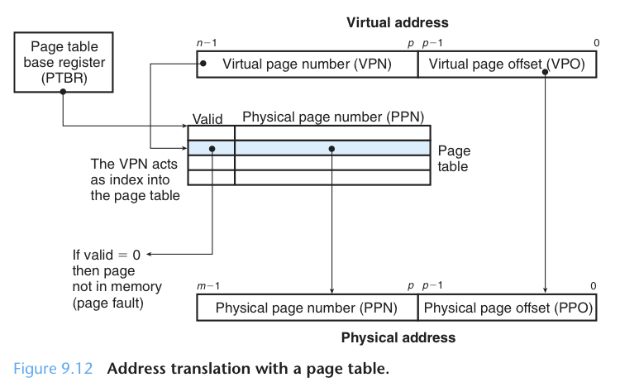
Single-Level Page Table addressing
…
In MMU:
Page table
Segment table
Base and bound

Slide 30
Paging
Too big!!
HW people mad!!
(many unused entries)
Logical View
Page Table Entries
Physical View
2^{n}
pg 1048576
stack
(e.g. 16 KB)
In MMU:
1-million entry
page table???
32-bit means
(4 GB / 4 KB) number of pages
heap
(e.g. 12 KB)
pg 2
2 → 1
code
(e.g. 6 KB)
pg 1
1 → 9
fr 3
pg 0
0 → 3
0
fr 2
Process 3
Physical View
(4KB-frames)
fr 1
fr 0

Slide 31
2-level Paging
Inner PT Entries
Physical View
Logical View
2^{n}
pg 1048576
Outer
Page table
pg 2
2 → 1
pg 1
1 → 9
fr 3
pg 0
2 level enough?
0 → 3
0
fr 2
Process 3
fr 1
Physical View
(4KB-frames)
fr 0

Slide 32
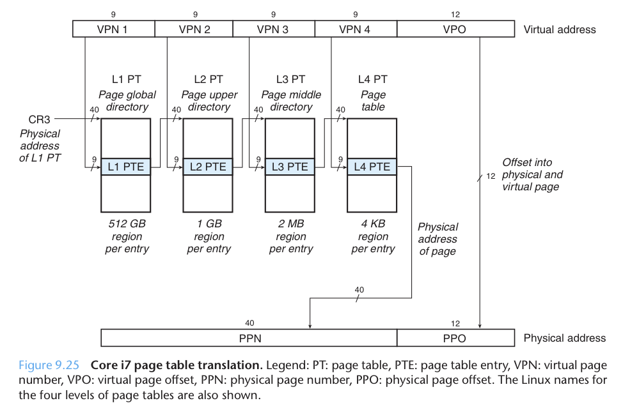
4-level paging
48-bit virtual address → 2⁴⁸ → 2^{8 *} 2^{^40} bytes → up to 2⁸ TB memory
We’ve learned
Address splitting
We’ve learned
table lookup/indexing

Slide 33
Memory mgmt … what’s next? (Just FYI)
Multi-level page tables
  (too complex to be in MMU)
  … but access to page tables is slow
  … up to 400% slowdown when accessing memory
Then, TLB was invented …
  Cache address translation
  … but only good for OS running on bare hardware, but not efficient for Virtualization (VMware, Xen, VirtualBox, …)
Then, TLB with para-virtualization was invented
  … life goes on, new hardware, new feature, new problem
Paging/TLB not covered in HW/exam
Page tables are not in MMU, but in memory

Slide 34
Virtual Memory
(with swap space)
...

Slide 35
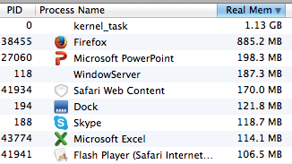
Virtual Memory
P1
Memory
Stack
Heap
http://en.wikipedia.org/wiki/Virtual_memory
  Software within the operating system may extend these capabilities to provide a virtual address space that can exceed the capacity of real memory and thus reference more memory than is physically present in the computer
  Malloc(4GB) with 1 GB DRAM possible
Swap-out/in
  Swap-out least recently used pages
  Swap-in: “Page faults”: page brought in to memory only when you need it
Key: temporal and spatial locality
Code
Excel
P2
Stack
Heap
Code
swap space

Slide 36
Summary
...

Slide 37
Goals of MM
Efficiency
  Do not waste memory resources
  Keep fragmentation low
Sharing
  Several processes coexist in main memory
  Cooperating processes can share portions of address space
    Two processes (e.g. banking system) share the same data segment
    Multiple processes open Office or Excel (share code segment)
Transparency
  Processes are not aware that memory is shared
  Works regardless of number and/or location of processes
Protection
  Robustness: Cannot corrupt OS or other processes
  Privacy: Cannot read data of other processes

Slide 38
Take-away points
Memory management problems
  Appear in many layers of software stack
malloc(), etc.
  malloc is a library, not a system call
  malloc manages the dynamic data (i.e. pointers) in the heap
  malloc(??) → uniform size?
  malloc(2000) → get how many bytes?
  So, internal or external fragmentation problem?
  p=malloc(100); *(p+101) = 0; → crash or not? Why?
Java Garbage Collector (GC)
  Same as malloc (but users don’t’ need to call malloc or free)
  Automatic free space management
Notes:
Next lecture, if have time can discuss some malloc issues above

Slide 39
END
...

Slide 40
EXTRA
...

Slide 41
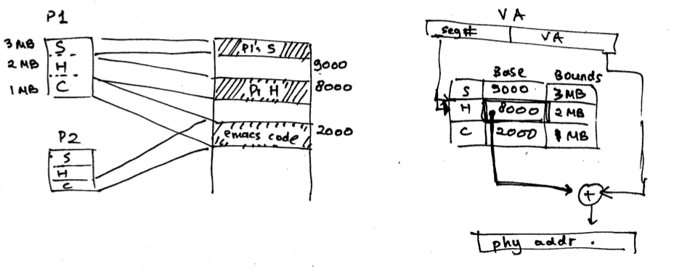
Example
A) OS’ job when P1 is created?
  (Assume in this OS, stack initially gets 3 MB, heap 2 MB, and code 1 MB)
  …
When P1 is run?
  …
Notes:
Create a segment table for P1
For each segment:
Set bounds (e.g. pcb1.table.stack = 3 MB, heap 2 MB, code 1 MB)
Allocate memory (size=bounds), and store the base addresses (e.g. p1.table.stack at 9000, heap at 8000, code at 2000)
Load the segment table of P1 into the MMU
Segment table is small, so it can fit in the MMU hardware

Slide 42
Example
B) If P1’s heap grows?
  …
C) Context switch from P1 to P2?
  …
Notes:
B)
If neighboring addresses are empty, just increase the bound of P1’s heap segment (p1.table.heap.bound += …)
Else, must relocate only P1’s heap segment (change P1’s heap base and bounds). Code and stack segments stay in the same place. (p1.table.heap.base = newaddr, p1.table.heap.bound += …)
Malloc() calls sbrk system call
C)
Reload the MMU with P2’s segment table

Slide 43
2 6 5 c
0010 1010 1001 1100
Seg #: 2 (stack)
Offset: 0x65c
Base: 0x3000
Physical addr: 3000+65c = 0x365c
What if the address is 16 bits and 2 bits for seg indexing?
2 6 5 c
0010 1010 1001 1100
Seg #: 0
Offset: 0x265c

