Slide 1
Object Adaptor
MPCS 51050 Pattern Presentation - Chung-An Chiu

Slide 2
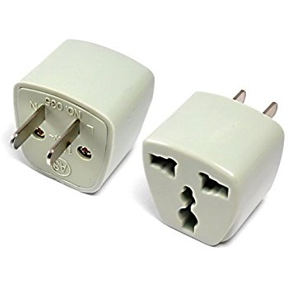

Slide 3
Why do we need adaptor?
How can a class be reused that does not have an interface that a client requires?
How can classes that have incompatible interfaces work together?
How can an alternative interface be provided for a class?
When you want to use an object that doesn’t have specific interface, but you don’t want it to permanently implement that interface

Slide 4
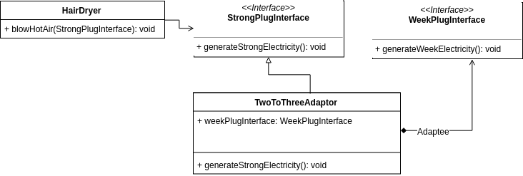
UML

Slide 5
Code example

Slide 6
Thank you!

